Slide 1
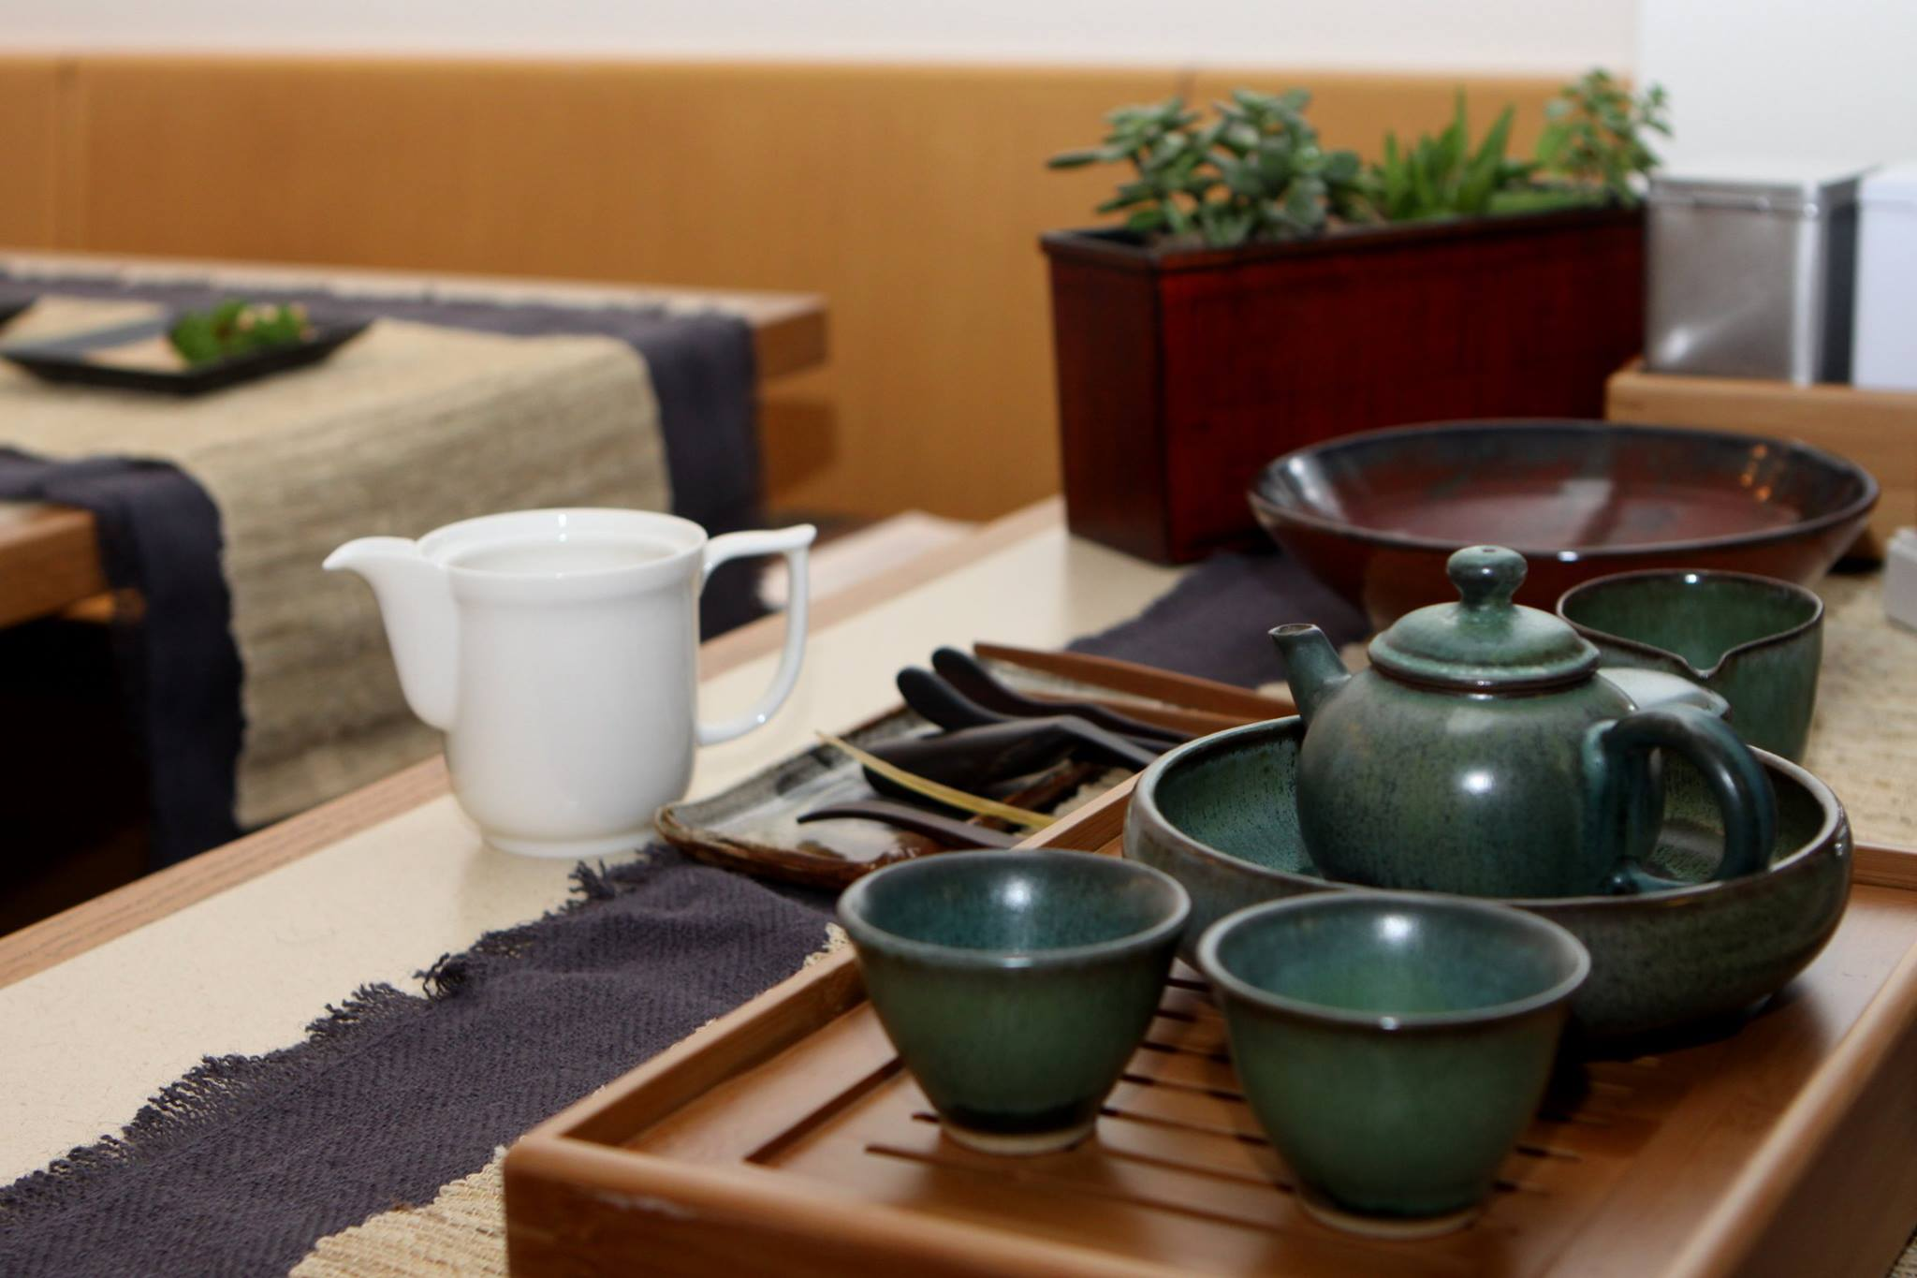
The Art of
Chinese Tea
and More
Presented by Lotus Perry
CLTA-WA Spring Workshop at UPS
March 4, 2017

Slide 2
WORKSHOP OUTLINE
(1:00-2:30 pm)
What We Need To Know About Chinese Tea
(KNOWLEDGE ACQUIRED)
茶文化的興起 The Rise of Tea
經典茶書 Canonical Texts
品茶 The Idea of Connoisseurship
茶禮 Tea as a Social Practice
(SKILLS INVOLVED)
演說的技巧 Effective Presentation
使用幻燈片 Use of PPT
中英茶用語 Tea Vocabulary in Chinese/English
Notes:
The Art of Chinese Tea and More
CLTA-WA Spring Workshop on Sat. 3/4/2017
Presented by Lotus Perry
(1:00-2:30 pm)
What We need to Know About Chinese Tea (PPT Presentation)
Description:
I will give a brief history of the rise of tea, tracing through canonical texts and focusing on the idea of connoisseurship. By studying tea as a social practice in China’s cultural tradition, I hope to help the audience gain a finer appreciation of tea drinking. Teachers who are interested in adopting parts of the PPT presentation for use in their own classrooms will learn basic vocabulary as well as special terminology to explain the topic of tea.
(2:30-2:45 pm)
Break
(2:45-4:00 pm)
Tea as a Cultural Topic in the FL Classroom: Tips, Resources & Design (Discussion | Q & A | Group Work)
This is a brainstorming session with the audience to explore ways in teaching culture in the classroom. I will use sample tea culture modules to guide audience for discussion, and will share tips, resources and ideas through a Q & A session and group work.

Slide 3
WORKSHOP OUTLINE
(2:45-4:00 pm)
Tea As a Cultural Topic In The FL Classroom
(BRAINSTORMING | DISCUSSION)
教案設計 CLASS MODULE
茶文化知識問答 TRIVIA
資料夾 RESOURCES
分享經驗 SHARE IDEAS
問題 Q & A
分組討論 GROUP WORK
Notes:
The Art of Chinese Tea and More
CLTA-WA Spring Workshop on Sat. 3/4/2017
Presented by Lotus Perry
(1:00-2:30 pm)
Brief History of Chinese Tea (PPT Presentation)
Description:
I will give a brief history of the rise of tea, tracing through canonical texts and focusing on the idea of connoisseurship. By studying tea as a social practice in China’s cultural tradition, I hope to help the audience gain a finer appreciation of tea drinking. Teachers who are interested in adopting parts of the PPT presentation for use in their own classrooms will learn basic vocabulary as well as special terminology to explain the topic of tea.
(2:30-2:45 pm)
Break
(2:45-4:00 pm)
Tea as a Cultural Topic in the FL Classroom: Tips, Resources & Design (Discussion | Q & A | Group Work)
This is a brainstorming session with the audience to explore ways in teaching culture in the classroom. I will use sample tea culture modules to guide audience for discussion, and will share tips, resources and ideas through a Q & A session and group work.

Slide 4
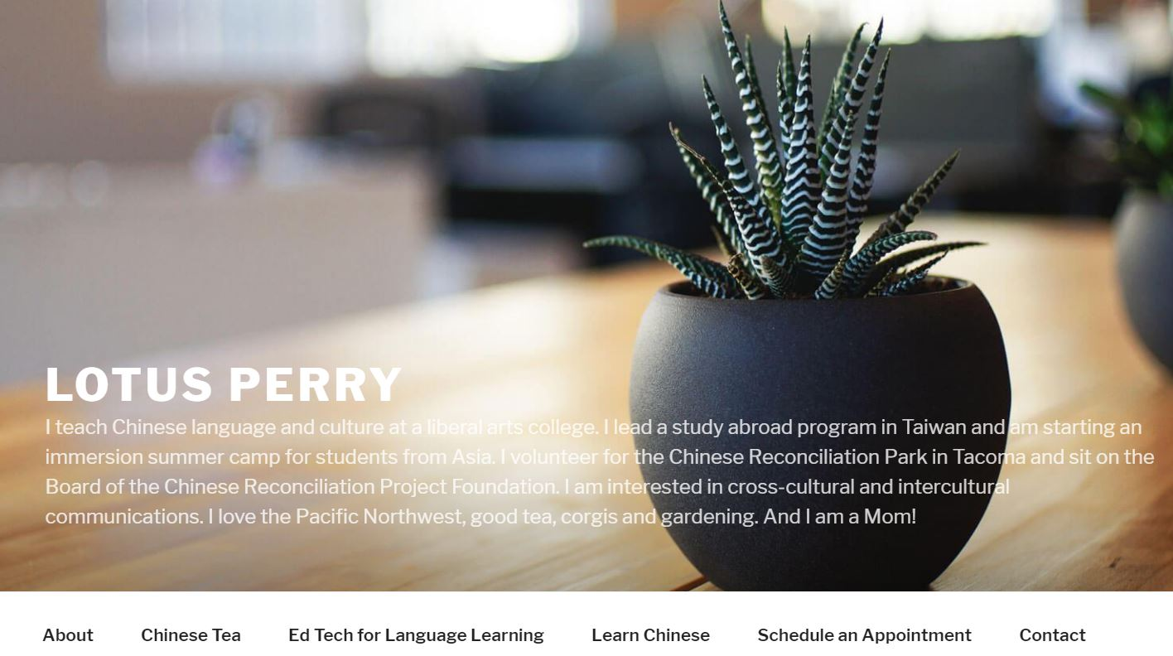
www.lotusperry.com
Notes:
The Art of Chinese Tea and More
CLTA-WA Spring Workshop on Sat. 3/4/2017
Presented by Lotus Perry
(1:00-2:30 pm)
Brief History of Chinese Tea (PPT Presentation)
Description:
I will give a brief history of the rise of tea, tracing through canonical texts and focusing on the idea of connoisseurship. By studying tea as a social practice in China’s cultural tradition, I hope to help the audience gain a finer appreciation of tea drinking. Teachers who are interested in adopting parts of the PPT presentation for use in their own classrooms will learn basic vocabulary as well as special terminology to explain the topic of tea.
(2:30-2:45 pm)
Break
(2:45-4:00 pm)
Tea as a Cultural Topic in the FL Classroom: Tips, Resources & Design (Discussion | Q & A | Group Work)
This is a brainstorming session with the audience to explore ways in teaching culture in the classroom. I will use sample tea culture modules to guide audience for discussion, and will share tips, resources and ideas through a Q & A session and group work.

Slide 5
茶文化简介About Chinese Tea
Tea “Taste”
Tea History
The Art
of Tea
Tea
Variety
Brewing
Tea
Drinking

Slide 6
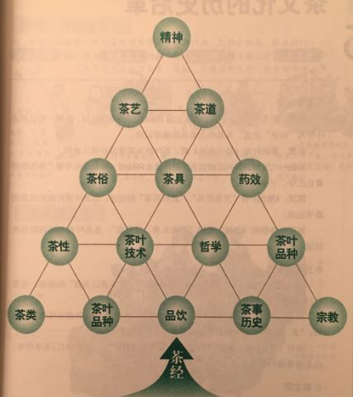
Tangible and Intangible Wealth of Tea Culture
人
精神 物
Spiritual + Material
Characteristics
茶艺Tea Skills
茶道Tea Ceremony
The Philosophy of
Tea Drinking
_________
The Way
_________
茶文化
图解茶经, 27页，南海出版社（2010）
Notes:
图解茶经, 27页，紫图编绘，南海出版社（2010）

Slide 7
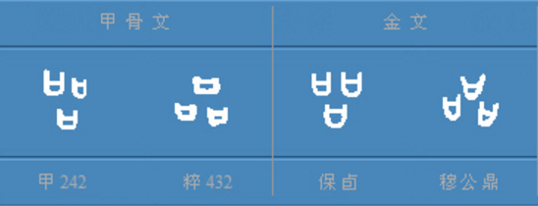
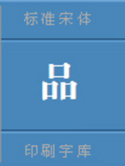
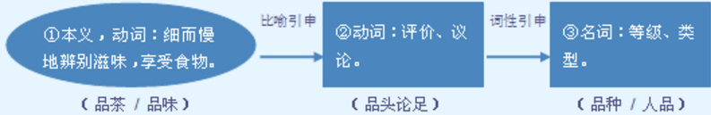
品茶 pǐnchá
Tea Connoisseurship
象型字典 Vividict.com
http://www.vividict.com/WordInfo.aspx?id=723
Notes:
Accessed on Oct. 1, 2016 at http://www.vividict.com/WordInfo.aspx?id=723.

Slide 8
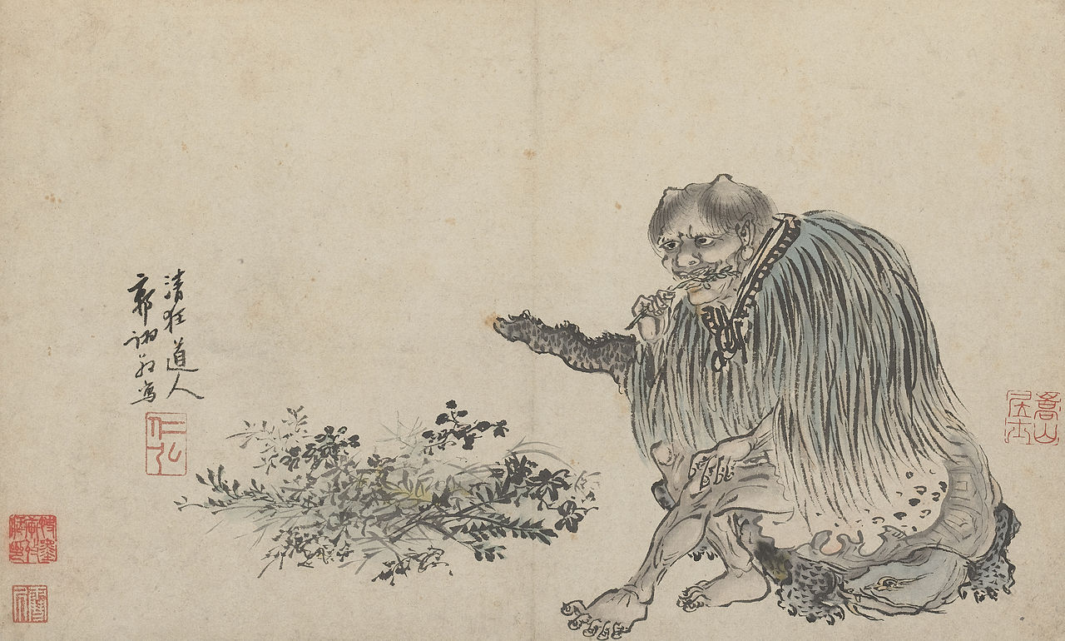
Tea Drinking in Pre-Tang Period
神农远古时代 Prehistoric Time
Tea Soup 利用生叶煮着喝，形成最早的原始粥茶法。
Shennong Painting
by Guo Xu (1503) 明 郭詡
《神农本草经》记述牛首
人身的炎帝“神农氏尝
百草，日遇七十二毒，
得萘解之”的传说
（萘即茶）
西周东周 Western/Eastern Zhou Dynasties (1046-256 BC)
Tea Growing in Sichuan Area 巴蜀茶叶开始发展。
Tea Tribute 西周时贡品有茶、漆和蜂蜜。
Tea Cultivation | Cooking开始人工栽培茶树，当菜肴汤料食用。

Slide 9
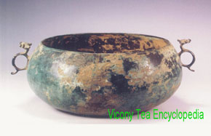
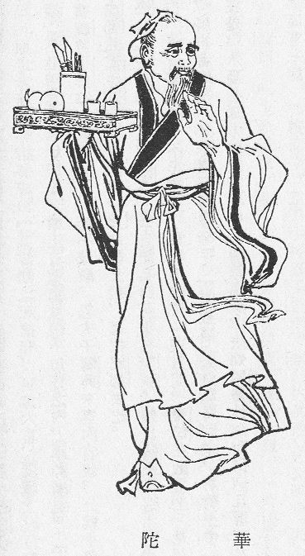
Tea Drinking in Pre-Tang Period
秦代 Qin Dynasty (221-206 BC: Tea Cultivation Expanded
四川茶树栽培开始向山西河南推广，当茗饮、调煮、羹饮、药用。
汉代 Han Dynasty (206 BC-220 AD) Tea Merchants | Tea Cakes
西汉时有“烹茶尽具”、
“武阳买茶”，开始商业化，
成都成为最早的茶叶集散
中心。东汉开始制作茶饼，
以便运输。
Tea in Medicine
华佗《食论》“苦荼久食，益意思”
首次记述茶叶药理功效。
Accessed on 2/23/2017, retrieved from 中国茶网
http://www.zgchawang.com/culture/show-34010.html
发布日期：2016-05-26 来源：中国茶文化知识
Notes:
Accessed on 2/23/2017, retrieved from 中国茶网 http://www.zgchawang.com/culture/show-34010.html
发布日期：2016-05-26 来源：中国茶文化知识

Slide 10
Tea Drinking in Pre-Tang Period
三国两晋 Three Kingdoms & Jin Dynasties (220-420 AD)
Alcohol Use in the Three Kingdoms
《三国志吴志》暴君孙皓酒宴人饮七升，臣子史學家韦曜（韋昭)
不善饮以茶代酒被发现处死。
Serve Guests Tea & Tea Snack
《晋书》载：谢安、恒温以茶果待客。
Sobering Power of Tea
茶有解酒提神的功效。
南北朝 Southern & Northern Dynasties (420-589 AD)
Tea Became More Common Place in the South among Literati
茶叶消费增加，文人雅士做诗品茶，宴会待客祭祀都用茶。
Influence of Taoism | Tea Promoted Health & Longevity
道家追求长生不老，认为茶“轻身换骨”是得道成仙的食物。

Slide 11
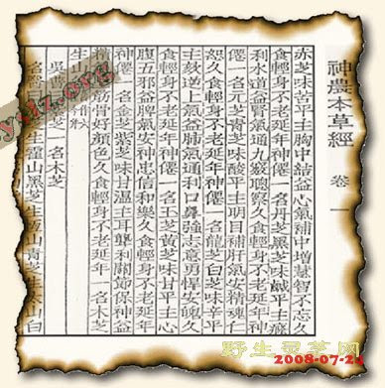
Tea as Food and Medicine
《神农草本经》
Shennong Bencao Jing 500 AD
茶味苦，饮之使人益思、
少卧、轻身、明目
Tea used in traditional medicine.
《晏子春秋》Yanzi Chunqiu 770-476 AD
茶叶作为菜肴汤料供人食用
Tea as an ingredient used in Chinese cuisine.

Slide 12
Tea Culture Established & Expanded
唐代 Tang Dynasty (618-907 AD)
Cultural Enlightenment + Economic Prosperity -> Tea Trade
文化经济发展迅速，茶业生产贸易兴旺。中唐后，
有茶法与茶税，“茶马互市”和“以茶治边。”
Promotion of Tea Drinking by Buddhist Monks
僧人嗜茶，提倡茶教，认为茶有三德即坐禅不眠、
生津化食、简朴养性。寺院也辟地种茶。
Tea Replaced Wine as a Social Activity
政府禁酒措施基于酒价昂贵，促进以茶代酒的风尚。
Lu Yu’s “The Classic of Tea” Sets the Procedural and Esthetic
Foundation of the Tea Culture
陆羽《茶经》的倡导奠定中国茶文化基础。
Notes:
Accessed on 2/23/2017, retrieved from 中国茶网 http://www.zgchawang.com/culture/show-34010.html
发布日期：2016-05-26 来源：中国茶文化知识
Accessed on 10/25/2016; retrieved from http://www.lcsd.gov.hk/ce/Museum/Arts/7thingsabouttea/en/ch5_1_1.htm
During the Tang dynasty, due to the popularity of Buddhism (Click here to read more about tea and Buddhism) and the promotion of Lu Yu, the tea-drinking habit gradually spread from the south to the north of China. By the middle of the dynasty, tea-drinking had already developed into a national custom in China. The Tang people had different methods in preparing the tea beverage. One of them was to boil tea leaves in a pot together with ginger, leek, mint, date, dogwood, and orange peel just as what the people did in Han dynasty.

Slide 13
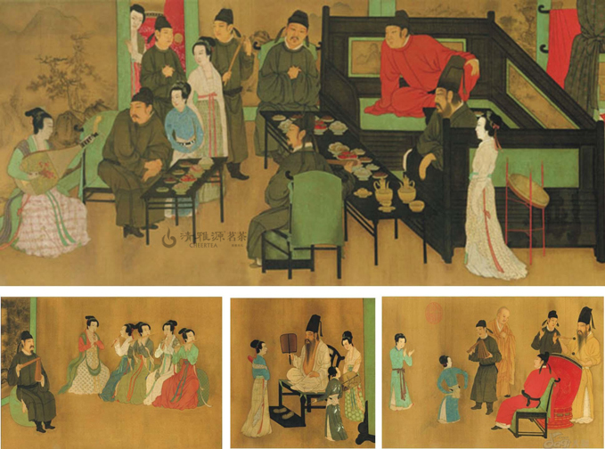
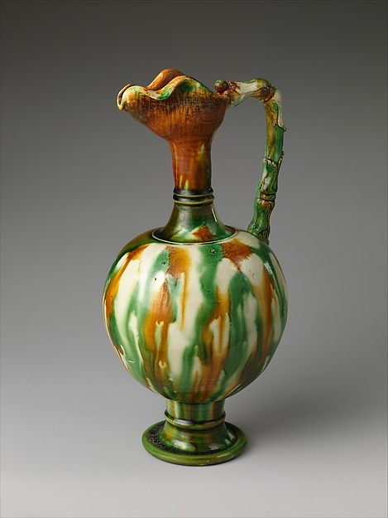
Tang Tea – An Elegant Affair
顾闳中 韩熙载夜宴图
Evening Banquet
Ewer
顾闳中 韩熙载夜宴图 完整全卷84480x3472像素
Accessed on 10/25/2016; retrieved from
http://www.aihuahua.net/ziyuan/guohua/10744.html
Notes:
顾闳中 韩熙载夜宴图 完整全卷84480x3472像素 Accessed on 10/25/2016; retrieved from http://www.aihuahua.net/ziyuan/guohua/10744.html

Slide 14
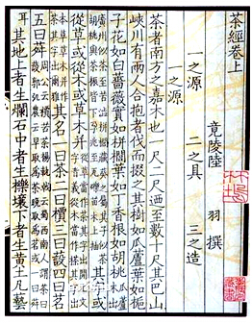
陸羽 Lu Yu (733-804)
《茶经》The Classic Of Tea (780)

Slide 15
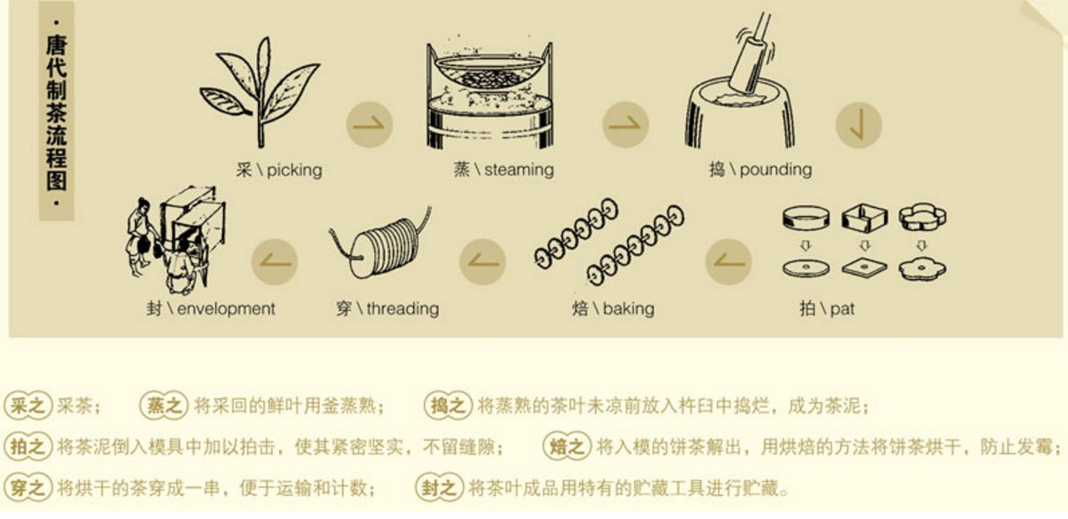
唐代饼茶制作 Tang Tea Bricks
Accessed on 10/25/2016; retrieved from
http://www.cteaw.com/article/201209/04/article_show_3828.html
Notes:
Accessed on 10/25/2016; retrieved from http://www.cteaw.com/article/201209/04/article_show_3828.html

Slide 16
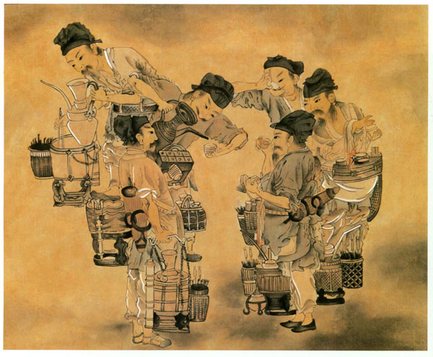
《斗茶图卷》 [唐]阎立本
Tea Competition
細賞古代茶事美圖 2015-05-26 中國茶網
《斗茶图卷》 [唐]阎立本 Accessed on 10/25/2016; retrieved from http://www.shiansart.com/news-p158/
Notes:
細賞古代茶事美圖 2015-05-26 中國茶網
《斗茶图卷》 [唐]阎立本 Accessed on 10/25/2016; retrieved from http://www.shiansart.com/news-p158/

Slide 17
Tea Connoisseurship Evolved
宋代 Song Dynasty (960-1279 AD)
Emperor Song Huizong as a Promoter of Tea Culture:
(basics of tea farming, terroir)
大观元年宋徽宗赵佶撰写《大关茶论》。
Improved Production Process &Tea Quality; Tea Competition
泡茶技艺的改进;水质的讲究;斗茶品评茶叶优劣。
Zen Priest Eisai Brought Back Tea Seeds to Japan (1191)
奈良朝时期(唐代)日本已将茶引入但並未流行。到日本禅师榮西兩次入宋携带回茶种,才廣為種植。
Tea Farming Moved to Southern Fujian Area
茶叶重心移向南方，建茶（武夷茶区现闽南岭南一带)。
Tea Drinking as a Kind of Aestheticized Performance
讲求茶具的使用和美感，审美的观念进入茶文化。
Notes:
Accessed on 2/23/2017, retrieved from 中国茶网 http://www.zgchawang.com/culture/show-34010.html
发布日期：2016-05-26 来源：中国茶文化知识

Slide 18
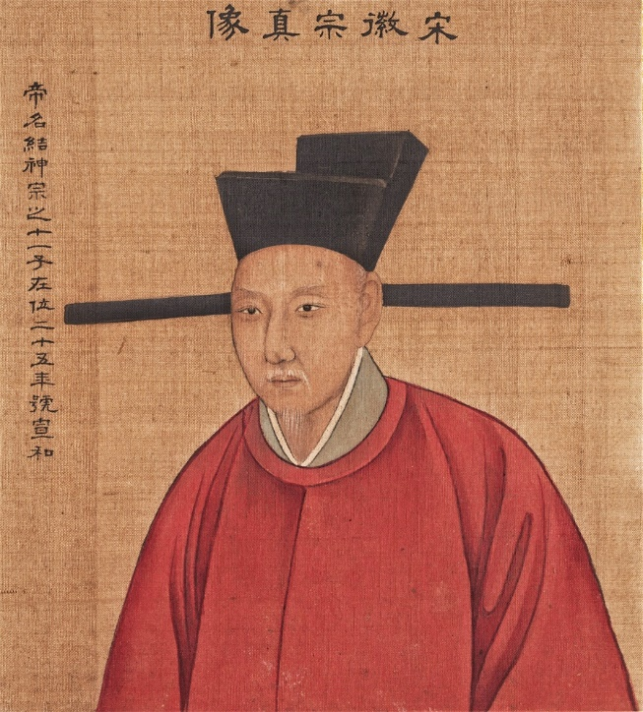
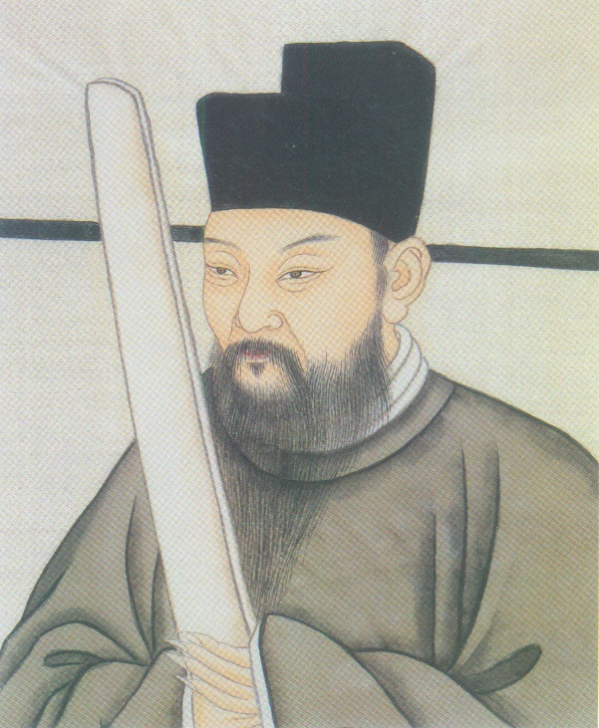
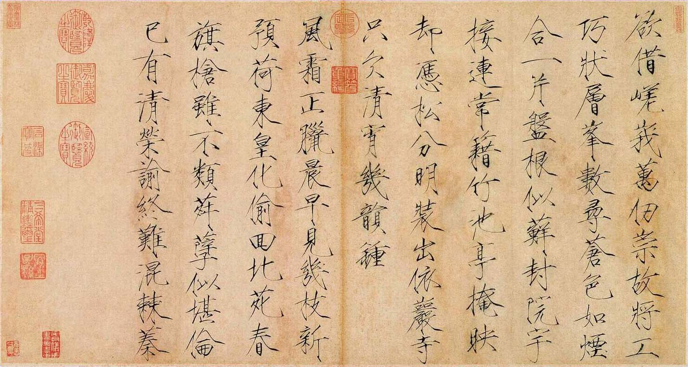
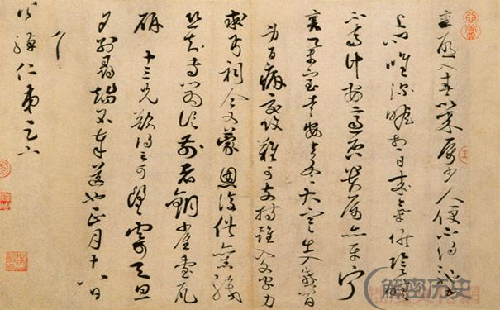
蔡襄《茶录》Cai Xiang (1012-1067)
宋徽宗《大关茶论》Emperor Huizong
(1082-1135)
Notes:
In the Song dynasty, the enthusiasm of tea drinkers was reflected in the social and intellectual life of the period. Offering tea to visitors became a universally accepted etiquette. Many scholars, officials and nobles were experts in the preparation of tea, and tea parties were popular. Tea was produced in the form of tea cakes which were often scented with Borneo-Camphor.
The most popular way in the preparation of tea decoction at that time was called the "whipped tea" method. Tea was first ground into fine powder. A fair quantity of tea powder was placed inside a tea bowl. Hot water was then added. The mixture was whipped with a bamboo whisk until froth appeared on the tea surface.
In the Song dynasty, the process of preparing the tea beverage was taken as a means to tranquilise the mind. Much attention was paid to the different steps in preparing a bowl of tea.

Slide 19
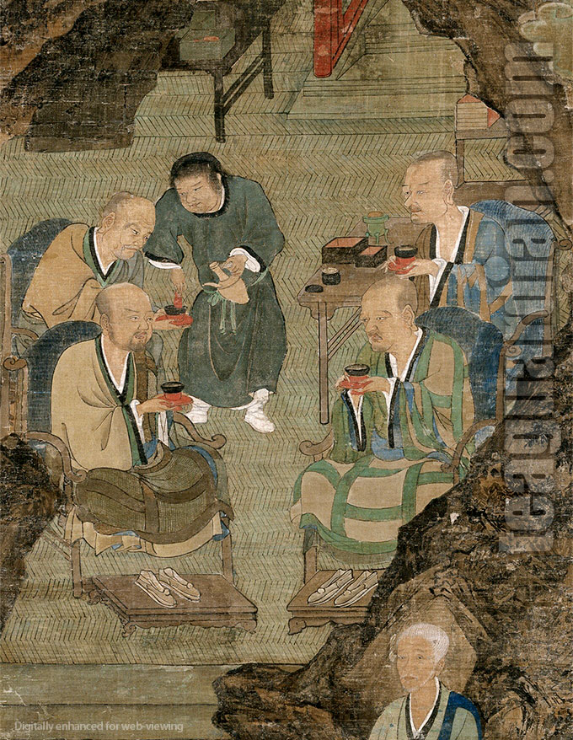
五百罗汉图
The Five Hundred Luohans (12th C.)
Accessed on 10/25/2016; retrieved from:
https://www.teaguardian.com/tea-hows/tea-wares/pictorial-history-of-gaiwan/
attachment/monks-drinking-tea-detail-the-five-hundred-luohans-arhats/
Notes:
Accessed on 10/25/2016; retrieved from: https://www.teaguardian.com/tea-hows/tea-wares/pictorial-history-of-gaiwan/attachment/monks-drinking-tea-detail-the-five-hundred-luohans-arhats/
Tea drinking in China had remained pretty much unchanged for a few centuries. In this 12th century painting, the monks are still holding tea bowls with receptacles in a design similar to that the servant holds in the 7th century painting. However, the servant now uses a long spout water pot — perhaps originally a wine pot — to add water into the bowl and at the same time whisks the content. Notice that the receptacles are in red and the bowls in black — vogue at the time, which had profound influence in Japanese tea ware design to this day.
Detail, Five Hundred Luohans ( ie Arhats / Arahants ) Scrolls 五百羅漢圖, Southern Song Dynasty ( 12th ~ 13th century ), no signature, probably by Zhou Guichang 周季常. Collection at Daitoku-ji, Kyoto

Slide 20
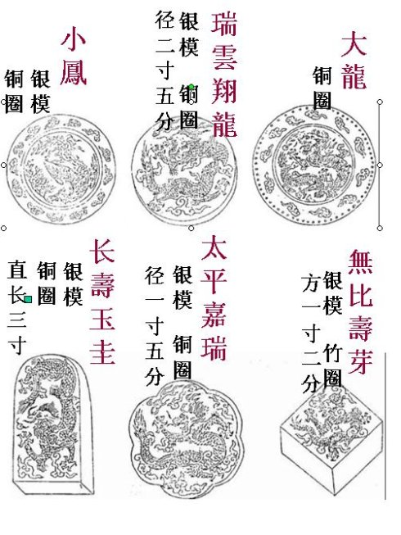
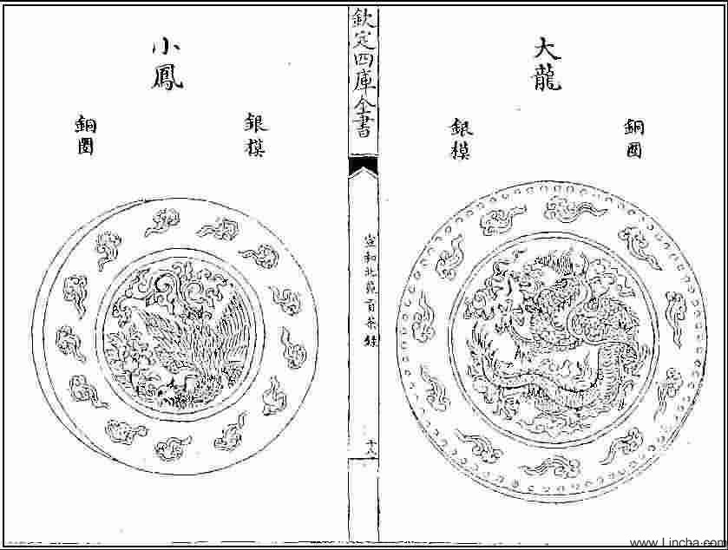
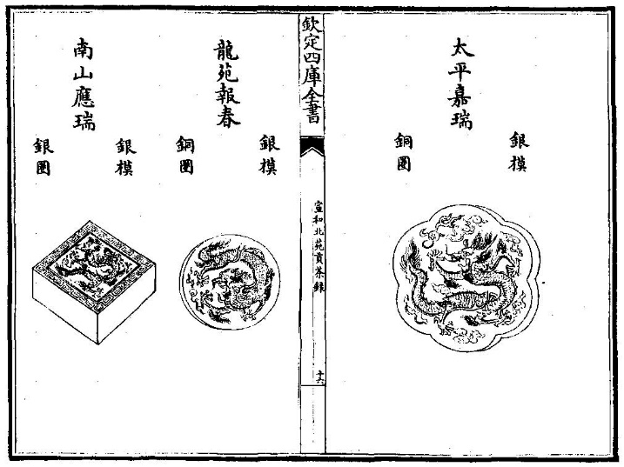
北苑貢茶 Beiyuan Tribute Tea
龙图风饼 Dragon & Phoenix Tea Cakes
Notes:
1. 福建茶叶历史渊源 2013-12-03 福建茶叶网 Accessed on 10/25/2016; retrieved from http://chuansong.me/n/453522
2. Accessed on 10/25/2016; retrieved from http://baike.baidu.com/view/1574296.htm
3. 建瓯辉煌的北苑贡茶龙团凤饼历史 建瓯茶叶六大特色 6年前 (2010-08-29)茶百科文化, 问道中国茶
0评论来源：本站原创 Accessed on 10/25/2016; retrieved from http://www.lincha.com/chinese-tea/jianou-beiyuan-history-488.shtml

Slide 21
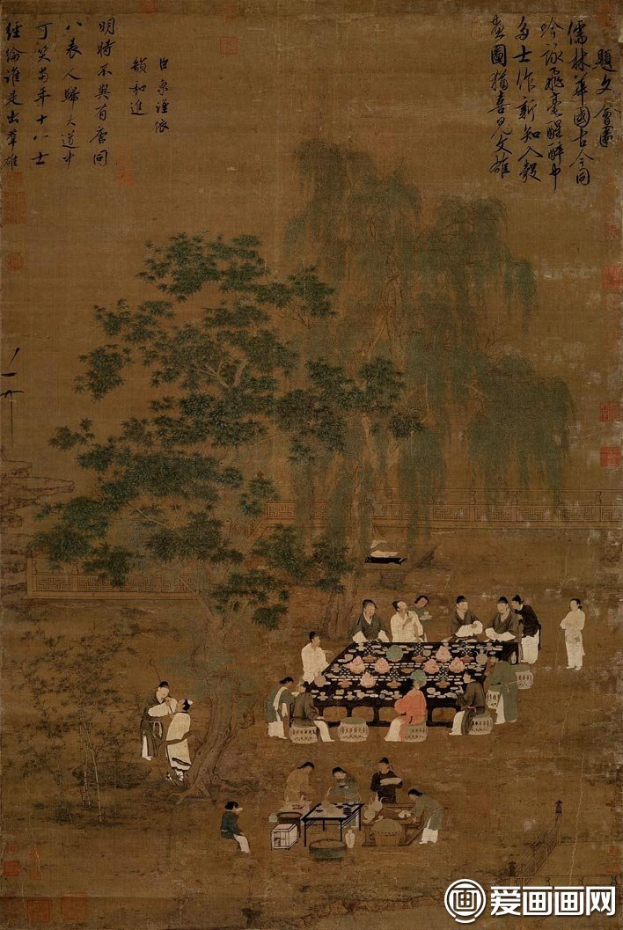
宋徽宗文繪圖
Literary Gathering
Notes:
Literary Gathering (文會圖). Zhao Ji (趙佶, 1082-1135), Song Dynasty (960-1279)
Handscroll, ink and colors on silk, 184.4 x 123.9 cm, National Palace Museum

Slide 22
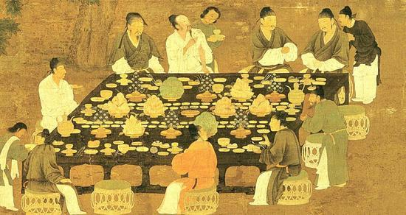
斗茶 Tea Compstition
Notes:
据蔡襄《茶录》和宋徽宗赵佶的《大观茶论》所述，建安“斗茶”，大体有以下几个程序：一是研茶协盏。即第一步是要将茶饼碾碎成末，置入微热过的茶盏之中。二是调膏点注。即第二步是先要执壶注入适量的初沸开水，调和茶末似浓膏，然后轮番点注，比试汤色，以清白色为贵，黄白色为贱。三是击拂候汤。即第三步是要使茶面泛起汤花，再视茶面出现水痕的先后，先者为劣，后者为尊。四是细啜吟咏。即第四步是在胜负甫定之后，继而细啜慢饮，品评得失，吟诗赋文，尽享其趣。 建安的茗战，经丁渭、蔡襄等名家的倡导，传播到上层社会，逐渐演化成一种鉴赏茶品，冲泡茶艺，清新雅致的茶道艺术。

Slide 23
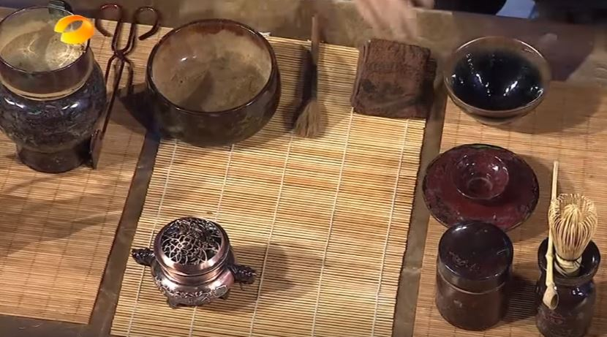
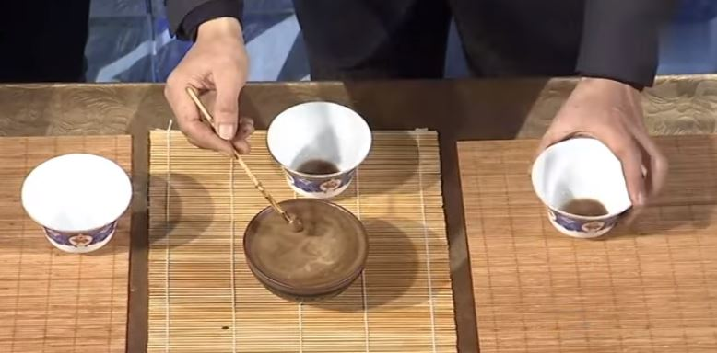
研
茶
协
盏
调膏点注
宋代 点茶
Notes:
湖南历史数据上传频道 锋尚之王之茶百戏传奇
Accessed on 10/25/2016; retrieved from https://www.youtube.com/watch?v=lISEnQ3rNt0

Slide 24
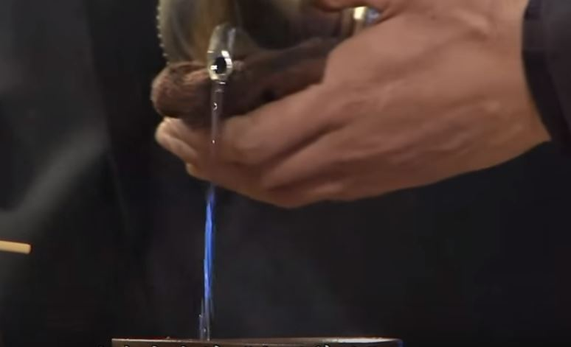
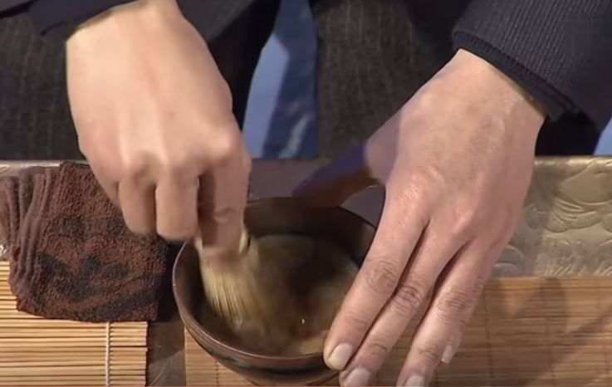
注水
Tea Artistry | Tea Esthetic
Ability of conjure shapes on the tea’s surface with a tea whisk was considered not only great skill but also find art.
击
拂
侯
汤
Notes:
湖南历史数据上传频道 锋尚之王之茶百戏传奇
Accessed on 10/25/2016; retrieved from https://www.youtube.com/watch?v=lISEnQ3rNt0

Slide 25
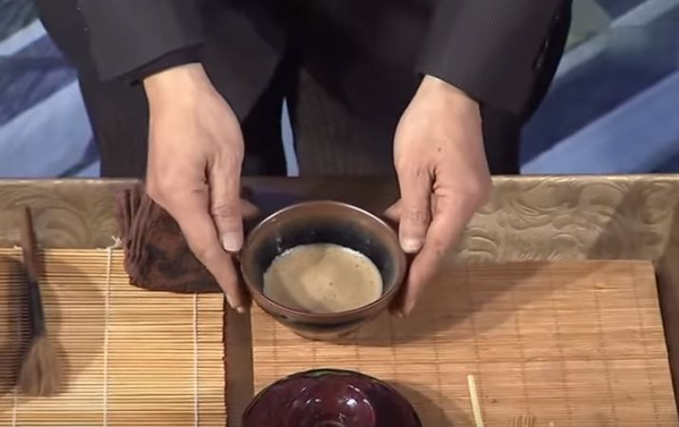
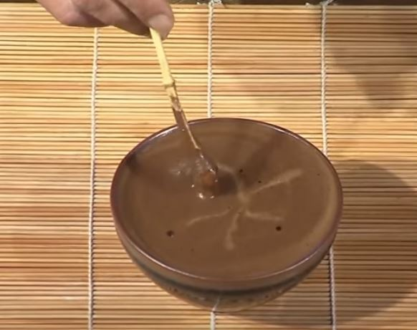
汤色 Color
汤花 Foam
水痕 Design
啜饮 Taste
Notes:
湖南历史数据上传频道 锋尚之王之茶百戏传奇
Accessed on 10/25/2016; retrieved from https://www.youtube.com/watch?v=lISEnQ3rNt0

Slide 26
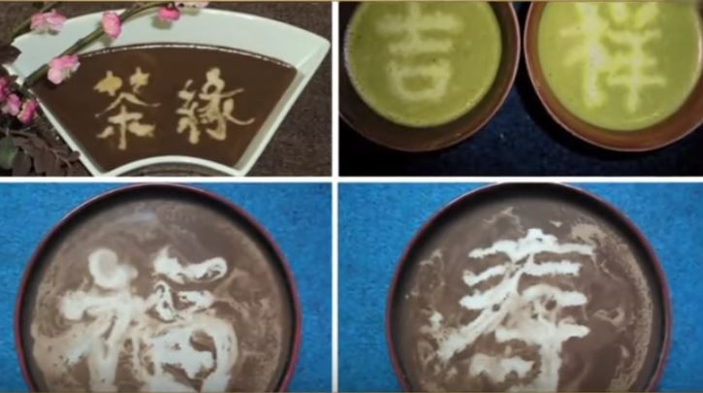
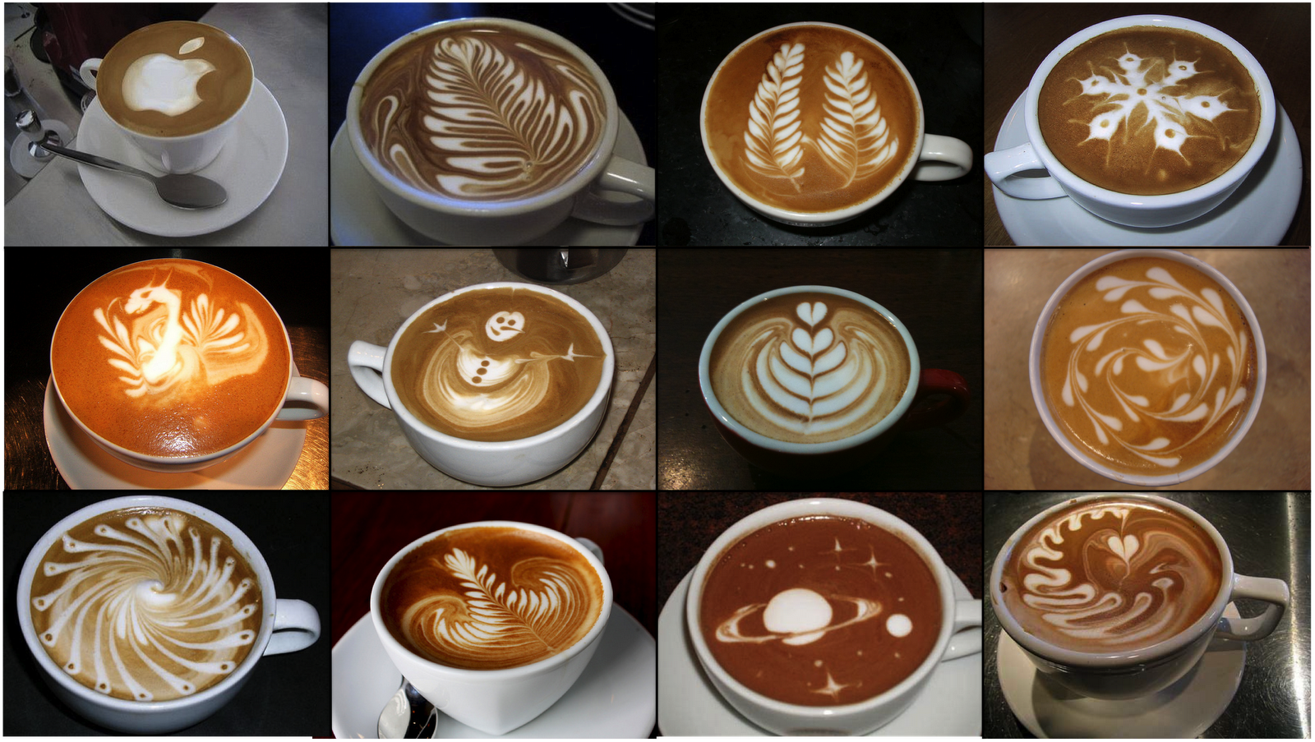

Slide 27
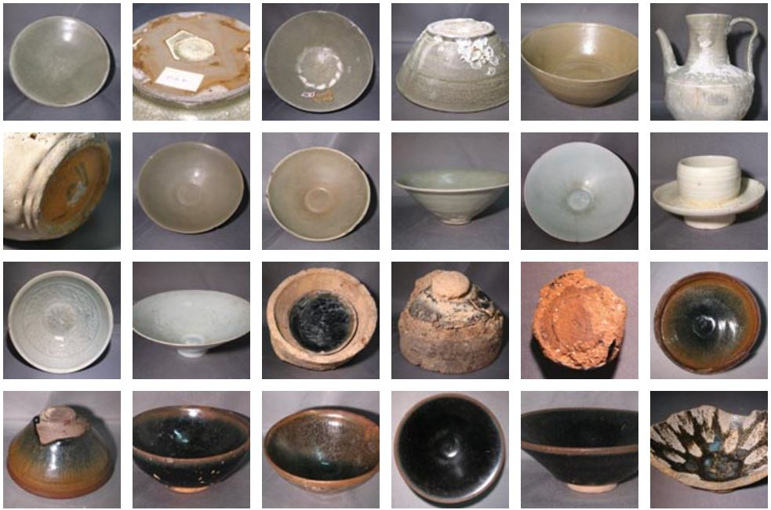
宋代茶盞 SONG TEA BOWLS
Notes:
Accessed on 10/25/2016; retrieved from http://www.lib.ntu.edu.tw/events/song/

Slide 28
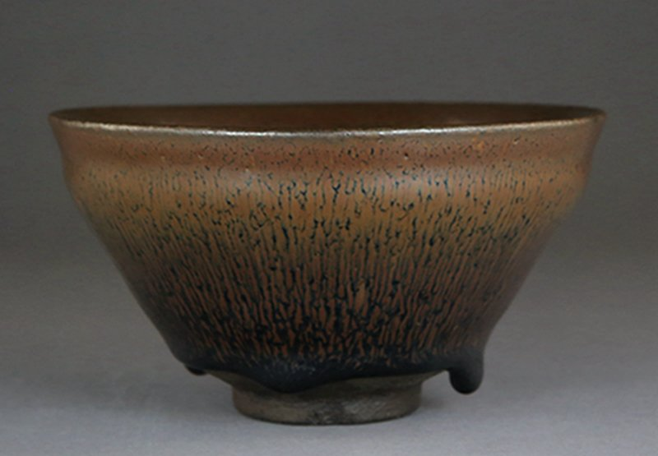
宋代兔毫盞 RABBIT-FUR TEA BOWL
Notes:
Accessed on 10/25/2016; retrieved from http://www.lib.ntu.edu.tw/events/song/

Slide 29
茶道 The “Way” of Tea
Monk Jiao Ran Coined the Phrase: The Tao of Tea
陆羽朋友僧人皎然（720-804）
三饮得道
《饮茶歌诮崔石使君》：
一饮涤昏寐，情思爽朗满天地；
再饮清我神，忽如飞雨洒轻尘；
三饮便得道，何须苦心破烦恼。

Slide 30
三不点 Three “Don’t Pours”
《尝新茶诗》苏东坡
泉甘器洁天色好
坐中拣怿客亦佳
泉甘器洁
天色好
客 佳
1. Tea non-new, spring water non-sweet, utensils unclean: first don’t pour.
2. Foul weather, ugly scenery: second don’t pour.
3. Uncultured, rude guests: third don’t pour.
-The Taste of Tea, Warren Peltier, p. 85
Notes:
品茶三不点 周重林 2011-09-01 12:48:45
Accessed on 10/25/2016; retrieved from https://www.douban.com/note/170197250/

Slide 31
茶德 Tea Esthetics & Morality
Tea Promotes Moral Cultivation
Moderation
Harmony
Contemplative Atmosphere
儒家：中庸、和谐
道家：清静无为、天人合一
佛家：静心、茶禅一味
陆羽：茶性简，不宜广
Quiet
Inner Calm
Purity
Frugal Simplicity
Link Between Humanity and Nature
Closer to Heaven
Unblemished Integrity

Slide 32
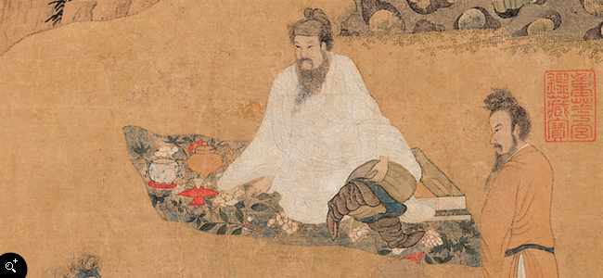
钱选 卢仝烹茶图
Qian Xuan (1235-1305) | Lu Tong Brewing Tea
Visualizes the ideal of purity in tea drinking
Admiration for a disillusioned gentleman who turned to tea as a refuge from the corruptions of power
唐代詩人盧仝（約795-835）
Notes:
Accessed on March 1, 2017. Retrieved from http://www.npm.gov.tw/exh98/form9801/ch_page_02.html.
傳 宋 錢選 畫盧仝烹茶圖 軸 紙本
本幅描繪唐代詩人盧仝（約795-835）席地坐於一裝飾華麗的花毯之上，身旁擺放有三足朱泥茶壺、白瓷茶甌、朱漆茶托、書畫冊等。前面則畫一老嫗煽火烹茶。以朱泥宜興茶壺煮茶，為明中期以後的葉茶泡法，故應與元代畫家錢選無關。就其淡雅的設色與秀氣的湖石草木造型看來，乃是由吳派風格轉換而來，與院藏丁雲鵬〈洗象圖〉等畫風與用筆皆極為相似，應為晚明出身安徽的畫家丁雲鵬（1547-1628之後）所作。

Slide 33
《七碗茶歌》盧仝
Seven Cups of Tea
日高丈五睡正濃， 軍將打門驚周公。
口云諫議送書信， 白絹斜封三道印。
開緘宛見諫議面， 手閱月團三百片。
聞道新年入山裡， 蟄蟲驚動春風起。
天子須嘗陽羨茶， 百草不敢先開花。
仁風暗結珠琲瓃， 先春抽出黃金芽。
摘鮮焙芳旋封裹， 至精至好且不奢。
至尊之餘合王公， 何事便到山人家。
柴門反關無俗客， 紗帽籠頭自煎吃。
碧雲引風吹不斷， 白花浮光凝碗面。

Slide 34
《七碗茶歌》盧仝
Seven Cups of Tea
一碗喉吻潤，兩碗破孤悶。
三碗搜枯腸，唯有文字五千卷。
四碗發輕汗，平生不平事，盡向毛孔散。
五碗肌骨清，六碗通仙靈。
七碗吃不得也，唯覺兩腋習習清風生。
蓬萊山，在何處？玉川子，乘此清風欲歸去。
山上群仙司下土，地位清高隔風雨。
安得知百萬億蒼生命，墮在巔崖受辛苦！
便為諫議問蒼生，到頭還得蘇息否？
English Translation
Notes:
http://lotusperry.com/chinese/the-seven-cups-of-tea/

Slide 35
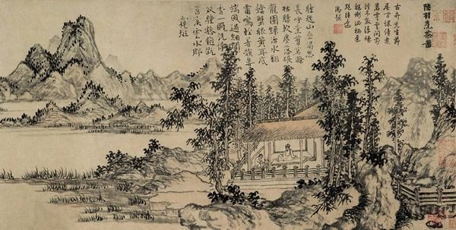
陸羽烹茶图 (元 赵原)
Painting Of Lu Yu Brewing Tea
Notes:
Accessed on 10/25/2016; retrieved form http://www.uuhuaku.com/uua/YiKuItemEW?id=2229

Slide 36
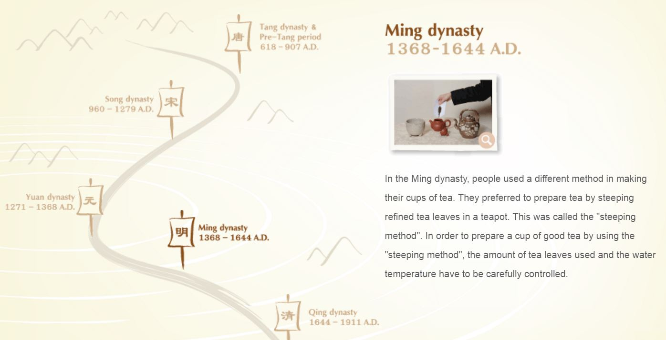

Tea Drinking in Ming Dynasty
Notes:
Accessed on 10/25/2016; retrieved from http://www.lcsd.gov.hk/ce/Museum/Arts/7thingsabouttea/en/ch5_1_4.htm
In the Ming dynasty, people used a different method in making their cups of tea. They preferred to prepare tea by steeping refined tea leaves in a teapot. This was called the "steeping method". In order to prepare a cup of good tea by using the "steeping method", the amount of tea leaves used and the water temperature have to be carefully controlled. At the beginning of the Ming dynasty, people used large teapots to brew tea so that they could drink many cups from one pot of tea. They later discovered that when the leaves were being steeped too long in hot water, the tea would become bitter in taste and the last few cups would not be as fresh as the first few ones. That was why the size of teapots became smaller and smaller. Apart from underglazed teapots and white glaze teapots, those teapots made in purple clay at Yixing of Jiangxu province were most treasured by the tea epicures.

Slide 37
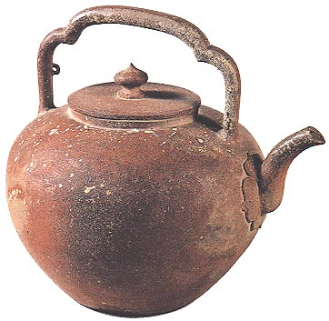
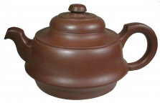
明 宜兴茶壶
Ming Yixing Tea Pot
紫砂壶
Purple Clay Tea Pot

Slide 38
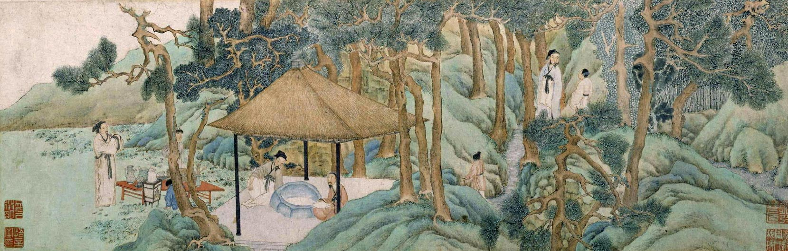
惠山茶会图 文徵明
Hui Mountain Tea Banquet (1518)
Tea Environment and Tea Enjoyment
Notes:
Hui Mountain Tea Banquet by Wei Zheng Ming; Ming Dynasty, 1518
文徵明作品 故宫博物院藏 2015-06-27 00:41:17| 分类： 明代绘画 | 标签：吴门四家 文徵明 北京故宫
Accessed on 10/25/2016; retrieved from http://jsl641124.blog.163.com/blog/static/17702514320155261411601/

Slide 39
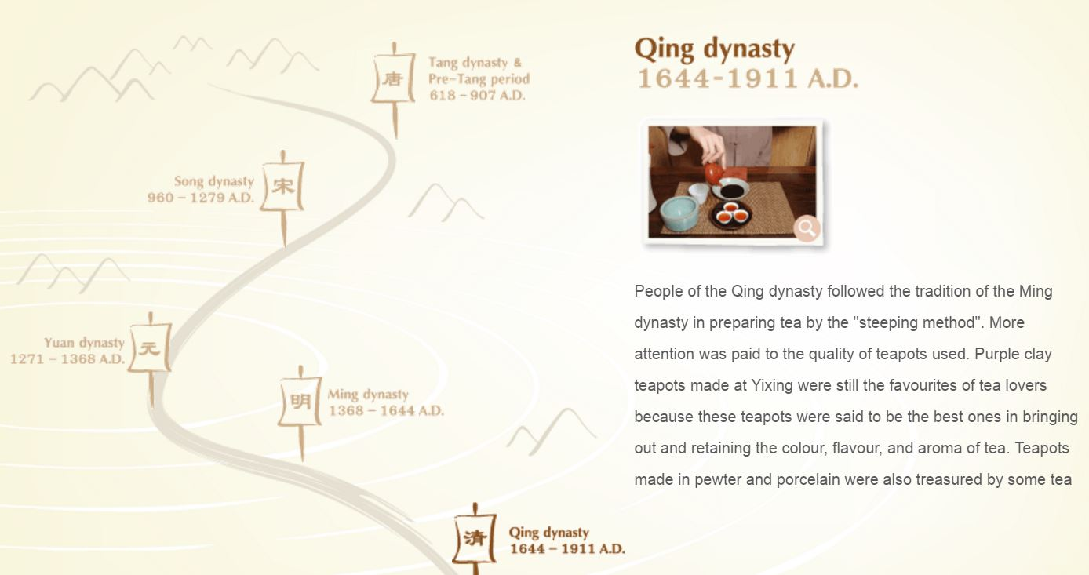
Tea Drinking in Qing Dynasty
Notes:
Accessed on 10/25/2016; retrieved from http://www.lcsd.gov.hk/ce/Museum/Arts/7thingsabouttea/en/ch5_1_5.htm
People of the Qing dynasty followed the tradition of the Ming dynasty in preparing tea by the "steeping method". More attention was paid to the quality of teapots used. Purple clay teapots made at Yixing were still the favourites of tea lovers because these teapots were said to be the best ones in bringing out and retaining the colour, flavour, and aroma of tea. Teapots made in pewter and porcelain were also treasured by some tea epicures because the former could keep the tea warm for a longer time while the latter had the feeling of cleanliness. Besides teapots, people of the Qing dynasty also used covered teacups for brewing tea.
Covered teacup was an ideal utensil for preparing tea for one person. Tea manufacturers of the Qing dynasty invented the special method to control tea fermentation, which resulted in the production of black tea and oolong tea. Beginning from the Qing dynasty, people had more choice in the selection of tea.
The production of oolong tea in the Qing dynasty had brought along a new way in brewing this special kind of tea, which is often referred to as the "gongfu tea".
The procedures in the preparation of gongfu tea are very complicated. Special requirements are set by the gongfu tea lovers as to how the water should be prepared, the amount of tea leaves to be used, how to pour in the boiling water, and how to drink the tea. The teapot and teacups used for the gongfu tea are very small in size and they are often purple-clay wares from Yixing of the Jiangxu province. It is said that such a drinking style is the best way in bringing out the colour, flavour, and aroma of oolong tea. Perhaps this explains why such a drinking style has survived for a few hundred years and its still very popular among the natives of Chaozhou and Fujian province. (Click here for a video presentation on "gongfu tea")
Info. for teachers | About us | Privacy policy | Important notices© 2012 Hong Kong Museum of Tea Ware

Slide 40
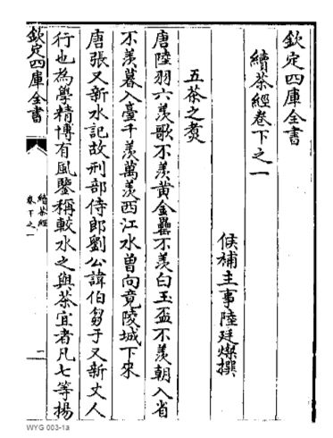
续茶经 陆廷灿 （清）
Sequel To The Classic Of Tea （1735）
Notes:
https://www.kanripo.org/text/KR3i0024/003

Slide 41
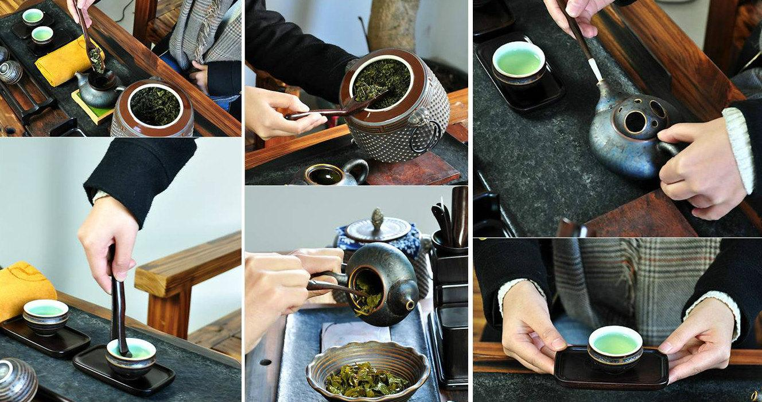
功夫茶 Gong Fu Tea

Slide 42
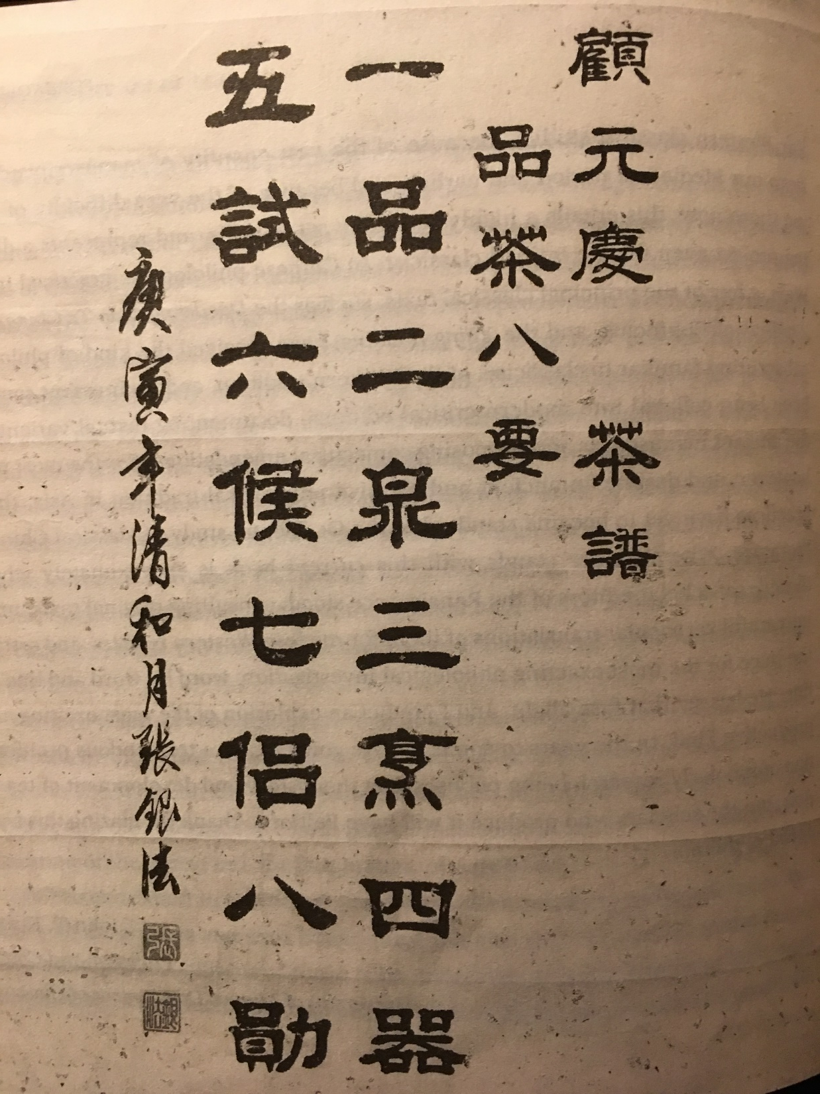
One Quality
Two Spring
Three Boil
Four Utensils
Five Try by Sip & Taste
《
Six Fire & temperature
Seven Companions
Eight Meritorious Service
Notes:
《茶譜》（明）錢椿年著於嘉靖十八年（1539年），顧元慶於嘉靖二十年15刪校。全書共9節：
茶略
茶品
藝茶
採茶 一芽二葉
藏茶 收藏時用箬葉包裹，兩三天焙一次，溫度同人體溫。
制茶諸法
橙茶、蓮花茶、茉莉花茶、玫瑰花茶等的製法。
煎茶四要：擇水，洗茶，侯湯，擇瓶。
點茶三要：洗滌器，熁盞，擇果。
茶效。止咳，利水道，明目，除煩。
Accessed on 10/25/2016; retrieved from http://www.aictea.it/risorse/materiali/pdf_chashu/chapu_guyuanqing.pdf

Slide 43
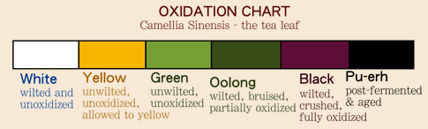
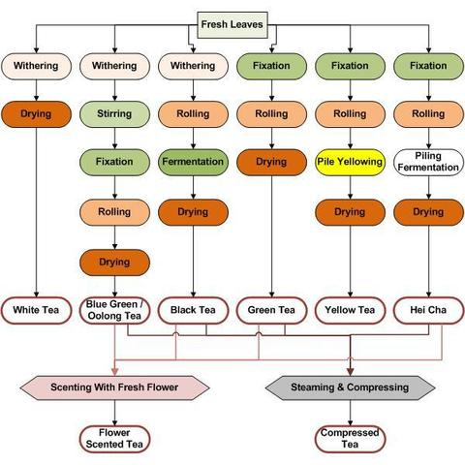
生茶 ◆ 熟茶 ◆ 普洱茶
采青
萎凋
发酵
杀青
揉捻
闷黄
渥堆发酵
干燥
(初制茶)
精制
加工

Slide 44
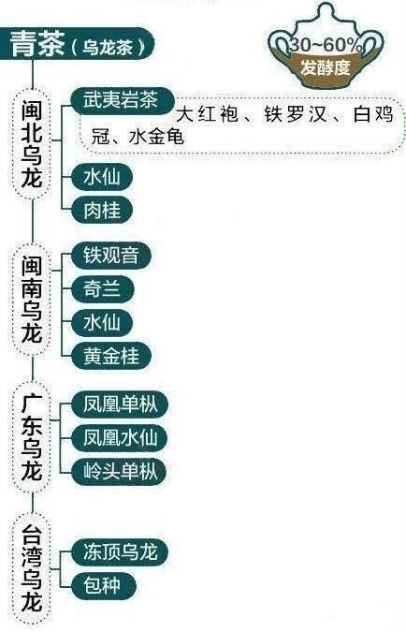
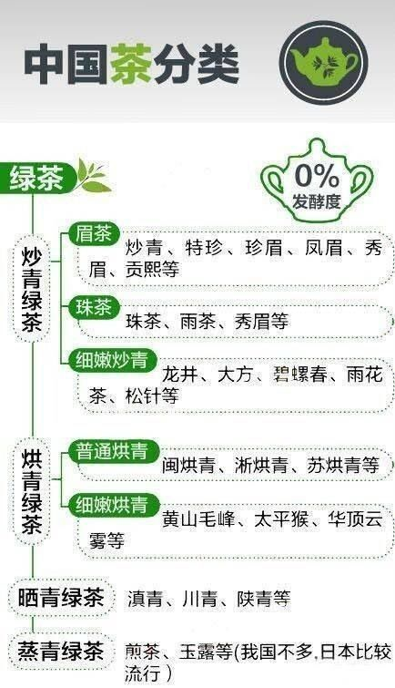
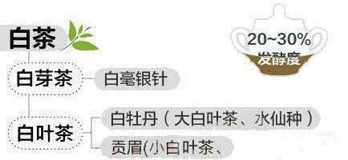
Notes:
Accessed on 10/25/2016; retrieved from http://www.zgchaye.cn/file/upload/201404/28/10-40-24-56-1.jpg

Slide 45



Slide 46
黑茶 Fermented Tea (Dark Tea)
渥堆发酵 Fermentation
- microbial fermentation
several months to many years.
dark tea, not be confused with black tea 红茶
fermentation of tea leaves alters their chemistry, affecting the organoleptic
qualities of the tea
fermentation is carried out primarily by molds
Notes:
Fermented tea (also known as post-fermented tea or dark tea) is a class of tea that has undergone microbial fermentation, from several months to many years. The exposure of the tea leaves to humidity and oxygen during the process also causes endo-oxidation (derived from the tea-leaf enzymes themselves) and exo-oxidation (which is microbially catalysed). The tea leaves and the liquor made from them become darker with oxidation. Thus, the various kinds of fermented teas produced across China are also referred to as dark tea, not be confused with black tea. The most famous fermented tea is Pu-erh, produced in Yunnan Province,^{[1][2]} and the Anhua dark tea produced in Anhua County of Hunan Province.
The fermentation of tea leaves alters their chemistry, affecting the organoleptic qualities of the tea made from them. Fermentation affects the smell of the tea and typically mellows its taste, reducing astringency and bitterness while improving mouthfeel and aftertaste. The microbes may also produce metabolites with health benefits.^{[1][3]}
The fermentation is carried out primarily by molds. Aspergillus niger was implicated as the main microbial organism in the Pu-erh process,^{[1][4][5]} but that species identification has been challenged by comprehensive PCR-DGGE analysis, which points to Aspergillus luchuensis as the primary agent of fermentation.^{[6][7][8][9]}
Most fermented teas are made in China, but several varieties are produced in Japan.^{[10]} In Shan State, Myanmar, lahpet is a form of fermented tea that is eaten, and similar pickled teas are also eaten in northern Thailand and southern Yunnan.^{[11]}

Slide 47
與茶為友 Be Friends with Tea
泡茶五要素5-Keys of Brewing
1. 水溫water temperature
2. 水質water quality
3. 茶水比例tea to water ratio
4. 時間infusion time
5. 沖泡器brewing utensils
Notes:
http://teaarts.blogspot.com/2012/03/chinese-english-tea-studies-terminology.html
泡茶的基本態度是“與茶為友be friends with tea”。
4.2.泡茶五要素5-Keys of Brewing
4.3.水溫water temperature
4.4.水質water quality
4.5.茶水比例tea to water ratio （g：cc）
4.6.時間infusion time
4.7.沖泡器brewing vessel

Slide 48


如何鉴赏茶 Tea Appreciation
色香味
Color Smell Finish
回甘 Finish with Sweetness
Notes:
Accessed on 10/25/2016, retrieved from http://tearroir.com/premium-loose-leaf-teas/three-things-tea-needs-to-learn-from-wine
1. Color Matters as Much for Tea as it does for Wine
Wine people know how to look at color.
For serious.
When wine lovers drink wine, they hold their glass up to the light. They look at the color of the wine in the glass against the light, examine how transparent or opaque the wine is, and watch the “legs” of the wine roll down the glass to get an idea of their wine’s viscosity.
Although color is just as important in tea as it is in wine, tea lovers tend to be a little bit behind the times. They just don’t know quite what to look for when they check the color of a tea.
We check the color of the tea before we brew it. We pour some tea into a white ceramic platelet, and go in and push the tea around with our fingers, inspecting all of the different leaves, strips, shapes, colors.
The color of a leaf should be consistent. There shouldn’t be wild variation between green and yellow and brown. The shape of the leaves pre-brew should be fairly uniform.
When you brew up the tea, be sure to look at it just like wine people look at their wines. Put your tea in a glass and throw it up against some light in the background. Is the tea a light greenish-yellow, or is it a darker amber, or brown color? Look at how transparent or opaque the tea is. All of these factors say something about the body, and character of the tea you’re about to taste.
2. Smell Matters as Much for Tea as it does for Wine
The nose. The aroma. The bouquet.
The nose of the tea is the foreplay, and foreplay matters.
Just like in wine, smell is an important aspect of your tasting experience with tea (or any beverage, for that matter). If you’ve got an exceptional high mountain Oolong tea, or 25 year old Pu’er tea that has an amazing and complex flavor profile, but the nose of the tea just isn’t up to snuff – you aren’t going to enjoy it as much as you should.
When you smell a tea, your nose, your nasal cavities, and your brain should all feel happy. If you smell a tea and feel like you’ve been transported to a fresh spring meadow – that’s a good thing. If you smell a tea and feel like your head has been locked in a cage in an underground sewer, that’s not such a good thing.
Never, ever overlook the importance of smell in a tea – it will help you make a good decision about the quality of what you’re tasting or drinking in a very short amount of time. And in some instances, paying close attention to the nose of a tea will help you avoid tasting some truly awful teas.
3. The “Finish” Matters as Much for Tea as it does for Wine
The “Finish” is another concept from the wine world which carries over directly into tea. When wine folks talk about the “finish” of a wine, they’re talking about the aftertaste. The flavors and textures of the wine that linger on their palate after they swallow the wine in their mouth. Some wines have a finish that will last for just a few seconds, and some more exceptional wines have a finish which will last for full minutes.
The Chinese have a number of terms which all get at the idea of the “finish” for tea. Hui wei describes the general idea of an aftertaste, something which resurges after you swallow the tea in your mouth. Hui gan describes the sweetness of the aftertaste. Kou gan describes the feelings of texture in your mouth which accompany the finish of a tea. Lastly, the cha di describes the “bottom of the tea,” and is like an aftertaste, or finish, but for the smell of the tea rather than the taste of the tea.
When you taste teas, you should be paying close attention to their finish. Do they linger on your palate, or do the flavors of the tea perform a vanishing act as soon as you swallow? High quality teas will linger on your palate.
When a tea has zero finish you know it’s old. You know it’s past its prime, and ready to be thrown out or thrown into your compost pile. When a tea has a rich and full finish with multiple layers of flavor, a finish which dances across the roof of your palate and all across your tongue, you know you’ve found a winner.
We try to learn as much as we can from the wine industry, from wine professionals, and even from wine writers. Wine people do an outstanding job of examining the color, nose, and finish of wines – something which tea hobbyists, enthusiasts, and professionals would do well to take note of.
A challenge to everyone in the tea industry reading this piece: go and learn one thing from a wine professional or magazine before you go to sleep tonight.

Slide 49

茶的咖啡因Caffeine Chart
Tea has less caffeine than coffee
One cup or eight ounces of black tea contains 14-70 mg of caffeine, and green tea 24-45 mg, compared to 95-200 mg in the same sized portion of coffee.
Notes:
Accessed on 10/25/2016; Caffeine Comparison at
https://cspinet.org/eating-healthy/ingredients-of-concern/caffeine-chart

Slide 50

Eight Tea Production Areas
八大茶产区介绍
Notes:
Accessed on 10/25/2016; retrieved form http://rthk.hk/chiculture/tea/regions.htm

Slide 51

Zhejiang Province Tea Production
浙江省茶叶产地

Slide 52

Tea Production in Taiwan
Notes:
Accessed on 10/25/2016; retrieved from http://www.sumusen.com.tw/article.php?id=177

Slide 53

中国茶书全集校正
Zhongguo chashu quanji jiaozheng
Ed. by 方健 Fang Jian
Publisher: 中州古籍出版社
Zhongzhou guji chubanshe
Years: 2014-12
Pages: 4347
ISBN: 9787534846540

Slide 54

  中國歷代茶書匯編
  Zhongguo lidai chashu huibian
  Ed. By 鄭培凱朱自振
  Zheng Peikai & Zhu Zizhen
  Publisher: 商務印書館
  Shangwu yishu guan
  Year: 2007
  Pages: 1212
  ISBN: 978-962-073-153-2

Slide 55
PRIMARY SOURCES
Cha Jing 《茶經》 (Classic of Tea) by Lu Yu 陸羽 (733-804). Beijing: Zhongguo Youyi chuanban gongsi, 2005.
Cha Lu 《茶錄》 (Record of Tea ) by Cai Xiang 蔡襄 (1012-1067). Retrieved from http://www.china.com.cn/aboutchina/zhuanti/cwh07/2007-09/14/content_8875870.htm
Da Guan Cha Lun 《大觀茶論》 (The Da Guan Era Treatise on Tea)
by Zhao Ji 趙佶 (1082-1035). Retrieved from http://www.twword.com/wiki/%E3%80%8A%E5%A4%A7%E8%A7%80%E8%8C%B6%E8%AB%96%E3%80%8B
Cha Pu《茶譜》 (Tea Manual ) by Gu Yuanqing 顧元慶 (1487-1565). Retrieved from
Xu Cha Jing 《續茶經》 (The Sequel to the Classic of Tea ) by Lu Tingcan 陸廷燦 (Qing Dynasty).
Retrieved from
https://www.kanripo.org/text/KR3i0024/003 (first printed in 1735; collected in Si Ku Quan Shu 四庫全書)

Slide 56
REFERENCE LIST
Benn, James A. (2015) Tea in China: A Religious and Cultural History. Honolulu: University of Hawai'i Press.
Evans, John C. (1992) Tea in China: The History of China’s National Drink. Westport: Greenwood Press.
Fan, Zengping 范增平. (2000) 《茶藝學》 Taipei: Wan quan lou tu shu you xian gong si.
Hinsch, Bret. (2015) The Rise of Tea Culture: The invention of the Individual. LanHam: Rowman & Littlefield Publishers
Heiss, Mary Lou and Robert J. (2007) The Story of Tea: A Cultural History and Drinking Guide. Berkeley: Ten Speed Press.
Peltier, Warren. (2011) The Ancient Art of Tea. Rutland: Tuttle Publishing.
Qiu, Jiping 裘纪平. (2003) 《茶经图说》Hangzhou: Zhe jiang she ying chu ban she.
Zitu 紫圖圖書. (2010) 《图解茶经》Haikou: Nan hai chu ban gong si.

