Slide 1
Lesson 16

Slide 2
Descriptive Complements
The subject of a sentence can be described by a complement following 得 (de).

Slide 3
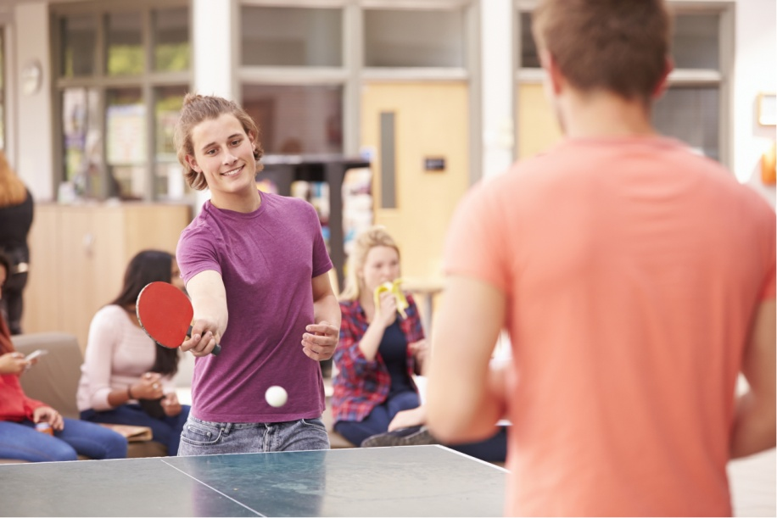
We had a happy time playing. [We played. We were very happy.]
Wǒmen wánr de hěn gāoxìng.
我们玩儿得很高兴。

Slide 4
The kid gave a very cute smile. [The child smiled, and the child looked cute.]
Háizi xiào de hěn kě’ài.
孩子笑得很可爱。

Slide 5
He was worn out from playing ball. [He played ball, and he was worn out.]
Tā dǎ qiú dǎ de hěn lèi.
他打球打得很累。

Slide 6
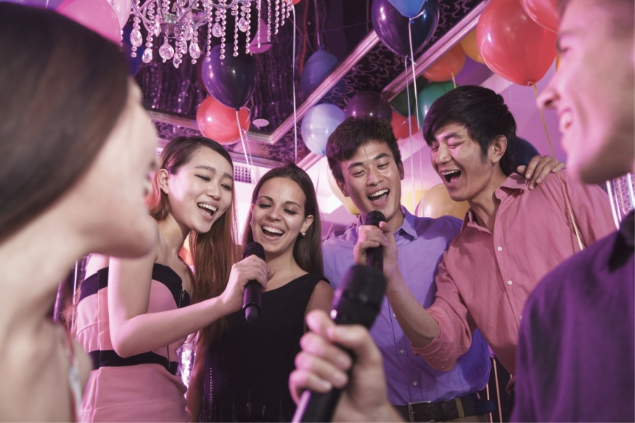
He was so happy that he ended up singing and dancing. [He was happy, and he was singing and dancing.]
Tā gāoxìng de yòu chàng yòu tiào.
他高兴得又唱又跳。

Slide 7
In the sentences above, the verbs 玩 (wán), 笑 (xiào), and 打球 (dǎ qiú) and the adjective 高兴 (gāoxìng) give the causes
the complements 高兴 (gāoxìng), 可爱 (kě’ài), 累 (lèi) and 又唱又跳 (yòu chàng yòu tiào) describe the effects on the subject.

Slide 8
when an adjective serves as a descriptive complement, it is often preceded by the adverb 很 (hěn), just like a predicate adjective.

Slide 9
A complement describing the subject seldom appears in the negative.
INCORRECT:
Tā gāoxìng de méiyǒu yòu chàng yòu tiào.
他高兴得没有又唱又跳。

Slide 10
For the use of the word 印象 (yìnxiàng, impression), compare these two sentences:
Lǐ Yǒu duì Wáng Péng de yìnxiàng hěn hǎo
李友对王朋的印象很好
Li You has a very good impression of Wang Peng
Lǐ Yǒu gěi Wáng Péng de yìnxiàng hěn hǎo
李友给王朋的印象很好
Li You made a very good impression on Wang Peng

Slide 11
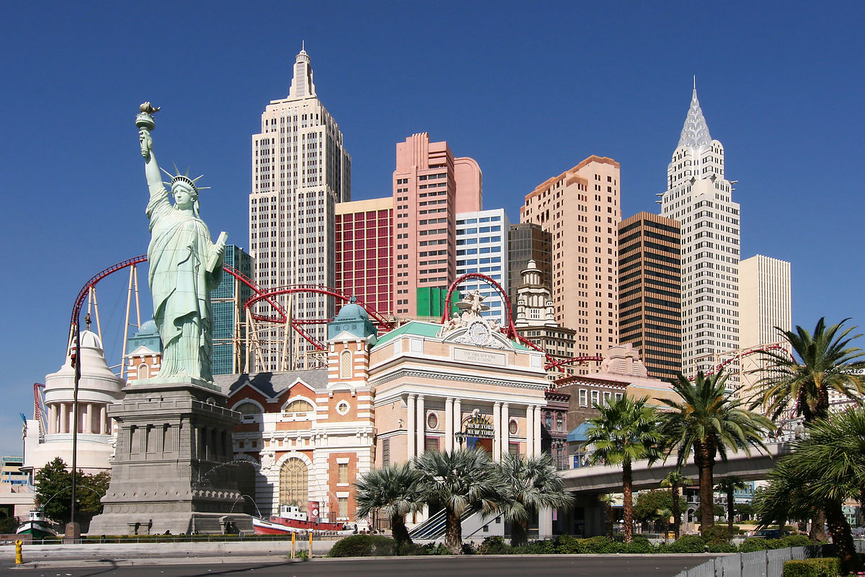
……印象怎麼樣？
去過紐約嗎?
見過李友的朋友嗎?

Slide 14
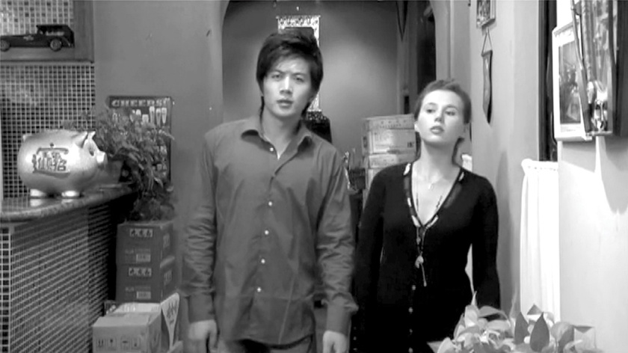
to show a film
演电影 (yǎn diànyǐng)
to show a film
can also mean “to act in a film”
放电影 (fàng diànyǐng)
to show a film

Slide 15
Potential Complements
得 (de) or 不 (bu) is placed between a verb and a resultative or directional complement to indicate whether a certain result can be realized or not.

Slide 16
Dancing is too difficult. I can’t learn it.
Tiàowǔ tài nán, wǒ xué bu huì.
跳舞太难，我学不会。

Slide 17
A: Can you be back by 6:30 p.m.? I will wait for you for dinner.
B: I have a meeting, and can’t make it back by 6:30 p.m.
Nǐ wǎnshang liù diǎn bàn néng huí lai ma? Wǒ děng nǐ chī wǎnfàn.
你晚上六点半点能回来吗？我等你吃晚饭。
Wǒ děi kāi huì, liù diǎn bàn huí bu lái.
我得开会，六点半回不来。

Slide 18
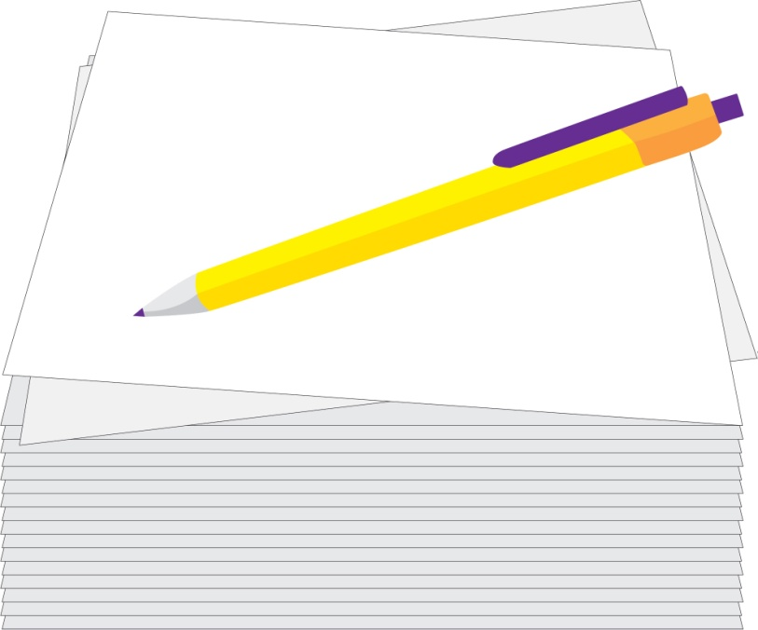
I can’t finish watching this DVD today.
Zhè zhāng dié wǒ jīntiān kàn bu wán
这张碟我今天看不完。

Slide 19
A: Can you understand this Chinese letter?)
Zhè fēng Zhōngwén xìn nǐ kàn de dǒng ma?
这封中文信你看得懂吗？
B: Yes, I can understand it.
Wǒ kàn de dǒng.
我看得懂。

Slide 20
Potential complements usually appear in negative sentences.
They are used in affirmative sentences much less often, mainly in answering questions that contain a potential complement.
The affirmative form and the negative form of a potential complement can be put together to form a question.

Slide 21
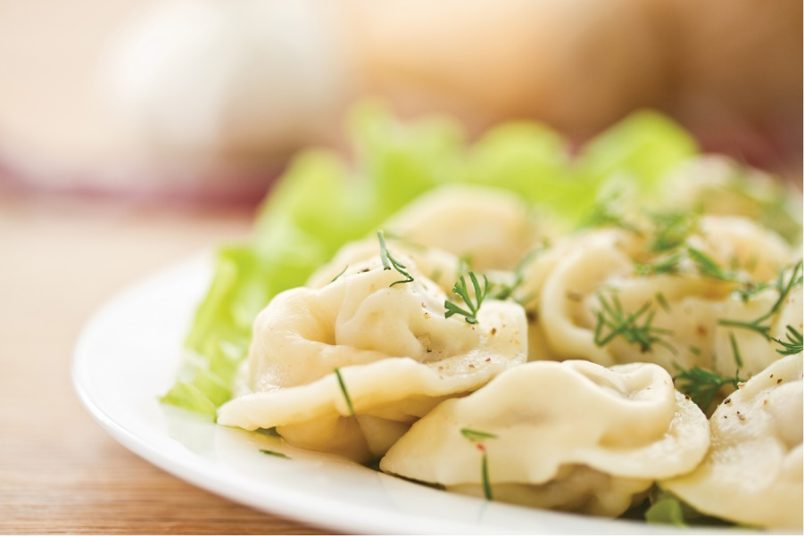
Can you eat fifty dumplings or not?
Wǔ shí ge jiǎozi nǐ chī de wán chī bu wán?
五十个饺子你吃得完吃不完？

Slide 22
They are often the only way to convey the idea that the absence of certain conditions prevents a result from being achieved.
Potential complements have a unique function that cannot be fulfilled by the “不能 (bù néng) + verb + resultative/directional complement” construction.
For example, 做不完 (zuò bu wán) means “not able to finish,” while 不能做完 (bù néng zuò wán) conveys the idea of “not allowed to finish.”

Slide 23
The teacher speaks too fast. I can’t hear [her] clearly.
Lǎoshī shuō de tài kuài, wǒ tīng bu qīngchu.
老师说得太快，我听不清楚。

Slide 24
INCORRECT:
*Lǎoshī shuō de tài kuài, wǒ bù néng tīng qīngchu.
*老师说得太快，我不能听清楚。

Slide 25
There is too much homework today. I can’t finish it.
CORRECT:
Jīntiān de gōngkè tài duō, wǒ zuò bu wán.
今天的功课太多，我做不完。
INCORRECT:
Jīntiān de gōngkè tài duō, wǒ bù néng zuò wán.
今天的功课太多，我不能做完。

Slide 26
早 (zǎo)
The primary meaning of 早 (zǎo) is “early”
in an extended sense it can also mean “a long time ago,” or “early on”

Slide 27
就 (jiù)
When used before a noun or pronoun, 就 (jiù) means “only.”
Often the noun or pronoun is modified by a numeral-measure word combination.

Slide 28
Our class is small, with just eight students.
Wǒmen bān rén hěn shǎo, jiù bā ge xuésheng.
我们班人很少，就八个学生。

Slide 29
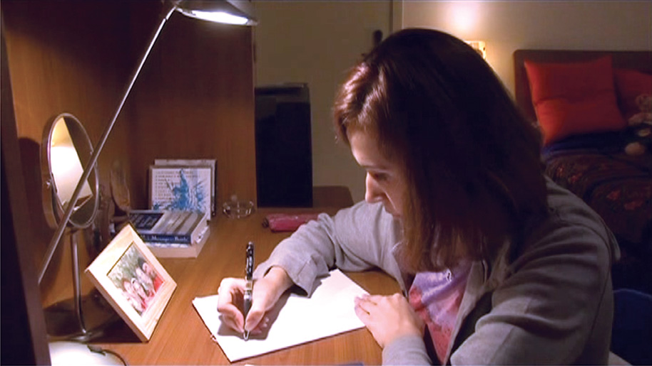
There’s little homework today. Only five Chinese characters.
Jīntiān gōngkè hěn shǎo, jiù wǔ ge Hànzì.
今天功课很少，就五个汉字。

Slide 30
There are five people in our family. Only you are allergic to MSG.
Wǒmen yì jiā wǔ kǒu, jiù nǐ duì wèijīng guòmǐn.
我们一家五口，就你对味精过敏。

Slide 31
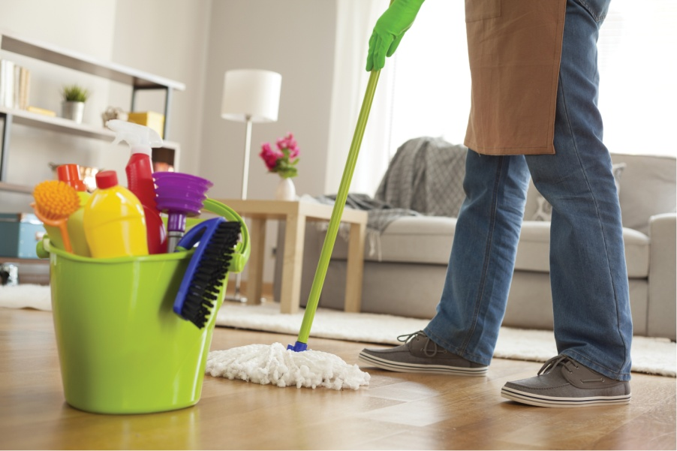
I have cleaned two of the three rooms. Only one room hasn’t been tidied up yet.
Sān ge fángjiān wǒ dǎsǎo le liǎng ge, jiù yí ge fángjiān hái méi zhěnglǐ.
三个房间我打扫了两个，就一个房间还没整理。

Slide 32
Achieving certainty with one word: 一言为定 (yì yán wéi dìng)
is one of the numerous four-character idioms that have their origins in Classical Chinese but continue to be on the lips of almost every native speaker of the language.

Slide 34
Directional Complements
Directional complements indicate the direction in which a person or object moves.
A directional verb can be placed after another verb to become what is known as a “simple directional complement.”
When a simple directional complement is combined with 来 or 去 (lai or qu), we have what is called a “compound directional complement.”

Slide 35
directional verbs
上 (shàng, to go up)
下 (xià, to go down)
进 (jìn, to go in)
出 (chū, to go out)
回 (huí, to return)
过 (guò, to go over)
起 (qǐ, to rise)
开 (kāi, to part from)
到 (dào, to arrive)
来 (lái, to come)
去 (qù, to go)

Slide 36
directional verbs
上 (shàng, to go up) 上來 vs 上去
下 (xià, to go down) 下來 vs 下去
进 (jìn, to go in) 進來 vs 進去
出 (chū, to go out) 出來 vs 出去
回 (huí, to return) 回來 vs 回去
过 (guò, to go over) 過來 vs 過去
起 (qǐ, to rise) 拿起來 put it up 看起來 it appears; it seems; looks like V+起來 start v+ing

Slide 37
“compound directional complement.”
When a simple directional complement such as 上, 下, 进, 出, 回, 过, 起, 开 or 到 (shang, xia, jin, chu, hui, guo, qi, kai or dao) is combined with 来 or 去 (lai or qu), we have what is called a “compound directional complement.”

Slide 38
Simple Directional Complements:
Pattern I:
A. Subject + Verb + Place Word / Noun (Phrase) + 来/去
B. Subject + Verb +来/去+ Noun
Pattern II:
A. Subject + Verb + 上/下… + Place Word /Noun

Slide 39
Simple Directional Complements: Pattern I: A. Subject + Verb + Place Word / Noun (Phrase) + 来/去
他 下 楼 来。
Tā xià lóu lai.
(He is coming downstairs.)
subject + verb + place word + directional complement

Slide 40
She is going upstairs.
她上楼去。
Tā shàng lóu qu.

Slide 41
When a verb is followed by a location word, that verb can only be a directional verb such as 上 (shàng), 下 (xià), 进 (jìn), 出 (chū), 回 (huí), 过 (guò), or 到 (dào), as shown in (1) and (2).

Slide 42
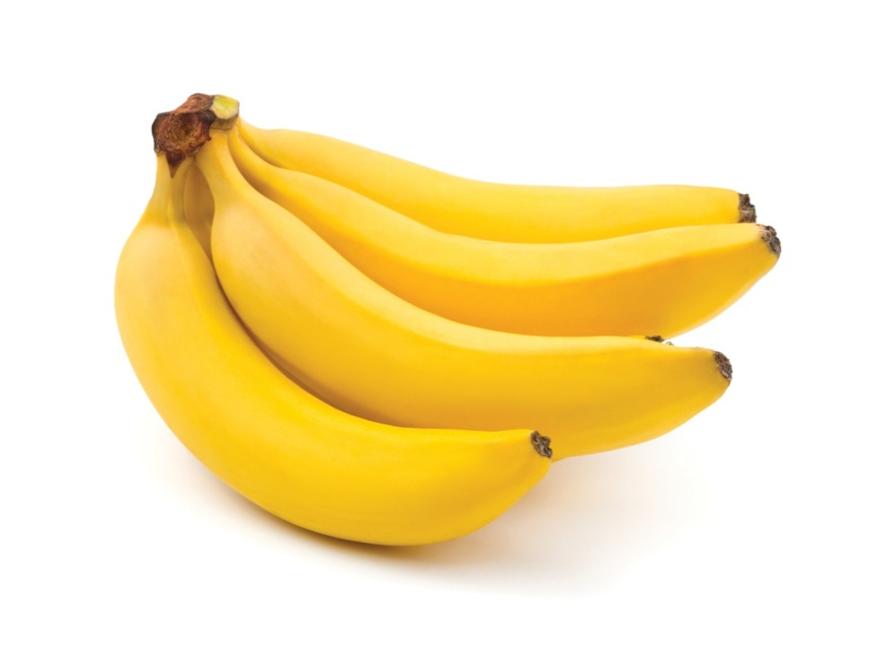
请 你 买 一些水果 来。
Qǐng nǐ mǎi yì xiē shuǐguǒ lai.
(Please buy some fruit [and bring it] here.)
subject + verb + noun phrase + directional complement

Slide 43
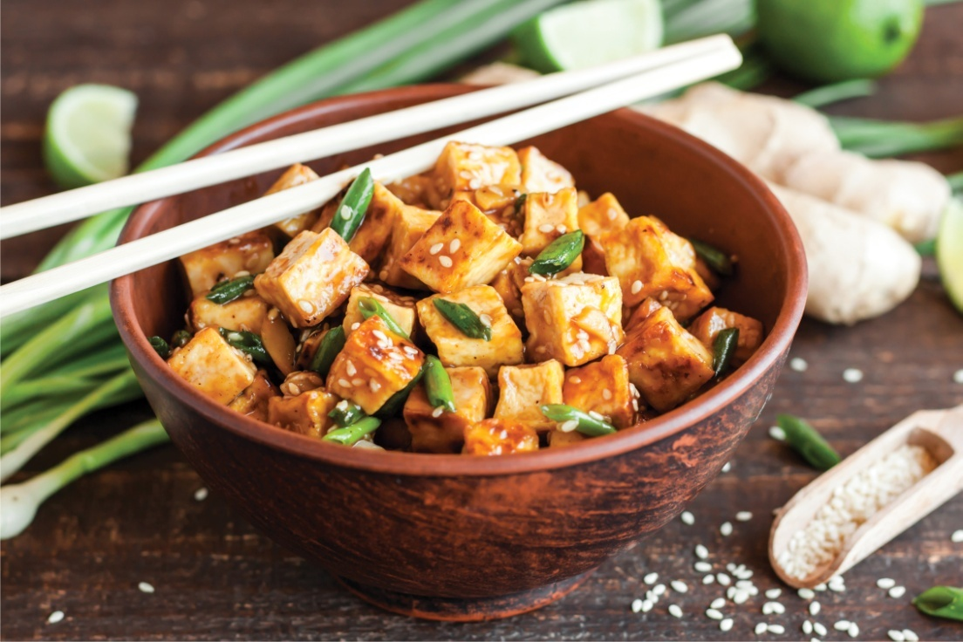
你给他送一点儿吃的东西去。
Nǐ gěi tā sòng yìdiǎnr chī de dōngxi qu.
(Take some food to him.)

Slide 44
When the object of the verb is a location word, the sentence can only appear in Pattern A, as in (1) and (2).
When the object is a regular noun and the action is not completed, the sentence often appears in Pattern A as well, as in (3) and (4).

Slide 45
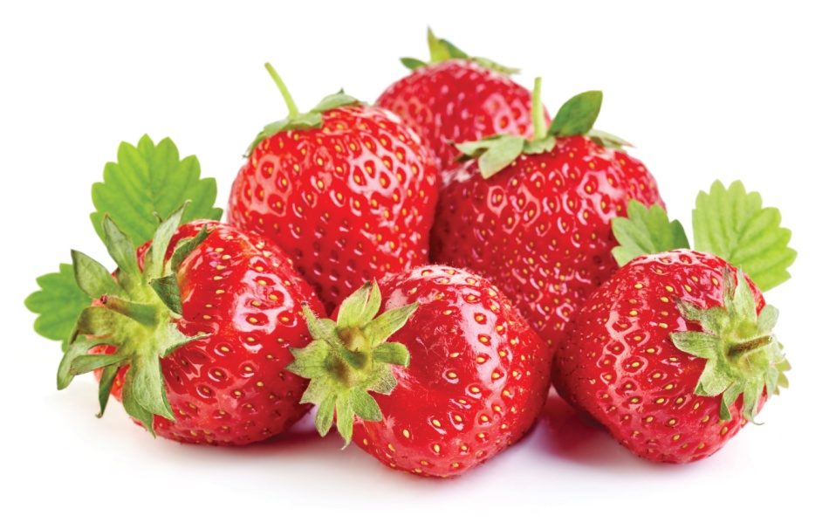
Simple Directional Complements: Pattern I: B. Subject + Verb +来/去+ Noun
他买来了一些水果。
Tā mǎi lai le yì xiē shuǐguǒ.
(He bought some fruit and brought it here.)

Slide 46
Simple Directional Complements: Pattern II: A. Subject + Verb + 上/下… + Place Word /Noun
他走上楼。
Tā zǒu shang lóu.
(He walked upstairs.)
[The sentence doesn’t indicate whether the speaker is upstairs or downstairs.]

Slide 47
老师走进教室。
Lǎoshī zǒu jin jiàoshì.
(The teacher walked into the classroom.)
[The sentence doesn’t indicate whether the speaker is in the classroom or not.]

Slide 48
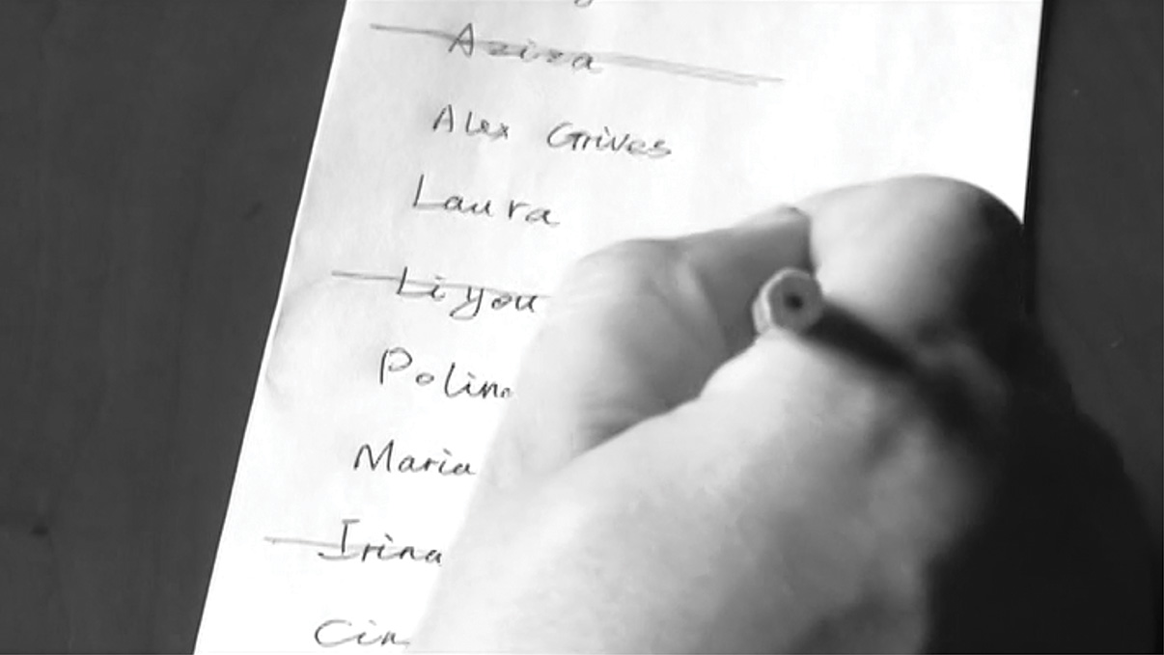
他拿出一张纸。
Tā ná chu yì zhāng zhǐ.
(He took out a piece of paper.)

Slide 49
Compound Directional Complements A. Subject + Verb + 上/下… + Place Word / Noun+ 来/去
她走下楼来。
Tā zǒu xia lóu lai.
(She walked downstairs.)
[The speaker is downstairs.]

Slide 50
老师走进教室去/来。
Lǎoshī zǒu jin jiàoshì qu/lai.
(The teacher walked into the classroom.)
With 去, the speaker is not in the classroom;
with 来, the speaker is in the classroom.

Slide 51
弟弟跳上床来/去。
Dìdi tiào shang chuáng lai/qu.
(My little brother jumped onto the bed.) With 来, the speaker is on the bed;
with 去, the speaker is not on the bed.

Slide 52
我的同学走进书店来/去。
Wǒ de tóngxué zǒu jin shūdiàn lai/qu.
(My classmate walked into the bookstore.)
With 来, the speaker was in the bookstore;
with 去, the speaker was not in the bookstore.

Slide 53
请你买回一些梨来。
Qǐng nǐ mǎi hui yì xiē lí lai.
(Please buy some pears and bring them back here.)

Slide 54
他拿出一张纸来。
Tā ná chu yì zhāng zhǐ lai.
(He took out a piece of paper.)

Slide 55
请大家都拿起笔来。
Qǐng dàjiā dōu ná qi bǐ lai.
(Please pick up a pen, everyone.)

Slide 56
起 (qi), in the same way as 起来 (qi lai), signifies a movement from a lower point to a higher point.
However, 起 (qi) compounds only with 来 (lai), never with 去 (qu), in forming a directional complement combination.
The difference between 上 (shang) and 起 (qi) is that 上 (shang) is followed by a location word which indicates the end point of the movement, while 起 (qi) never precedes a location word.

Slide 57
to go upstairs
走上楼
zǒu shang lóu
*走起楼*
zǒu qi lóu

Slide 58
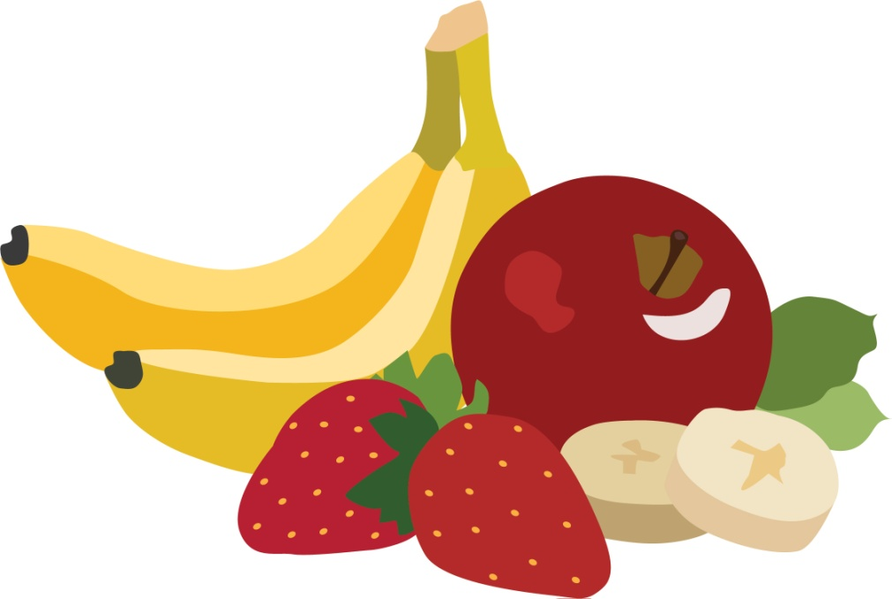
Compound Directional Complements B. Subject + Verb + 上/下… + 来/去 + Noun
他买回来了一些水果。
Tā mǎi hui lai le yì xiē shuǐguǒ.
(He bought some fruit and brought it back here.)

Slide 59
把 (bǎ) construction used with a directional complement
When the 把 (bǎ) construction is used with a directional complement, the sentence can appear in either of these two patterns:
I. Simple Directional Complement Subject + 把 + Object + Verb + 来/去
II. Compound Directional Complement Subject + 把 + Object +Verb + 上/下… (+ place word) + 来/去

Slide 60
I. Simple Directional Complement Subject + 把 + Object + Verb + 来/去
请把你的床搬来。
Qǐng bǎ nǐ de chuáng bān lai.
Please move your bed here.

Slide 61
把这杯冰茶拿去。
Bǎ zhè bēi bīngchá ná qu.
Take this glass of iced tea [with you].

Slide 62
II. Compound Directional Complement Subject + 把 + Object +Verb + 上/下… (+ place word) + 来/去
我把书拿起来了。
Wǒ bǎ shū ná qi lai le.
I picked up the book.

Slide 63
快把车开回家去。
Kuài bǎ chē kāi hui jiā qu.
Drive the car back home right away.

Slide 64
谢谢 再见!

