Slide 1
Lesson 15 看病 Seeing a Doctor

Slide 2
Indicating an extreme degree using 死 (sǐ)
Placed after an adjective, 死 (sǐ) can serve as a complement to indicate an extreme degree of the condition named by the adjective.

Slide 3
It’s extremely painful to get a shot.
打针疼死了。
Dǎ zhēn téng sǐ le.

Slide 4
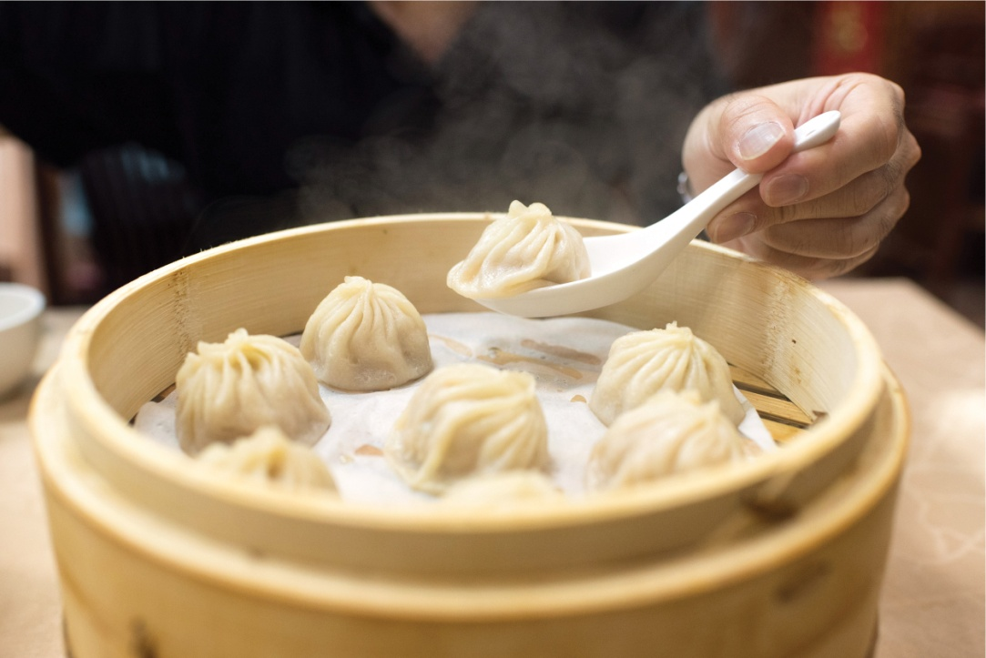
I’m starving.
我饿死了。
Wǒ è sǐ le.

Slide 5
It’s awfully hot today.
今天热死了。
Jīntiān rè sǐ le.

Slide 6
死 (sǐ) often follows an adjective with a pejorative meaning and therefore the combination carries a negative connotation.
Occasionally, however, it may also be used in a positive context.

Slide 7
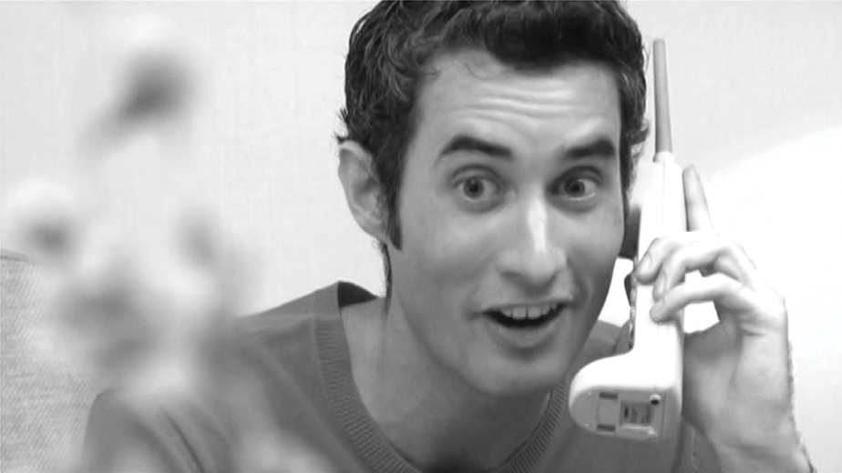
He was incredibly happy to hear about this.
知道了这件事，他高兴死了。
Zhīdào le zhè jiàn shì, tā gāoxìng sǐ le.

Slide 8
Times of Actions
次 (cì) is the measure word most frequently used to indicate that an action is performed a certain number of times.
The “number + 次 (cì)” combination follows the verb.

Slide 9
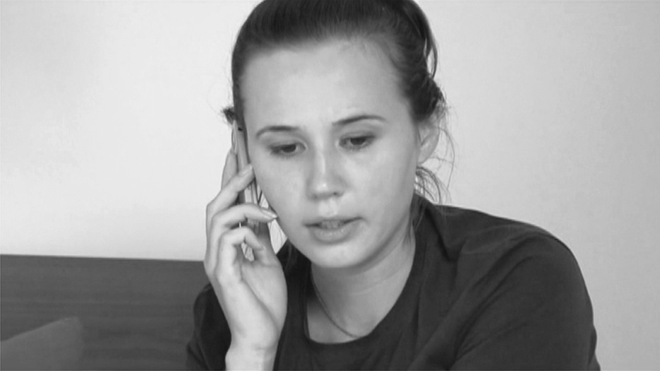
I made two phone calls in the morning.
上午我打了两次电话。
Shàngwǔ wǒ dǎ le liǎng cì diànhuà.

Slide 10
I took the medicine three times yesterday.
昨天我吃了三次药。
Zuótiān wǒ chī le sān cì yào.

Slide 11
If the object is not a person or a place, 次 (cì) should be placed between the verb and the object.
If the object represents a person or a place, 次 (cì) can go either between the verb and the object or after the object.

Slide 12
A: Last year I went to China once. How about you?
去年我去了一次中国。你呢？
Qùnián wǒ qù le yí cì Zhōngguó. Nǐ ne?
B: Last year I went to China twice.
去年我去了中国两次。
Qùnián wǒ qù le Zhōngguó liǎng cì.

Slide 13
A: I went looking for Dr. Wang three times yesterday.
昨天我找了三次王医生。
Zuótiān wǒ zhǎo le sān cì Wáng yīshēng.
B: Is that right? I also went looking for Dr. Wang three times yesterday.
是吗？昨天我也找了王医生三次。
Shì ma? Zuótiān wǒ yě zhǎo le Wáng yīshēng sān cì.

Slide 14
If the object is a personal pronoun, however, 次 (cì) must follow the object.

Slide 15
Yesterday I went looking for him twice, but he was not in either time.
我昨天找了他两次，他都不在。
Wǒ zuótiān zhǎo le tā liǎng cì, tā dōu bú zài.

Slide 16
遍 (biàn) is another measure word for occurrences of actions,
but it pertains to the entire course of the action from the beginning to the end.

Slide 17
Please read the text (from the beginning to the end) once
请你念一遍课文。
Qǐng nǐ niàn yí biàn kèwén.

Slide 18
Nouns denoting body parts involved in the actions can also sometimes serve as measure words for occurrences of actions.

Slide 19
I ate a few mouthfuls last night…
昨天晚上我吃了几口…
Zuótiān wǎnshang wǒ chī le jǐ kǒu…

Slide 20
Indicating the beginning of an action using 起来 (qi lai)
起来 (qi lai) indicates the moment when something static becomes dynamic
it signifies the beginning of an action or state.

Slide 21
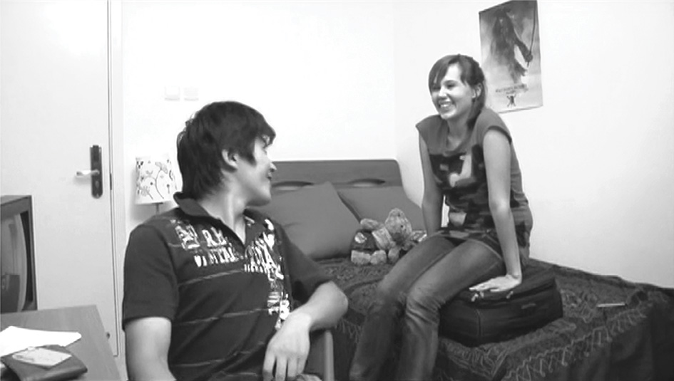
We began chatting as soon as we met.
我们一见面就聊了起来。
Wǒmen yí jiàn miàn jiù liáo le qi lai

Slide 22
He began to write a letter as soon as he got home.
他一回家就写起信来。
Tā yì huí jiā jiù xiě qi xìn lai.

Slide 23
Note that the object is placed between 起 (qi) and 来 (lai), rather than after 起来 (qi lai).

Slide 24
The students started to play ball after the class was over.
下了课以后，学生们打起球来。
Xià le kè yǐhòu, xuésheng men dǎ qi qiú lai.

Slide 25
把 (bǎ) Construction
Subject + 把 (bǎ) + Object + Verb + Other Element (Complement/了{le}, etc.)

Slide 26
In the 把 (bǎ) construction, what follows the position 把 (bǎ) and precedes the verb serves as both the object of 把 (bǎ) and the object of the verb.
In general, a sentence in the 把 (bǎ) construction highlights the subject’s disposal of or impact upon the object, with the result of the disposal or impact indicated by the element following the verb.

Slide 27
我把你要的书找到了。
Wǒ bǎ nǐ yào de shū zhǎo dào le.
I have found the books that you wanted.
The resultative complement 到 (dào) serves as the “other element.”

Slide 28
The resultative complement 错 (cuò) serves as the “other element.”
the subject 你 (nǐ) exerts an impact on the character through the action of 写 (xiě), of which 错 (cuò) is the result.
你把这个字写错了。
Nǐ bǎ zhè ge zì xiě cuò le.
You wrote this character incorrectly.

Slide 29
Please pass me that pair of pants.
请把那条裤子给我。
Qǐng bǎ nà tiáo kùzi gěi wǒ.
The indirect object 我 (wǒ) serves as the “other element.”

Slide 30
Would you take a look at this text?
你把这篇课文看看。
Nǐ bǎ zhè piān kèwén kàn kan.
The reduplicated verb 看 (kàn) serves as the “other element.”

Slide 31
Finish up this cup of coffee!
把这杯咖啡喝了！
Bǎ zhè bēi kāfēi hē le!

Slide 32
How did you manage to forget your girlfriend’s birthday?
你怎么把女朋友的生日忘了？
Nǐ zěnme bǎ nǚpéngyou de shēngrì wàng le?

Slide 33
Compare the following two sentences:
老王给了小张一些钱。
Lǎo Wáng gěi le Xiǎo Zhāng yì xiē qián.
Old Wang gave Little Zhang some money.
老王把钱给小张了。
Lǎo Wáng bǎ qián gěi Xiǎo Zhāng le.
Old Wang gave the money to Little Zhang.

Slide 34
If the subject of a sentence is given, the object is something known to both the speaker and listener, and the verb is followed by a complement in the form of a prepositional phrase with 在 (zài) or 到 (dào), that sentence must appear in the 把 (bǎ) construction.

Slide 35
Put the pen on the desk.
CORRECT:
INCORRECT:
你把笔放在桌子上。
Nǐ bǎ bǐ fàng zài zhuōzi shang.
你放笔在桌子上。
Nǐ fàng bǐ zài zhuōzi shang.

Slide 36
Please deliver this letter to the attorney’s office.
CORRECT:
INCORRECT:
请你把这封信送到律师的办公室。
Qǐng nǐ bǎ zhè fēng xìn sòng dào lǜshī de bàngōngshì.
请你送这封信到律师的办公室。
Qǐng nǐ sòng zhè fēng xìn dào lǜshī de bàngōngshì.

Slide 37
The preposition 对 (duì)
The preposition 对 (duì) introduces the person or thing that receives a certain effect from someone or something else.
Its English translation varies depending on the context.

Slide 38
This medicine is very effective for colds.
这种药对感冒很有用。
Zhè zhǒng yào duì gǎnmào hěn yǒu yòng.

Slide 39
Her computer is very useful for her pronunciation practice.
她的电脑对她练习发音很有用。
Tā de diànnǎo duì tā liànxí fāyīn hěn yǒu yòng.

Slide 40
You must be allergic to something.
你一定对什么东西过敏了。
Nǐ yídìng duì shénme dōngxi guòmǐn le.

Slide 41
越来越… (yuè lái yuè...)
The structure 越来越… (yuè lái yuè...) denotes a progressive change over time.

Slide 42
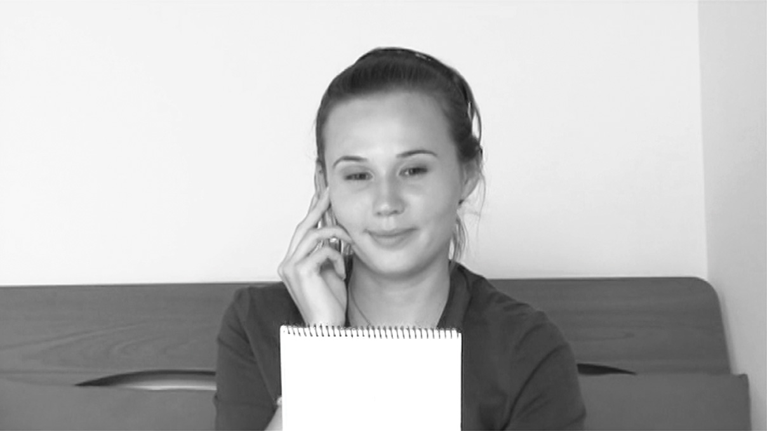
Li You’s Chinese is getting better and better.
李友的中文越来越好。
Lǐ Yǒu de Zhōngwén yuè lái yuè hǎo.

Slide 43
The weather is becoming warmer and warmer.
天气越来越暖和了。
Tiānqì yuè lái yuè nuǎnhuo le.

Slide 44
My cousin is doing worse and worse on her exams.
表姐考试考得越来越糟糕。
Biǎojiě kǎo shì kǎo de yuè lái yuè zāogāo.

Slide 45
再说 (zàishuō)
The expression 再说 (zàishuō) introduces an additional reason for an action that has been taken or decision that has been made.
It is different from 再 + 说 (zài + shuō, to say again).

Slide 46
A: Why aren’t you going to New York?
B: I don’t have the time, and besides, I don’t have the money.
我没有时间，再说，也没有钱。
Wǒ méiyǒu shíjiān, zàishuō, yě méiyǒu qián.
你为什么不去纽约？
Nǐ wèishénme bú qù Niǔyuē?

Slide 47
I didn’t like the dance party tonight. The music was lousy. Besides, there were too few people there.
我不喜欢今天晚上的舞会，音乐不好，再说人也太少。
Wǒ bù xǐhuan jīntiān wǎnshang de wǔhuì, yīnyuè bù hǎo, zàishuō rén yě tài shǎo.

Slide 48
再说 (zàishuō) = 而且 (érqiě)
Like 再说 (zàishuō), 而且 (érqiě, moreover; in addition) also conveys the idea of “furthermore, additionally”.

Slide 49
而且 (érqiě) can be replaced with 再说 (zàishuō)
A: Why aren’t you going to New York?
你为什么不去纽约？
Nǐ wèishénme bú qù Niǔyuē?
B: I don’t have the time. Besides, I don’t have the money.
我没有时间，而且，也没有钱。
Wǒ méiyǒu shíjiān, érqiě, yě méiyǒu qián.

Slide 50
而且 (érqiě) cannot be replaced with 再说 (zàishuō) This is Mr. Wang. He is not only my teacher but also my friend.
CORRECT:
INCORRECT:
这是王先生，他不但是我的老师，而且也是我的朋友。
Zhè shì Wáng xiānsheng, tā búdàn shì wǒ de lǎoshī, érqiě yě shì wǒ de péngyou.
这是王先生，他不但是我的老师，再说也是我的朋友。
Zhè shì Wáng xiānsheng, tā búdàn shì wǒ de lǎoshī, zàishuō yě shì wǒ de péngyou.

Slide 51
看医生 (kàn yīshēng) and 看病 (kàn bìng)
The two phrases 看医生 (kàn yīshēng) and 看病 (kàn bìng) are interchangeable
in northern China 看病 (kàn bìng) is much more common than 看医生 (kàn yīshēng).

Slide 52
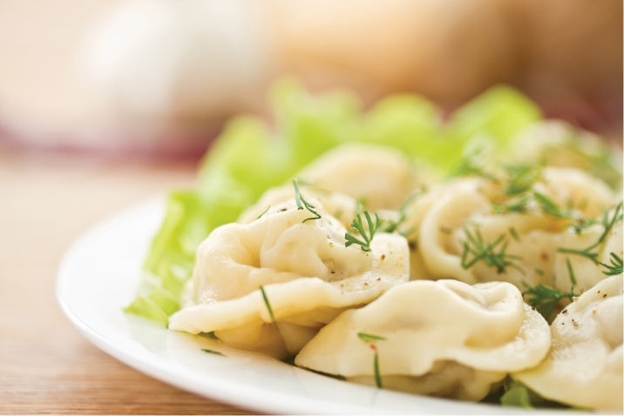
我尝尝 (Wǒ cháng chang) vs.我试试 (Wǒ shì shi)
When tasting or trying the flavor of a food or drink, one says 我尝尝 (Wǒ cháng chang, Let me taste it) instead of 我试试 (Wǒ shì shi, Let me try),
However, one says 试试 (shì shi) when trying most other things.

Slide 53
谢谢 再见!

