Slide 1
Lesson 14 生日晚会
Shēngrì wǎnhuì Birthday Party

Slide 2
呢 (ne) Indicating an Action in Progress
呢 (ne), at the end of a sentence, indicates that the action is in progress.
It is like 在 (zài), which is never used at the end of a sentence, but rather before a verb.

Slide 3
你写什么呢？
Nǐ xiě shénme ne?
What are you writing?

Slide 4
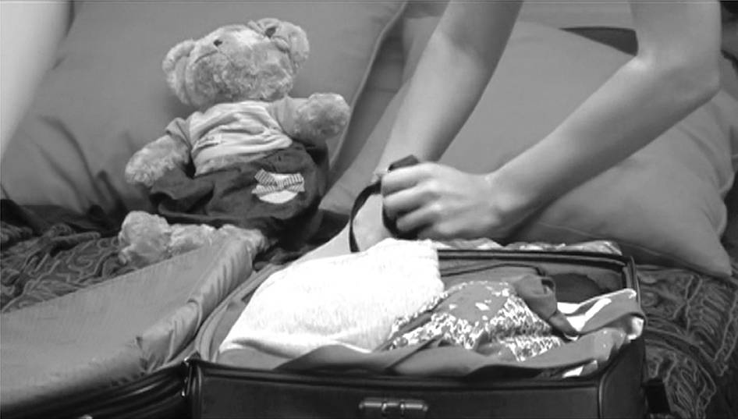
你找什么呢？
Nǐ zhǎo shénme ne?
What are you looking for?

Slide 5
呢 (ne) can be used in conjunction with 在 (zài):
你在写什么呢？
Nǐ zài xiě shénme ne?
What are you writing?
你在找什么呢？
Nǐ zài zhǎo shénme ne?
What are you looking for?

Slide 6
在 (zài) can be preceded by 正 (zhèng).
我昨天给他打电话的时候，他正在做功课呢。
Wǒ zuótiān gěi tā dǎ diànhuà de shíhou, tā zhèngzài zuò gōngkè ne.
When I called him yesterday, he was right in the middle of doing his homework.
The phrase 正在 (zhèngzài) places extra emphasis on the progressive nature of an action.

Slide 7
別去找他，他正在睡觉呢。
Bié qù zhǎo tā, tā zhèngzài shuì jiào ne.
Don’t go look for him. He is sleeping.

Slide 8
Verbal Phrases and Subject-Predicate Phrases Used as Attributives
In Chinese, attributives, often followed by the particle 的 (de),
always appear before the elements that they modify.
Verbs, verbal phrases, and subject-object phrases can all serve as attributives.

Slide 9
吃的东西
chī de dōngxi
things to eat

Slide 10
穿的衣服
chuān de yīfu
clothes to wear, or clothes being worn

Slide 11
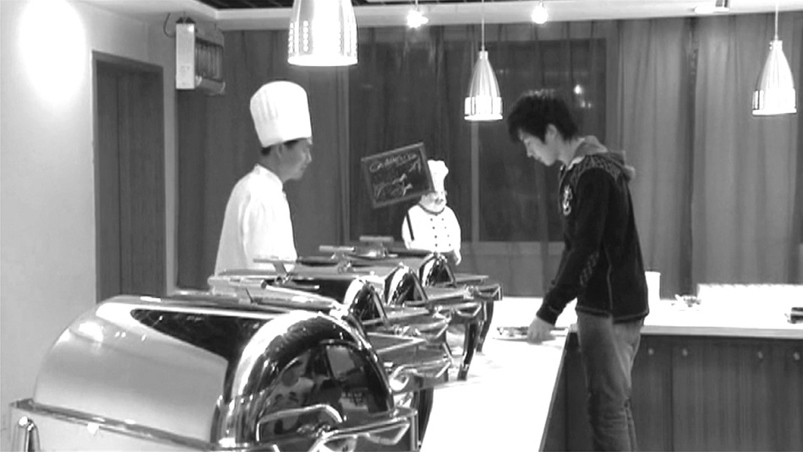
新买的饭卡
xīn mǎi de fànkǎ
newly-bought meal cards

Slide 12
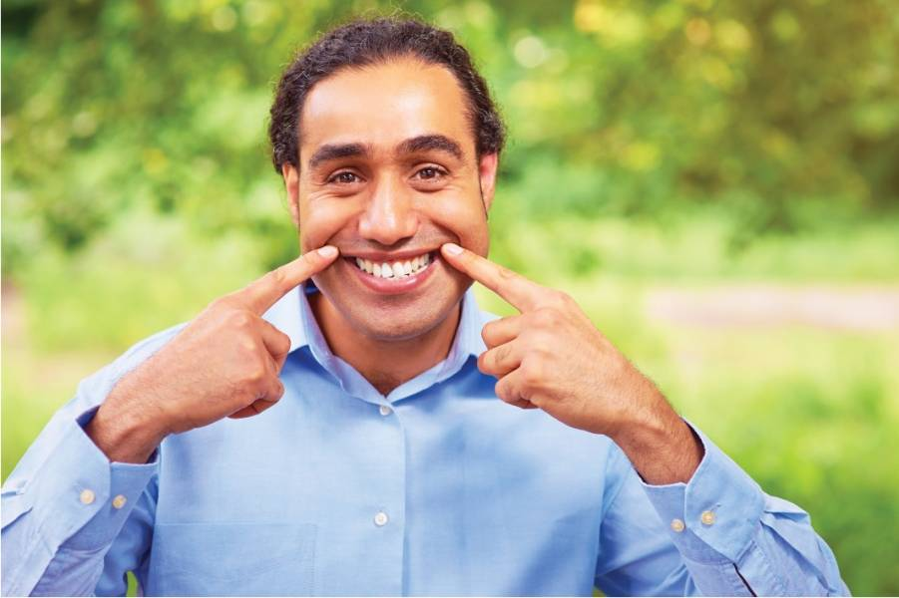
昨天来的同学
zuótiān lái de tóngxué
the classmate who arrived yesterday

Slide 13
以前认识的朋友
yǐqián rènshi de péngyou
the friend one got acquainted with in the past

Slide 14
我妈妈做的豆腐
wǒ māma zuò de dòufu
the tofu dish that my mother makes/made

Slide 15
老师给我们的功课
lǎoshī gěi wǒmen de gōngkè
the homework the teacher assigned us

Slide 16
朋友送的苹果
péngyou sòng de píngguǒ
the apples given by a friend

Slide 17
请你跳舞的那个人
qǐng nǐ tiào wǔ de nà gè rén
that person who asked you to dance

Slide 18
我妹妹爱的那个很帅的男人
wǒ mèimei ài de nà ge hěn shuài de nánren
that very handsome man that my sister loves

Slide 19
Time Duration
Subject + Verb + (Object + Verb) +
(了) (le) + Duration of time

Slide 20
老高想在上海住一年。
Lǎo Gāo xiǎng zài Shànghǎi zhù yì nián.
Old Gao wishes to live in Shanghai for a year.
[Sentences in this pattern must be in the affirmative.]

Slide 21
我每天在书店工作三个钟头。
Wǒ měitiān zài shūdiàn gōngzuò sān ge zhōngtóu.
I work in a bookstore for three hours every day.

Slide 22
昨天下雪下了二十分钟。
Zuótian xià xuě xià le èrshí fēnzhōng.
It snowed for twenty minutes yesterday
[If the verb takes an object, the verb has to be repeated.]

Slide 23
Subject + Verb + (了) (le) + Duration of time + (的) (de) + Object
If the verb has an object, the following alternative pattern can be used to express the same idea.

Slide 24
昨天下了二十分钟（的）雪。
Zuótian xià le èrshí fēnzhōng (de) xuě.
It snowed for twenty minutes yesterday.

Slide 25
你上暑期班上了多长时间？
Nǐ shàng shǔqī bān shàng le duō cháng shíjiān?
How long were you in summer school?

Slide 26
我上了四个星期
（的）暑期班。
Wǒ shàng le sì ge xīngqī (de) shǔqī bān.
I was in summer school for four weeks.

Slide 27
Sentences with 是…的 (shì...de)
To describe or inquire about the time, the place, the manner, or the initiator of an action that we know already happened, we need to use the 是…的 (shì...de) structure.
The use of 是 (shì), however, is optional.

Slide 28
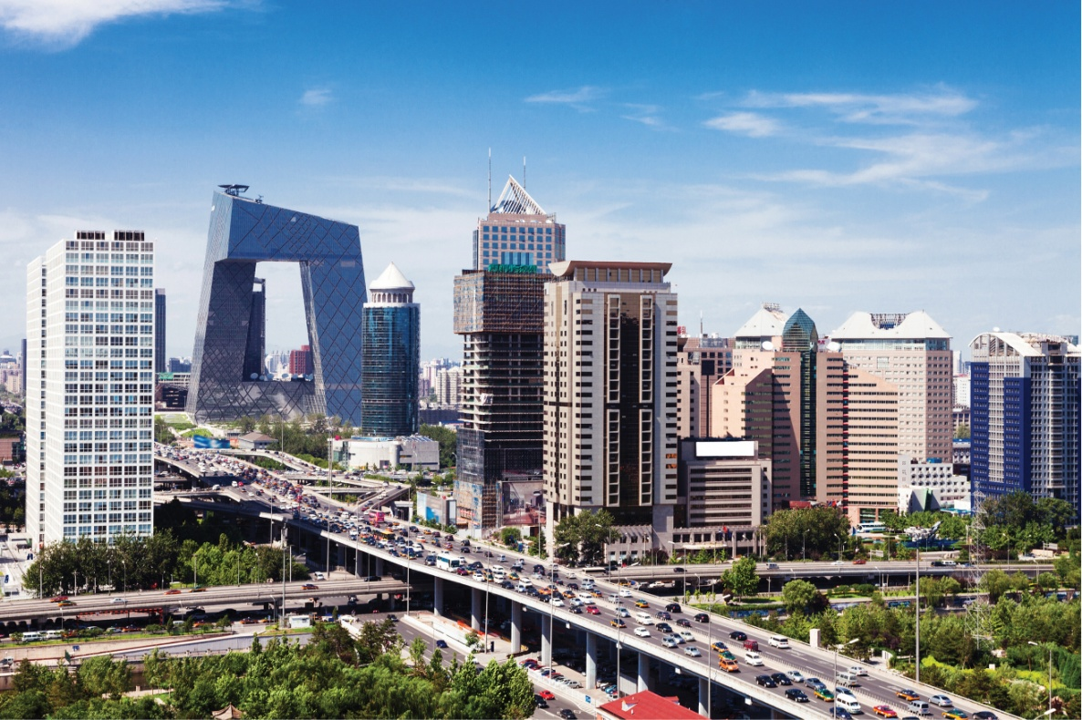
A: 你去过北京吗？
Nǐ qù guo Běijīng ma?
Have you been to Beijing?
B: 我去过北京。
Wǒ qù guo Běijīng.
Yes, I’ve been to Beijing.

Slide 29
Person A now becomes aware of Person B’s action of 去北京 (qù Běijīng, went to Beijing), and wants to find out when that action was performed:
B: 我是跟我表姐一起去的。
Wǒ shì gēn wǒ biǎojiě yìqǐ qù de.
I went with my cousin.
A: 你是跟谁一起去的？
Nǐ shì gēn shéi yìqǐ qù de?
With whom did you go?

Slide 30
Person A now wants to find out when that action was performed:
A: 你们是什么时候去的？
Nǐmen shì shénme shíhou qù de? (When did you go?)
B: 我们是寒假去的 。Wǒmen shì hánjià qù de. (We went during the winter break.)

Slide 31
A: 你们是怎么去的？Nǐmen shì zěnme qù de? (How did you go?)
B: 我们是坐飞机去的。Wǒmen shì zuò fēijī qù de. (We went there by airplane.)

Slide 32
A: 你看过这本书吗？Nǐ kàn guo zhè běn shū ma? (Have you read this book?)
B: 看过。
Kàn guo. (Yes, I have.)

Slide 33
A: 是什么时候看的？
Shì shénme shíhou kàn de?
When did you watch it?
[A already knows that the action 看 (kàn) was completed.]
B: 上个周末看的。
Shàng ge zhōumò kàn de.
I watched it last weekend.
[It was last weekend that I watched it.]

Slide 34
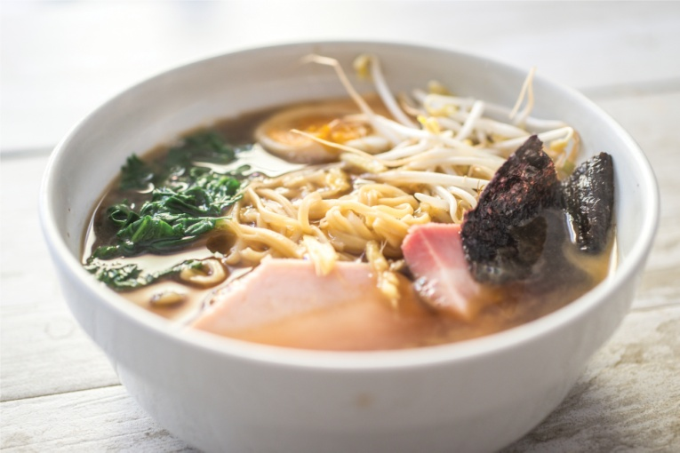
A: 你吃饭了吗？
Nǐ chī fàn le ma? (Have you eaten yet?)
B: 吃了。
Chī le. (Yes, I have.)
[The action 吃 (chī) is now known.]
A: 在哪儿吃的？
Zài nǎr chī de? (Where did you eat?)
B: 在学生餐厅吃的。Zài xuéshēng cāntīng chī de.

Slide 35
A: 你学过电脑吗？Nǐ xué guo diànnǎo ma? (Have you ever studied computers?)
B: 学过。Xué guo. (Yes, I have.)
A: 是跟谁学的？Shì gēn shéi xué de? (With whom did you study?)
B: 是跟王老师学的。Shì gēn Wáng lǎoshī xué de. (With Teacher Wang.)

Slide 36
还 (hái, still)
上午十一点了，他还在睡觉。
Shàngwǔ shíyī diǎn le, tā hái zài shuì jiào.
It’s 11 a.m., and he is still sleeping.

Slide 37
今天的功课，我还没写完。
Jīntiān de gōngkè, wǒ hái méi xiě wán.
I’m still not done with today’s homework.

Slide 38
这个语法老师教了，可是我还不懂。
Zhè ge yǔfǎ lǎoshī jiāo le, kěshì wǒ hái bù dǒng.
The teacher has gone over this grammar point, but I still don’t understand it.

Slide 39
又…又… yòu...yòu... both...and...
The two adjectives used in this structure are either both positive or both negative in meaning

Slide 40
both adjectives are positive in meaning
又聪明又用功
yòu cōngming yòu yònggōng
smart and hardworking

Slide 41
both adjectives are negative in meaning
又多又难
yòu duō yòu nán
too much and difficult

Slide 42
casual greeting
In Chinese culture, a common and cordial way to greet someone is by asking a casual question about the routine activity that the other person is engaged in at the moment.
As the situation is usually very obvious, the speaker does not expect, and is not interested in, an elaborate answer. Nor are these questions considered intrusive or personal.

Slide 43
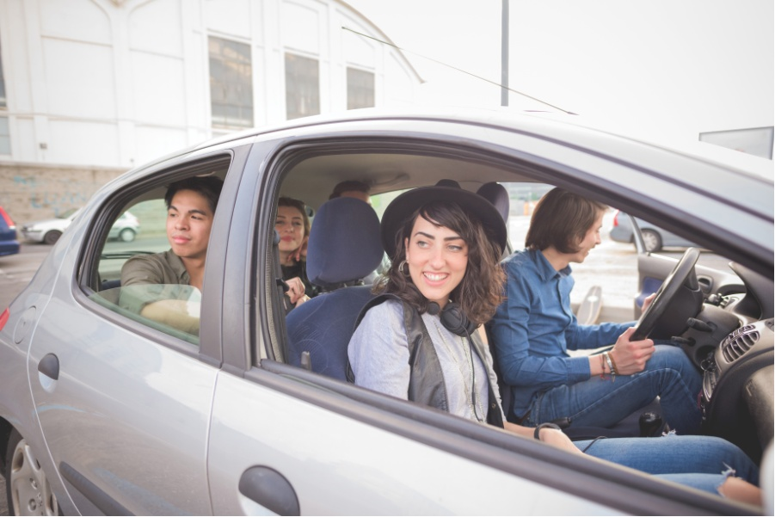
not only acknowledges the visitors’ arrival, but also serves as a casual greeting.
你们来了。
Nǐmen lái le.
You’re here.

Slide 44
upon seeing a friend on her way to a grocery store, one could ask
买菜呀?
Mǎi cài ya?
Going grocery shopping, eh?

Slide 45
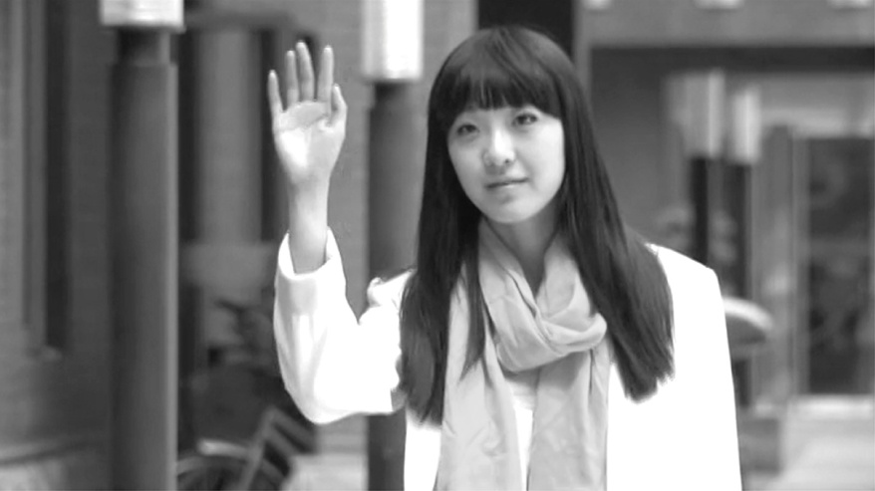
Running into a fellow student who is leaving a classroom, one could ask
下课了?
Xià kè le?
Just had your class?

Slide 46
the colloquial equivalent
钟头 (zhōngtóu)
小时 (xiǎoshí).

Slide 47
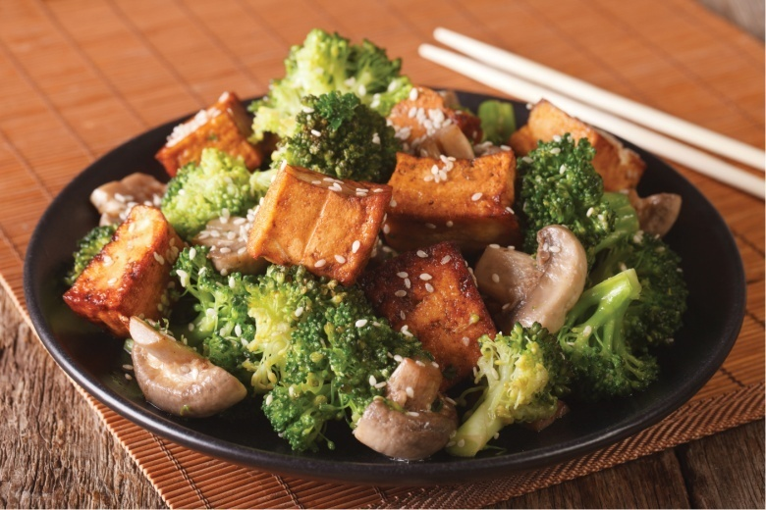
以为 (yǐwéi) is often used to signify an understanding or judgment which has proved to be erroneous.
If someone has realized that she was mistaken in assuming someone else to be vegetarian, she could say to that person:
我以为你吃素。
Wǒ yǐwéi nǐ chī sù.
I thought you were a vegetarian.

Slide 48
The Chinese words 班 (bān) and 课 (kè) denote two different concepts that are represented by the same word, “class,” in English.
课 (kè) refers to a course or a meeting time for the course.
我今天有电脑课。
Wǒ jīntiān yǒu diànnǎo kè.
I have a computer class today.
班 (bān) is the term for the group of students who take a course together.
我的电脑班有二十个人。
Wǒ de diànnǎo bān yǒu èrshí ge rén.
There are twenty people in my computer class.

Slide 49
The character 长 (zhǎng/cháng) has two different meanings and pronunciations.
Verb:
zhǎng
to grow
Adjective
cháng
long

Slide 50
谢谢 再见!

