Slide 1
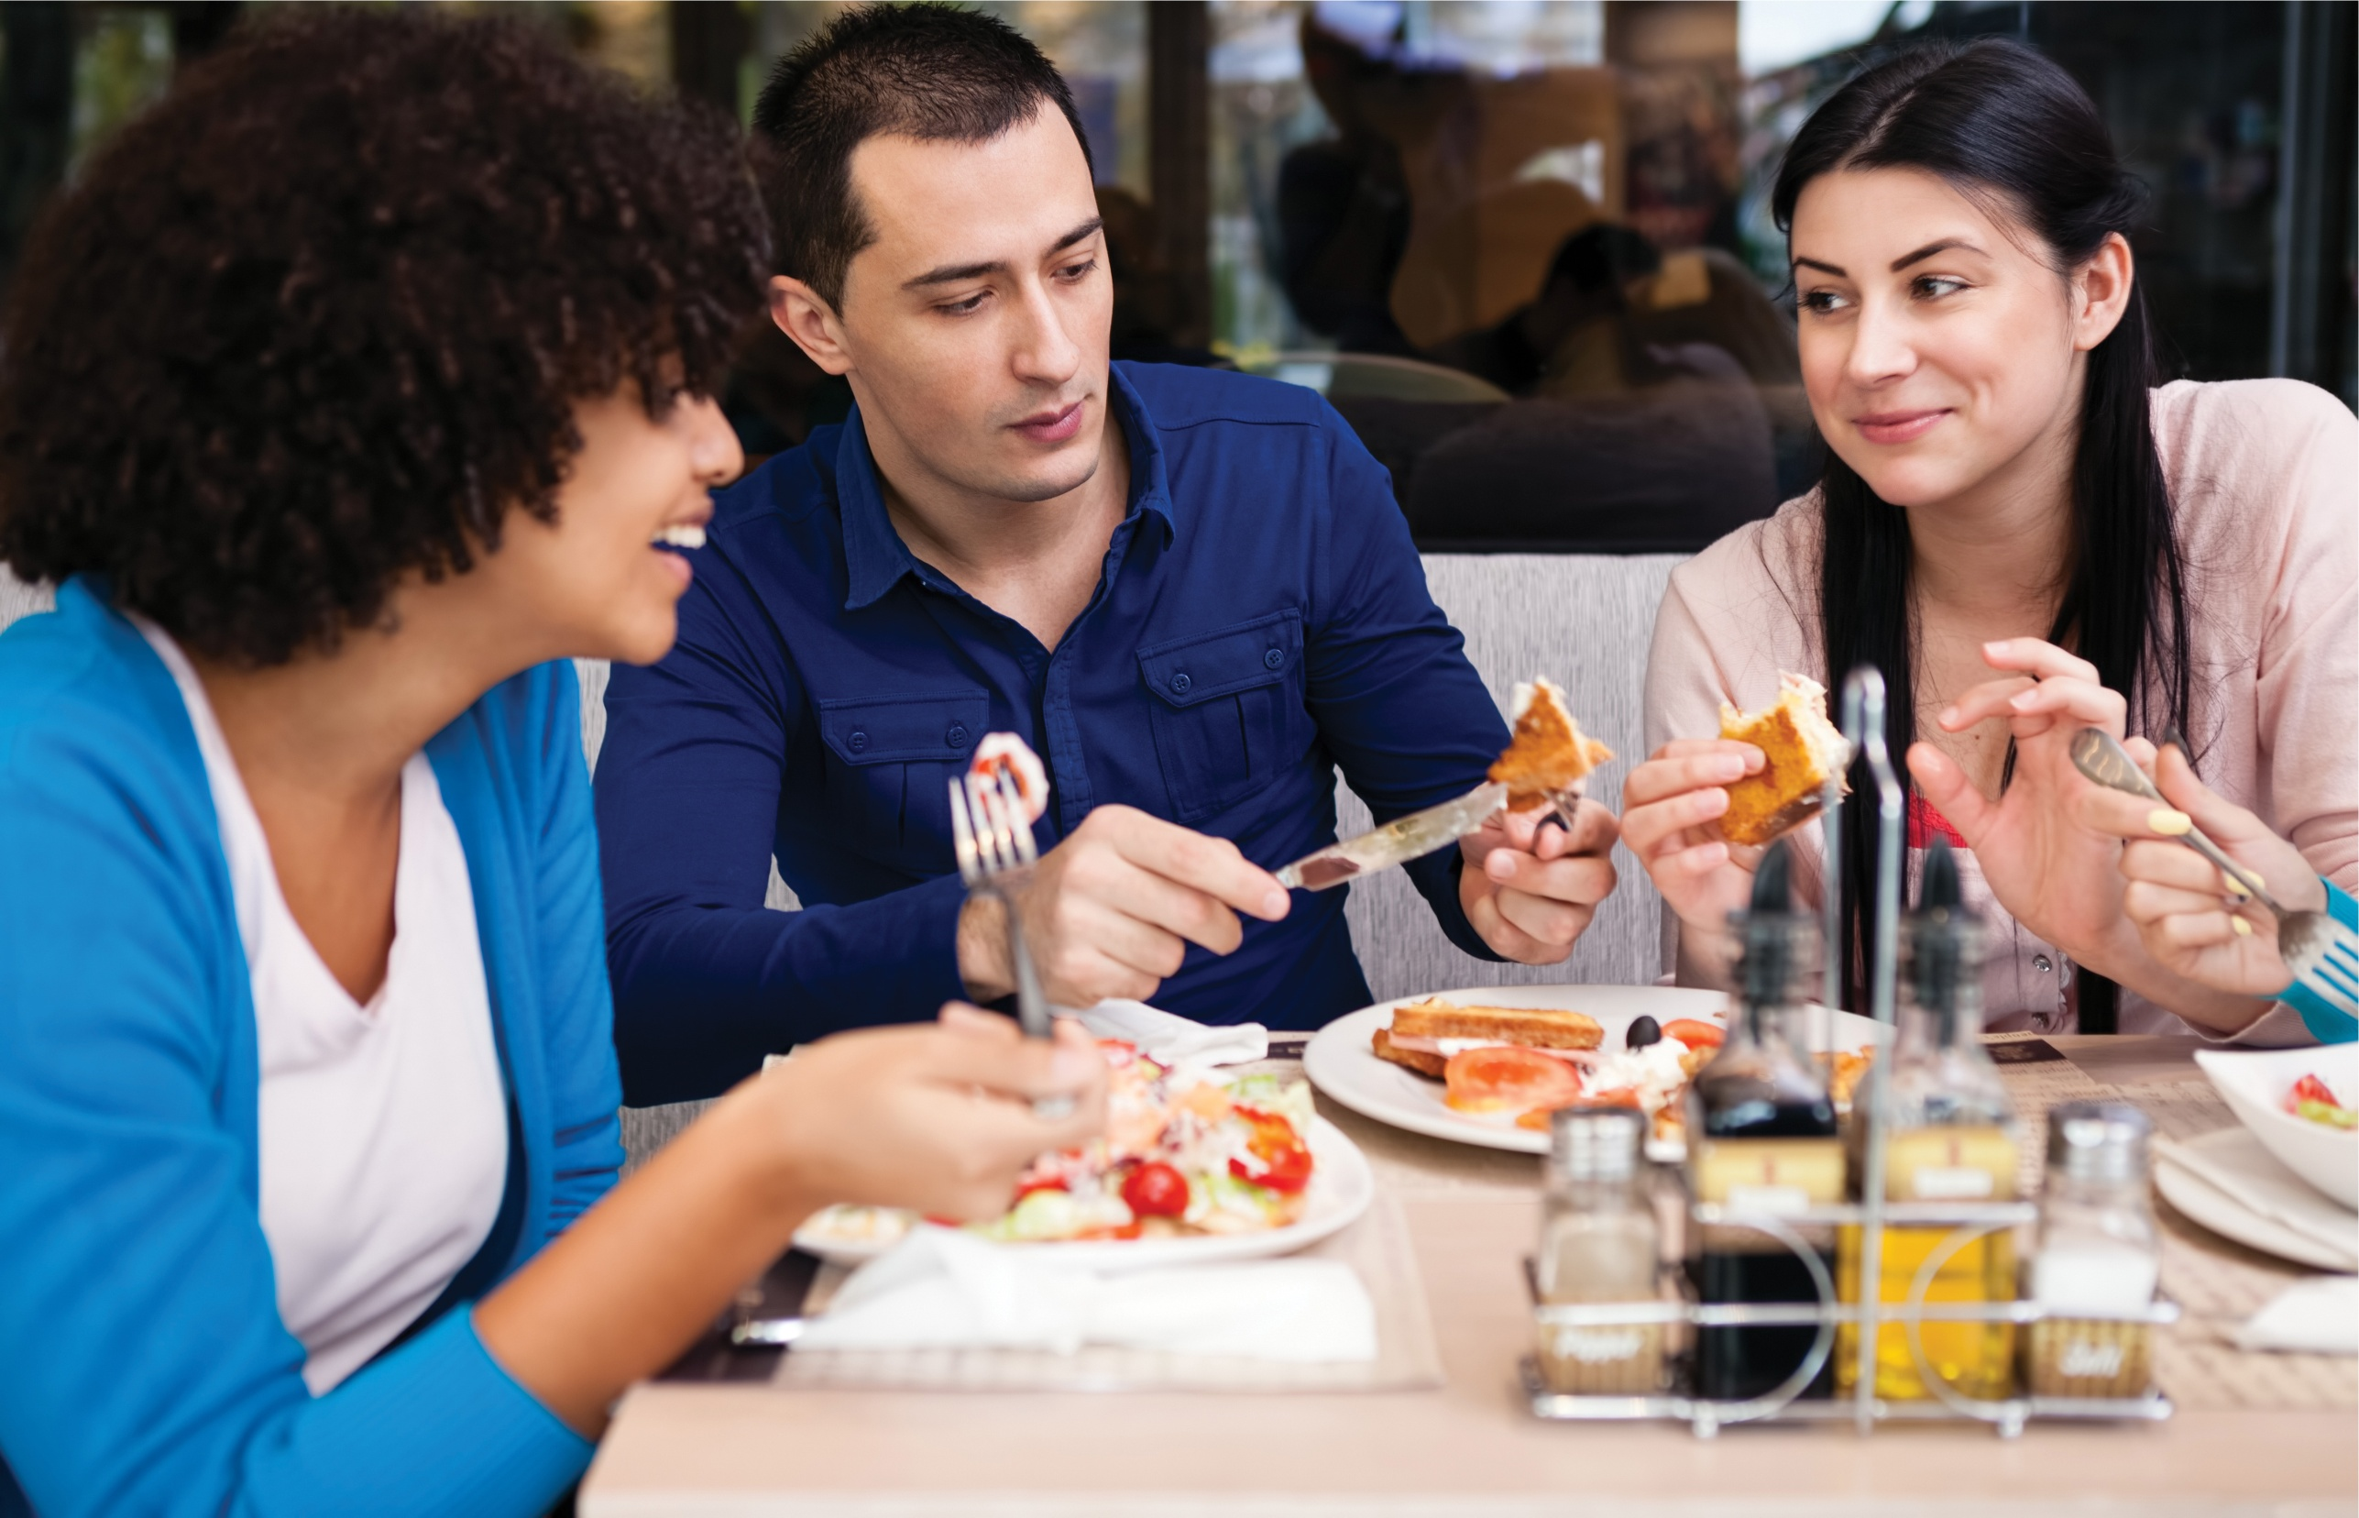
Lesson 12 吃饭 Chī fàn Dining

Slide 2
一…也/都…不/没… (yì...yě/dōu...bù/méi)
These structures are used to form an emphatic negation meaning “not at all” or “not even one.”

Slide 3
Subject + 一(yī) + Measure Word + Object + 也/都(yě/dōu) + 不/没 (bù/méi) + Verb
小李一个朋友也没有。
Xiǎo Lǐ yí ge péngyou yě méiyǒu.
Little Li does not have a single friend.
If the noun after 一 (yī) is countable, a proper measure word should be used between 一 (yī) and the noun.

Slide 4

爸爸今天一杯茶都没喝。
Bàba jīntiān yì bēi chá dōu méi hē.
My father didn’t have a single cup of tea today.
If the noun after 一 (yī) is countable, a proper measure word should be used between 一 (yī) and the noun.

Slide 5
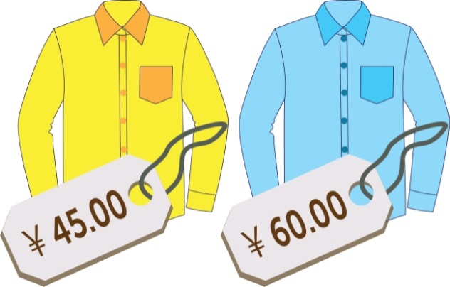
Topic (+ Subject) + 一(yī) + Measure Word + 也/都(yě/dōu) + 不/没 (bù/méi) + Verb
这些衬衫我一件也不喜欢。
Zhè xiē chènshān wǒ yí jiàn yě bù xǐhuan.
I don’t like any of these shirts.
If the noun after 一 (yī) is countable, a proper measure word should be used between 一 (yī) and the noun.

Slide 6


哥哥的鞋，弟弟一双都不能穿。
Gēge de xié, dìdi yì shuāng dōu bù néng chuān.
The younger brother cannot wear any of his older brother’s shoes.
If the noun after 一 (yī) is countable, a proper measure word should be used between 一 (yī) and the noun.

Slide 7
Subject + 一点儿 (yì diǎnr) + Object + 也/都 (yě/dōu) + 不/没 (bù/méi) + Verb
他去了商店，可是一点儿东西也没买。
Tā qù le shāngdiàn, kěshì yì diǎnr dōngxi yě méi mǎi.
He went to the store, but he didn’t buy anything at all.
If the noun is uncountable, the phrase 一点儿 (yì diǎnr) is usually used instead.

Slide 8
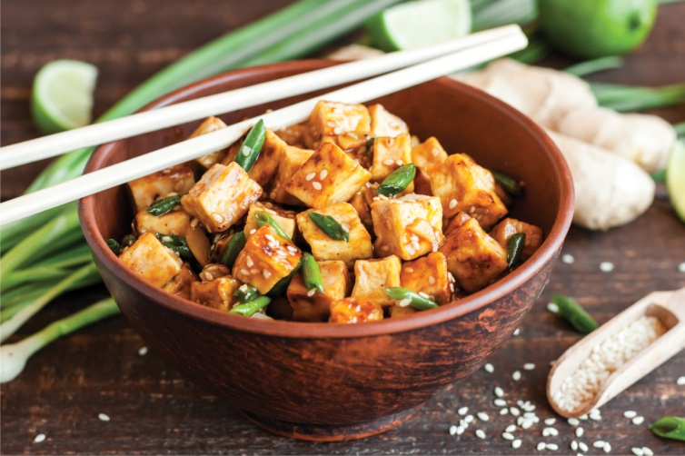
妈妈做菜一点儿味精都不放。
Māma zuò cài yì diǎnr wèijīng dōu bú fàng.
Mom doesn’t use any MSG in her cooking.
If the noun is uncountable, the phrase 一点儿 (yì diǎnr) is usually used instead.

Slide 9

The construction 一点儿 (yìdiǎnr) + 也/都 (yě/dōu) + 不 (bù/méi) can also be used before an adjective to express emphatic negation.
这儿的冬天一点儿也不冷。
Zhèr de dōngtiān yì diǎnr yě bù lěng.
Winter here is not cold at all.

Slide 10

那个学校一点儿也不漂亮。
Nà ge xuéxiào yì diǎnr yě bú piàoliang.
That school is not pretty at all.

Slide 11
这杯冰茶一点儿都不好喝。
Zhè bēi bīngchá yì diǎnr dōu bù hǎohē.
This glass of iced tea doesn’t taste good at all.

Slide 12
Adverb 多/少 (duō/shǎo) + V
多 (duō) and 少 (shǎo) are two adjectives whose usage is rather unusual.
To express the idea of doing something “more” or “less,” one places 多 (duō) or 少 (shǎo) before the verb.

Slide 13
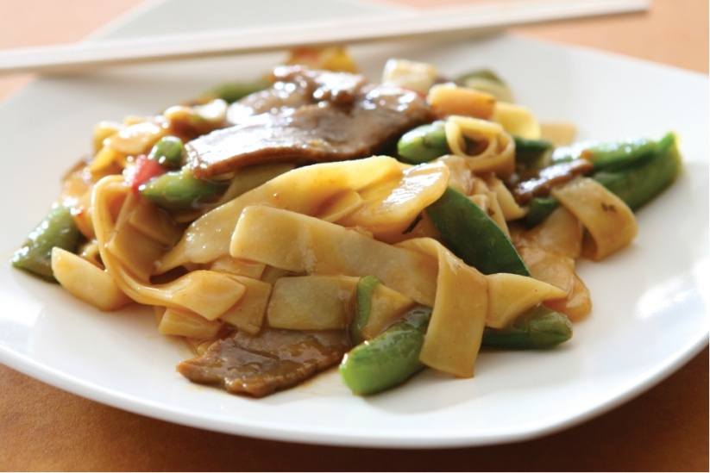
爸爸告诉妈妈做菜的时候少放盐，多放点儿糖。
Bàba gàosu māma zuò cài de shíhou shǎo fàng yán, duō fàng diǎnr táng.
Dad asked Mom to add less salt and more sugar when she cooks.

Slide 14
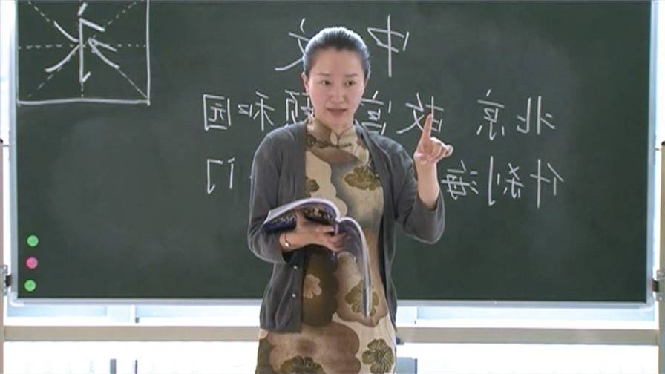
上中文课得多说中文，少说英文。
Shàng Zhōngwén kè děi duō shuō Zhōngwén, shǎo shuō Yīngwén.
In Chinese class, one should speak more Chinese and less English.

Slide 15
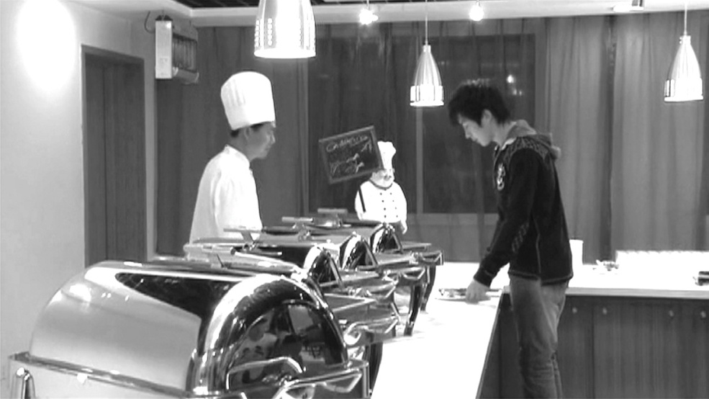
This “多/少 (duō/shǎo) + verb” construction can sometimes denote a deviation from the correct amount or number.
你多找了我一块钱。
Nǐ duō zhǎo le wǒ yí kuài qián.
You gave me one dollar too many.

Slide 16
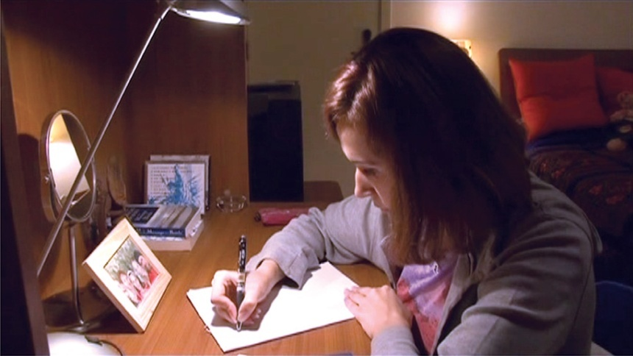
老师说要写五十个字，我写了四十五个，少写了
五个。
Lǎoshī shuō yào xiě wǔshí ge zì, wǒ xiě le sìshíwǔ ge, shǎo xiě le wǔ ge.
The teacher told us to write fifty characters. I wrote forty-five. I was five short.

Slide 17
刚 (gāng) vs. 刚才 (gāngcái)
As an adverb, 刚 (gāng) denotes that the action or change in situation took place in the most recent past.
刚才 (gāngcái) is a noun that refers to the time shortly before the act of speaking.

Slide 18

我哥哥刚从中国来，在这儿一个朋友都没有。
Wō gēge gāng cóng Zhōngguó lái, zài zhèr yí ge péngyou dōu méiyǒu.
My older brother just came from China. He doesn’t have a single friend here.

Slide 19

我刚洗完澡，舒服极了。
Wǒ gāng xǐ wán zǎo, shūfu jí le.
I just showered, and feel so great.

Slide 20
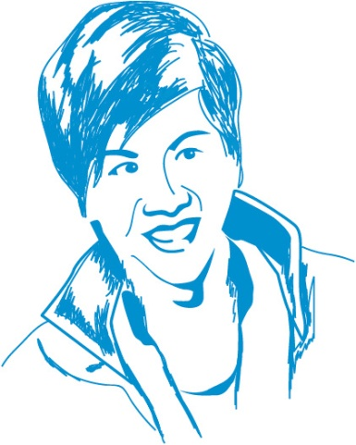
A:
你知道王朋在哪儿吗？
Nǐ zhīdào Wáng Péng zài nǎr ma?
Do you know where Wang Peng is?
B:
他刚才在这儿，我不知道他去哪儿了。
Tā gāngcái zài zhèr, wǒ bù zhīdao tā qù nǎr le.
He was here a moment ago. I don’t know where he went.

Slide 21
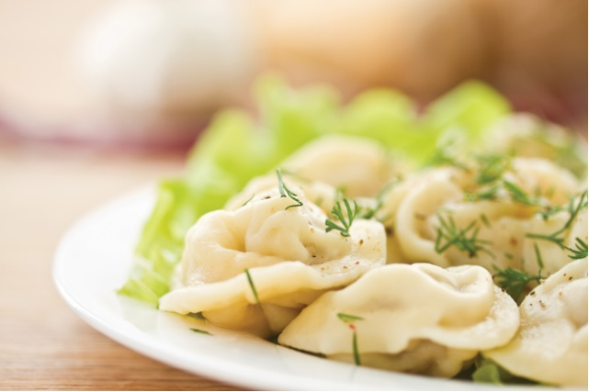
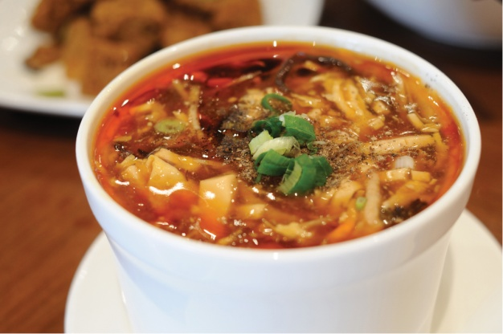
弟弟刚才吃了十五个饺子，喝了两碗酸辣汤。
Dìdi gāngcái chī le shíwǔ ge jiǎozi, hē le liǎng wǎn suānlàtāng.
My younger brother finished fifteen dumplings and two bowls of hot and sour soup a moment ago.

Slide 22

Although 刚 (gāng) and 刚才 (gāngcái) are similar in meaning, they are classified as different parts of speech and are therefore used differently.
刚 (gāng) can be followed by an expression that indicates the duration of time.
他刚走了两天。
Tā gāng zǒu le liǎng tiān.
He left only two days ago.

Slide 23

Unlike 刚才 (gāngcái), 刚 (gāng) cannot be followed by the negation words 不 (bù) or 没 (méi).
A:
你刚才为什么没说？
Nǐ gāngcái wèishénme méi shuō?
Why didn’t you say it a moment ago.
B:
我刚才不想说。
Wǒ gāngcái bù xiǎng shuō.
I didn’t want to say it a moment ago.

Slide 24

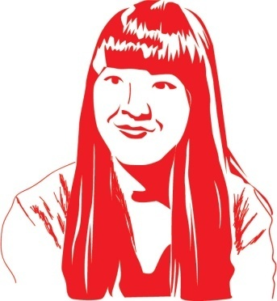
A sentence that includes 刚才 (gāngcái) often ends with了 (le)
A: 你刚才去哪儿了？老师要你去办公室找他。
Nǐ gāngcái qù nǎr le? Lǎoshī yào nǐ qù bàngōngshì zhǎo tā.
Where were you a moment ago? The teacher wanted you to go to his office.
B: 我刚才去图书馆了。
Wǒ gāngcái qù túshūguǎn le.
I went to the library.

Slide 25
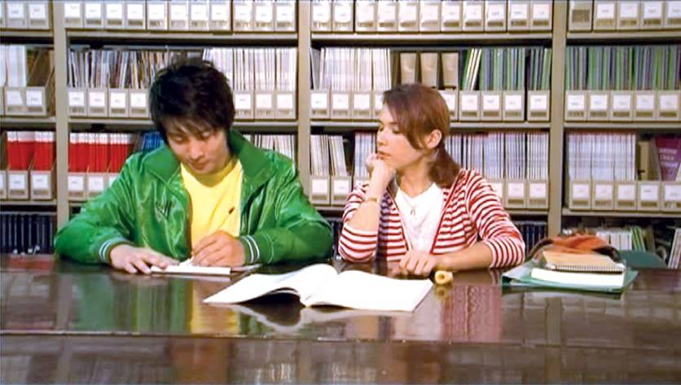
a sentence including 刚 (gāng) cannot have了 (le) at the end
A:
明天的考试你开始准备了吗？
Míngtiān de kǎo shì nǐ kāishǐ zhǔnbèi le ma?
Have you started preparing for tomorrow’s test?
B:
刚开始准备。
Gāng kāishǐ zhǔnbèi.
I just got started.

Slide 26
Resultative Complements
Following a verb, an adjective or another verb can be used to denote the result of the action, hence the term resultative complement.

Slide 27
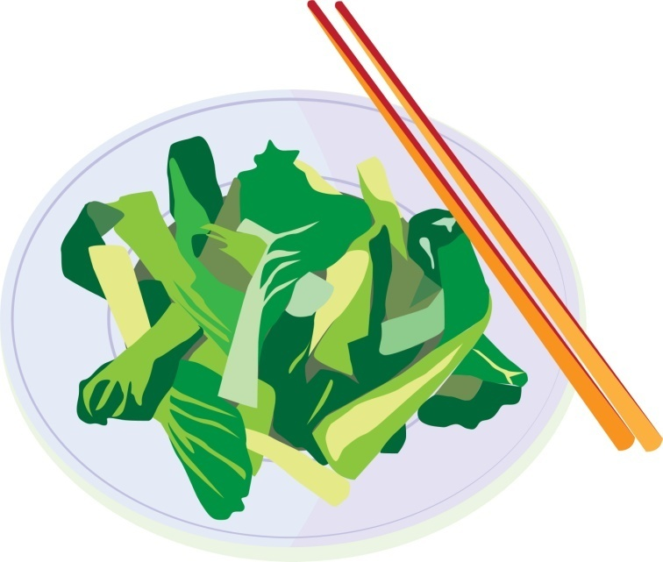
小白菜卖完了。
Xiǎo báicài mài wán le.
Baby bok choy is sold out.

Slide 28

你找错钱了。
Nǐ zhǎo cuò qián le.
You gave me the incorrect change.

Slide 29
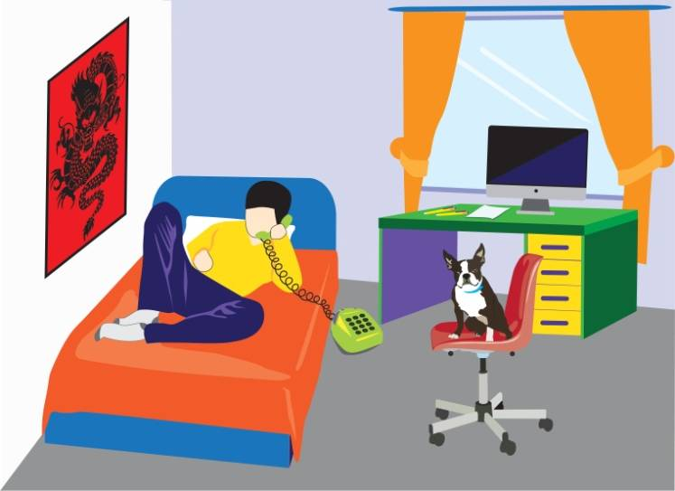
[清楚 qīngchu, clear]
那个人是谁你看清楚了吗?
Nà ge rén shì shéi nǐ kàn qīngchu le ma?
Did you see clearly who that person was?

Slide 30
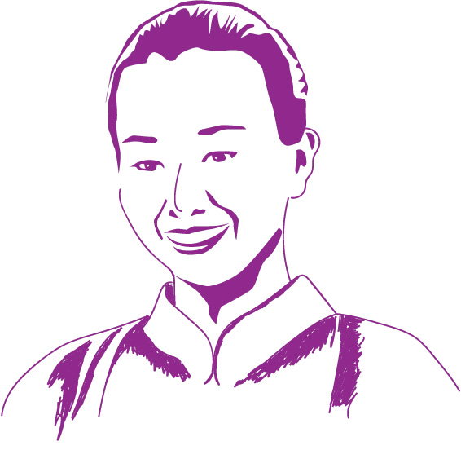
太好了，这个字你写对了。
Tài hǎo le, zhè ge zì nǐ xiě duì le.
Great! You wrote this character correctly.

Slide 31

Generally, the negative form of a resultative complement is formed by placing 没 (méi, no, not) or 没有 (méiyǒu, have not) before the verb.
小白菜还没卖完。
Xiǎo báicài hái méi mài wán.
Baby bok choy is not sold out yet.

Slide 32
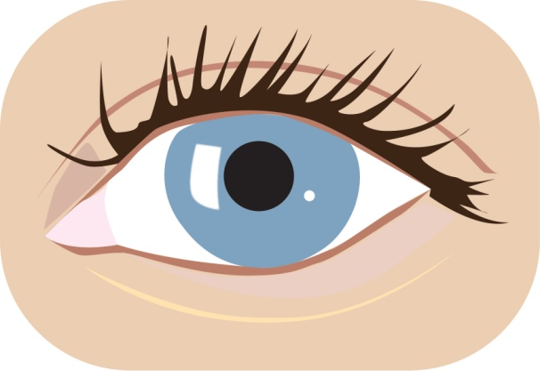
那个人我没看清楚。
Nà ge rén wǒ méi kàn qīngchu.
I didn’t see clearly who that person was.

Slide 33
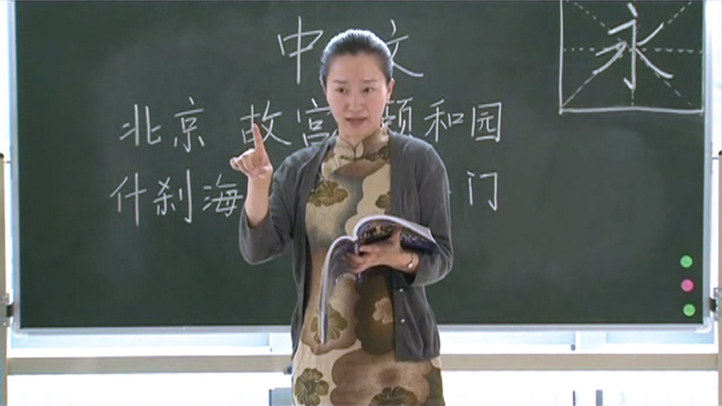
糟糕，这个字你没有写对。
Zāogāo, zhè ge zì nǐ méiyǒu xiě duì.
Yikes! You didn’t write this character correctly.

Slide 34
好 (hǎo) as a Resultative Complement
好 (hǎo) can serve as a complement following a verb, indicating the completion of an action. It often indicates readiness to start the next action or event.

Slide 35
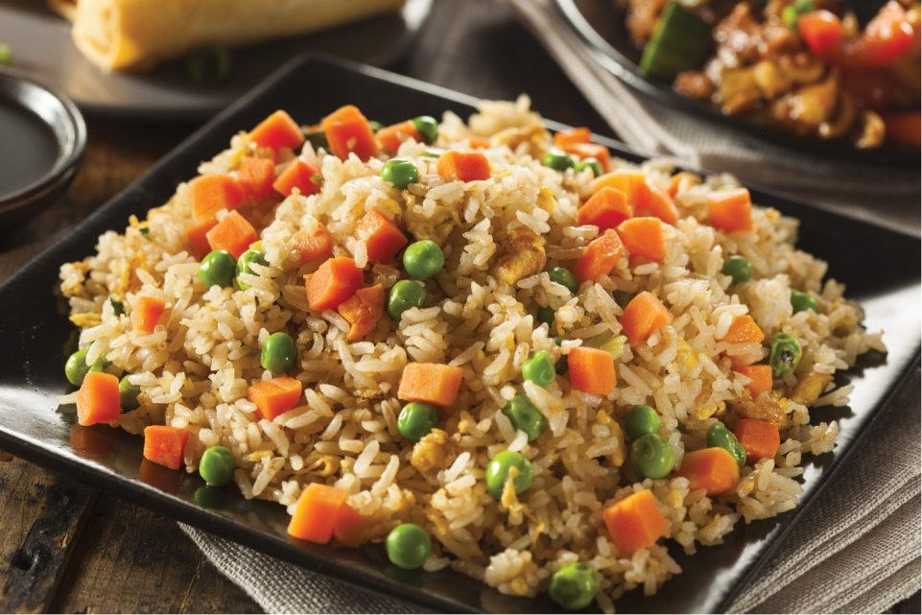
饭做好了，快来吃吧。
Fàn zuò hǎo le, kuài lái chī ba.
The food is ready. Come and eat.

Slide 36

功课做好了，我要睡觉了。
Gōngkè zuò hǎo le, wǒ yào shuì jiào le.
My homework is done.
I want to go to bed.

Slide 37

衣服我已经帮你买好了, 明天晚会你就可以穿了。
Yīfu wǒ yǐjīng bāng nǐ mǎi hǎo le, míngtiān wǎnhuì nǐ jiù kěyǐ chuān le.
I’ve already bought the dress for you. You can wear it for the party tomorrow night.

Slide 38
Reduplication of Adjectives
Some Chinese adjectives can be reduplicated.
When monosyllabic adjectives are reduplicated, the accent usually falls on the second occurrence.
When the reduplicated monosyllabic adjective takes a “r” suffi x, like 慢慢儿 (màn mānr, slow), its second occurrence is usually pronounced in the first tone, regardless what the adjective’s original tone is.
Reduplication of adjectives often suggests an approving and appreciative attitude on the speaker’s part.

Slide 39
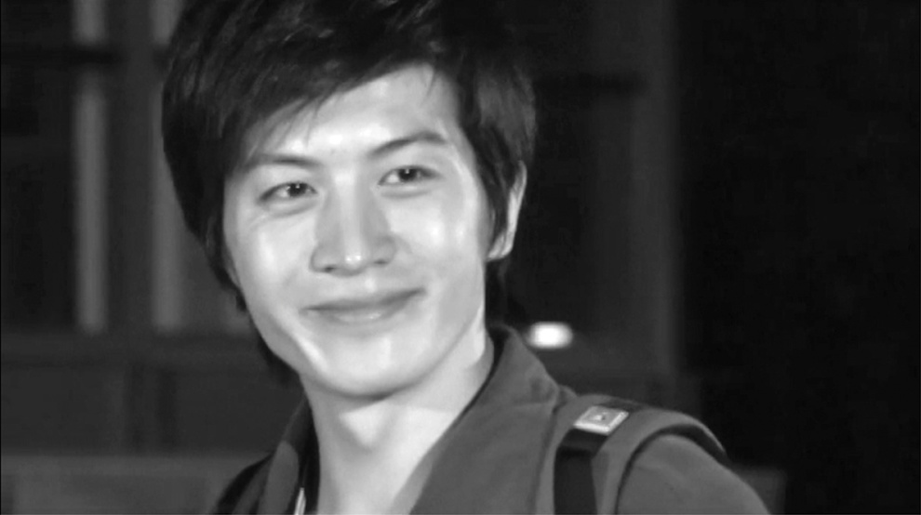
Reduplication of adjectives usually does not appear in the negative form.
王朋高高的，很帅。
Wáng Péng gāo gāo de, hěn shuài.
Wang Peng is tall and handsome.

Slide 40
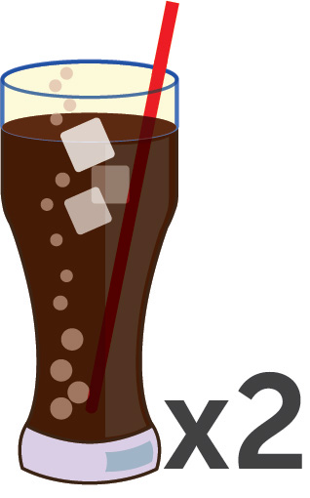
可乐凉凉的，很好喝。
Kělè liáng liáng de, hěn hǎo hē.
The cola is nicely chilled and tastes good.

Slide 41

酸辣汤酸酸的、辣辣的，非常好喝。
Suānlà tāng suān suān de, là là de, fēicháng hǎo hē.
The hot and sour soup is a bit sour and a bit hot; it tastes great.

Slide 42
The Verb 来 (lái)
In colloquial expressions, the verb 来 (lái) can serve as a substitute for certain verbs, mostly in imperative sentences.
The use of 来 (lái) is rather limited. It is usually used in restaurants and stores, especially when buying small things or coaxing someone to sing a song.

Slide 43
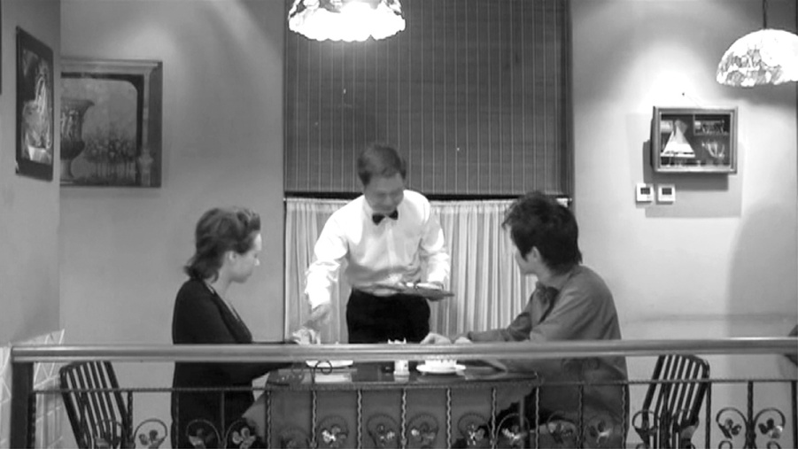
A：
先生，你们想吃点儿什么？
Xiānsheng, nǐmen xiǎng chī diǎnr shénme?
Sir, what would you like?
B：
来一盘糖醋鱼，一碗酸辣汤，和一碗米饭。
Lái yì pán tángcùyú, yì wǎn suānlàtāng, hé yì wǎn mǐfàn.
Give me a plate of sweet and sour fish, a bowl of hot and sour soup, and a bowl of rice, please.

Slide 44
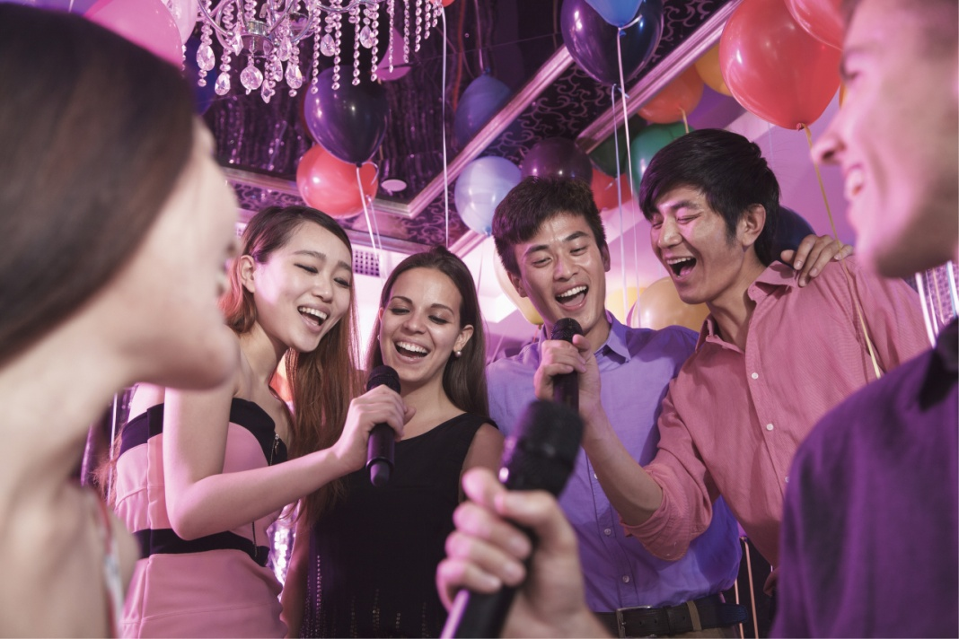

(At a party, when someone has sung a song)
再来一个！
Zài lái yí ge!
Encore!

Slide 45
谢谢
再见!

