Slide 1
Lesson 13 问路 Wèn lù
Asking Directions

Slide 2
Direction and Location Words
左/右/东/南/西/北/旁
often combine with suffixes such as 邊/边 (biān)

Slide 3
Direction and Location Words
上/下/前/後(后)/裡(里)/外/對(对)
(shàng/xià/qián/hòu/lǐ/wài/duì)
often combine with suffixes such as
面 (miàn), and 頭/头 (tóu). *duìmiàn only

Slide 4
Direction and Location Words
In the middle; in between A & B A 和 B 中间

Slide 6
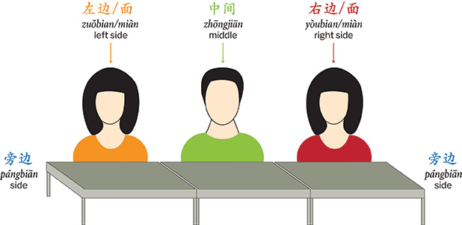

Slide 7
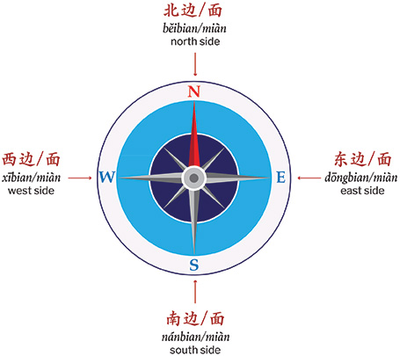

Slide 8
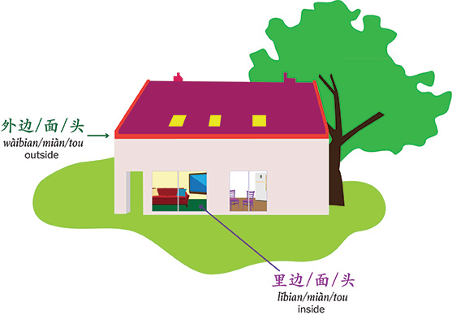

Slide 9
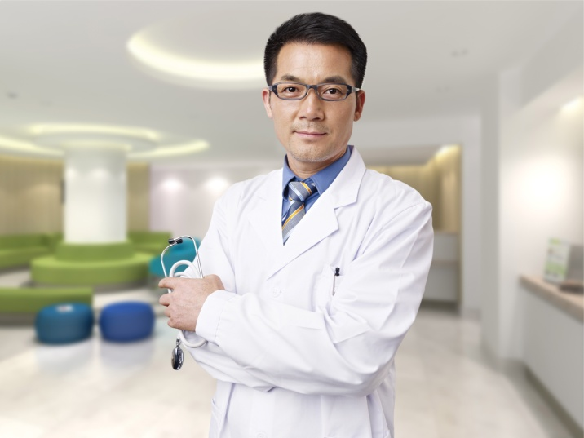
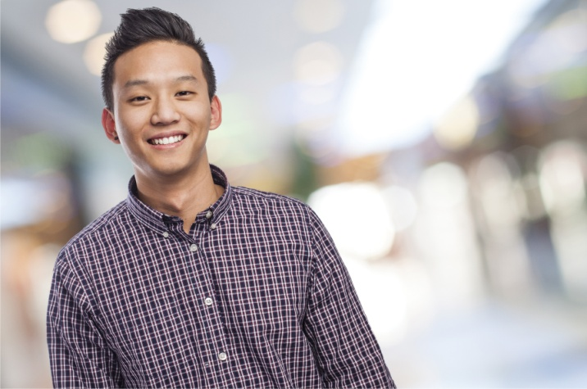
Comparative Sentences with比(bǐ)
I am taller than my brother.
我比弟弟高。
Wǒ bǐ dìdì gāo .

Slide 10
Comparative Sentences with 没有 (méiyǒu)
My younger brother is not as tall as I am.
我弟弟没有我高。
Wǒ dìdi méiyǒu wǒ gāo.

Slide 11
A 没有 (méiyǒu) B… vs. A 不比 (bù bǐ) B…
My younger brother is not taller than me.
我弟弟不比我高。
Wǒ dìdì bù bǐ wǒ gāo.
（They can be same tall.)

Slide 12
A Quick Summary of Comparative Sentences
A 比 (bǐ) B 大 (dà) A>B
A 没有 (méiyǒu) B 大 (dà) A<B
A 不比 (bù bǐ) B 大 (dà) A≤B

Slide 13
那么 (nàme) Indicating Degree
那么 (nàme) is often placed before adjectives or verbs such as 想 (xiǎng), 喜欢 (xǐhuan), 会 (huì), 能 (néng), and 希望 (xīwàng), to denote a high degree.

Slide 14
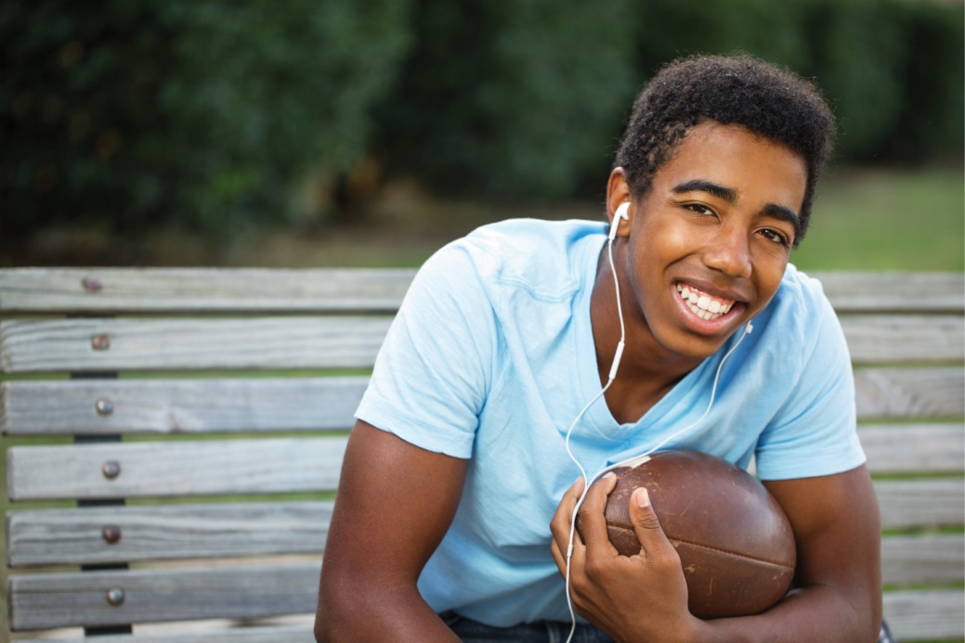
The older brother is so handsome and cool.
哥哥那么帅，那么酷。
Gēge nàme shuài, nàme kù.

Slide 15
没有…那么… (méiyǒu… nàme…)
没有…那么… (méiyǒu… nàme…) means “not reaching the point of.”

Slide 16
The younger brother is not as handsome and cool as the older brother.
弟弟没有哥哥那么帅，那么酷。
Dìdi méiyǒu gēge nàme shuài, nàme kù.

Slide 17
By using 那么(nàme), the speaker affirms the certain attribute of something or somebody in question.
By stating that the younger brother does not reach the same standard of handsomeness and coolness as the older brother, for instance, acknowledges that the older brother is handsome and cool.

Slide 18
到 (dào) + Place + 去 (qù) + Action
the combination of “到 (dào) + Place + 去 (qù) + Action” denotes the purpose of going somewhere.

Slide 19
我要到电脑中心去上网。
Wǒ yào dào diànnǎo zhōngxīn qù shàng wǎng.
I want to go to the computer center to use the internet.

Slide 20
他到朋友的宿舍去聊天儿了。
Tā dào péngyou de sùshè qù liáo tiānr le.
He went to his friend’s dorm to chat.

Slide 21
我们到飞机场去送李小姐。
Wǒmen dào fēijīchǎng qù sòng Lǐ xiǎojiě.
We went to the airport to see Miss Li off.

Slide 22
The Dynamic Particle 过 (guo)
The dynamic particle 过 (guo) is used to denote a past experience or occurrence that did not continue to the present but, typically, had an impact on the present.

Slide 23
The fact that the speaker worked in Chinatown for a year is the reason why he/she knows how to get there.
我在中国城工作过一年，所以我知道怎么走。
Wǒ zài Zhōngguóchéng gōngzuò guo yì nián, suǒyǐ wǒ zhīdào zěnme zǒu.
I worked in Chinatown for a year, so I know how to get there.

Slide 24
我见过李友，(所以知道)她很高。
Wǒ jiàn guo Lǐ Yǒu, (suǒyǐ zhīdào) tā hěn gāo.
I’ve met Li You before, (so I know) she is tall.

Slide 25
Expressions of time are often either unspecified or completely absent.
If there is no time expression, the implied time for the action or event is 以前 (yǐqián, before; previously).
Sometimes 以前 (yǐqián) can appear in the sentence as well.

Slide 26
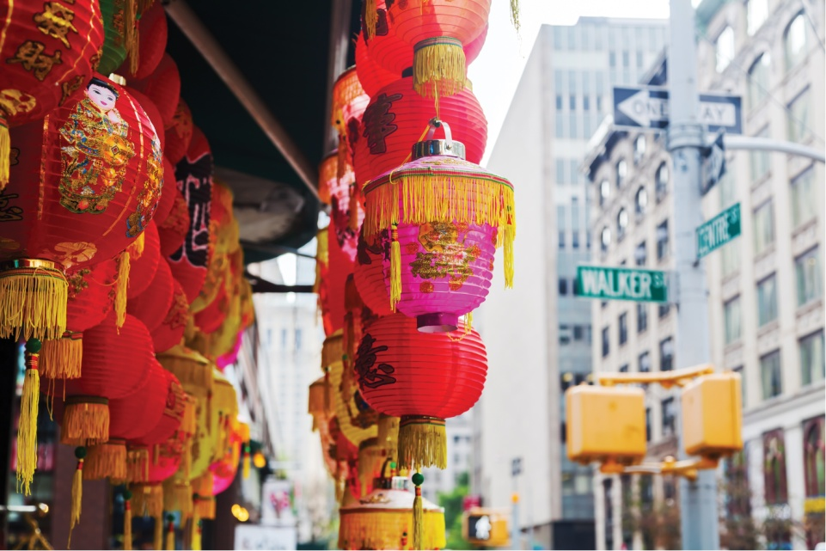
Chinatown
我以前去过中国城，
知道怎么走。
Wǒ yǐqián qù guo Zhōngguóchéng, zhīdào zěnme zǒu.
I’ve been to Chinatown before. I know how to get there.

Slide 27
An expression indicating a specifi c time can also occasionally appear in a sentence with 过 (guo).
你见过李小姐吗？
Nǐ jiàn guo Lǐ xiǎojiě ma?
Have you ever met Miss Li?
见过，上个月还见过她。
Jiàn guo, shàng ge yuè hái jiàn guo tā.
Yes. I saw her as recently as last month.

Slide 28
Reduplication of Verbs
Like adjectives, verbs can also be reduplicated.
Reduplication of a verb in this lesson refers to an anticipated or requested action, and it makes the tone of the sentence milder.

Slide 29
我用用你的电脑可以吗？
Wǒ yòng yong nǐ de diànnǎo kěyǐ ma?
May I use your computer for a minute?

Slide 30
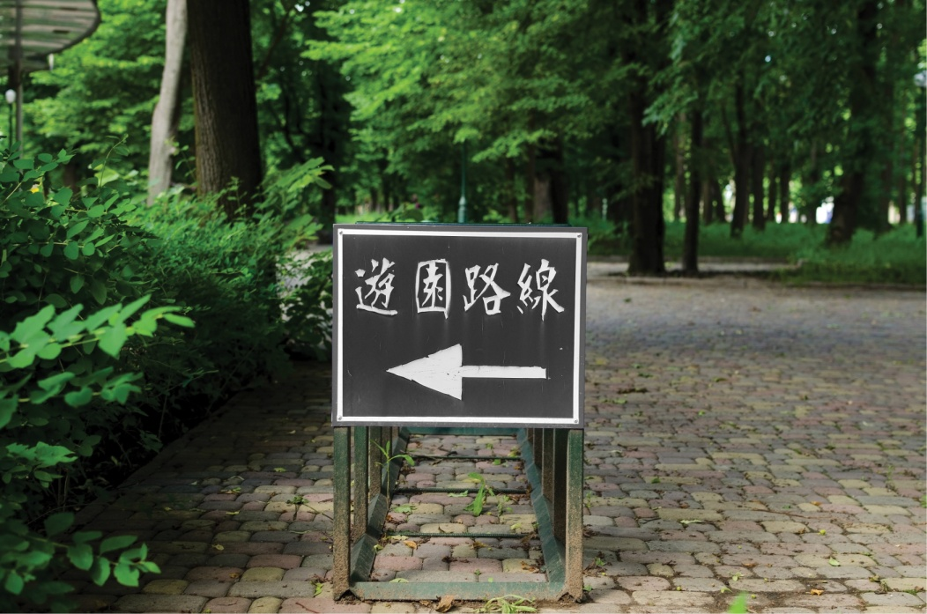
你考完试，我们一起去公园走走，聊聊天儿。
Nǐ kǎo wán shì, wǒmen yìqǐ qù gōngyuán zǒu zou, liáo liao tiānr.
Let’s take a walk in the park and have a chat after your exam.

Slide 31
If a sentence includes both a modal verb and an action verb, only the action verb can be reduplicated.
她想看看我的新手机。
Tā xiǎng kàn kan wǒ
de xīn shǒujī.
She wants to take a look at my new cell phone.

Slide 32
Resultative Complements
完 (wán)
到 (dào)
见 (jiàn)
好 (hǎo)
错 (cuò)
懂 (dǒng)
清楚 (qīngchu)
会 (huì)

Slide 33
完 (wán):
看完 (kàn wán) (finish reading)
吃完 (chī wán) (finish eating)
喝完 (hē wán) (finish drinking)
考完 (kǎo wán) (finish taking a test)
买完 (mǎi wán) (finish buying)
卖完 (mài wán) (sell out)

Slide 34
到 (dào):
找到 (zhǎo dào) (find [something or someone] successfully)
看到 (kàn dào) (see [something or someone])
听到 (tīng dào) (hear [something or someone])
买到 (mǎi dào) (buy [something] successfully)

Slide 35
见 (jiàn):
看见 (kàn jiàn) (see [something or someone]) — same as 看到 (kàn dào)
听见 (tīng jiàn) (hear [something or someone]) — same as 听到 (tīng dào)

Slide 36
好 (hǎo):
做好 (zuò hǎo) (complete doing something, which is now ready)
买好 (mǎi hǎo) (complete buying something, which is now ready)
准备好 (zhǔnbèi hǎo) (prepare something, which is ready)

Slide 37
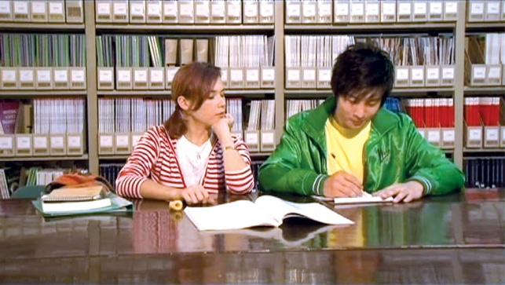
错 (cuò):
买错 (mǎi cuò) (buy the wrong thing)
找错 (zhǎo cuò) (give the wrong change; fi nd the wrong person or thing)
写错 (xiě cuò) (write [something] incorrectly)
说错 (shuō cuò) (say [something] incorrectly)
走错 (zǒu cuò) (go the wrong way)

Slide 38
懂 (dǒng):
听懂 (tīng dǒng) (comprehend what one hears)
看懂 (kàn dǒng) (comprehend what one reads or sees)

Slide 39
清楚 (qīngchu):
看清楚 (kàn qīngchu) (see [something] clearly)
听清楚 (tīng qīngchu) (hear [something] clearly)

Slide 40
会 (huì)
学会 (xué huì)
acquire the skills [for doing something that one was previously unable to do]

Slide 41
一…就… (yī...jiù..., as soon as...then...)
This structure connects two actions.
It can be used to combine actions in two different types of situations: habitual situations or one-time situations.
In a habitual situation, whenever the first action occurs, the second action immediately follows

Slide 42
他一上课就想睡觉。
Tā yí shàng kè jiù xiǎng shuì jiào.
He feels sleepy every time the class starts.

Slide 43
李律师一累就喝咖啡。
Lǐ lǜshī yí lèi jiù hē kāfēi.
Attorney Li drinks coffee whenever he feels tired.

Slide 44
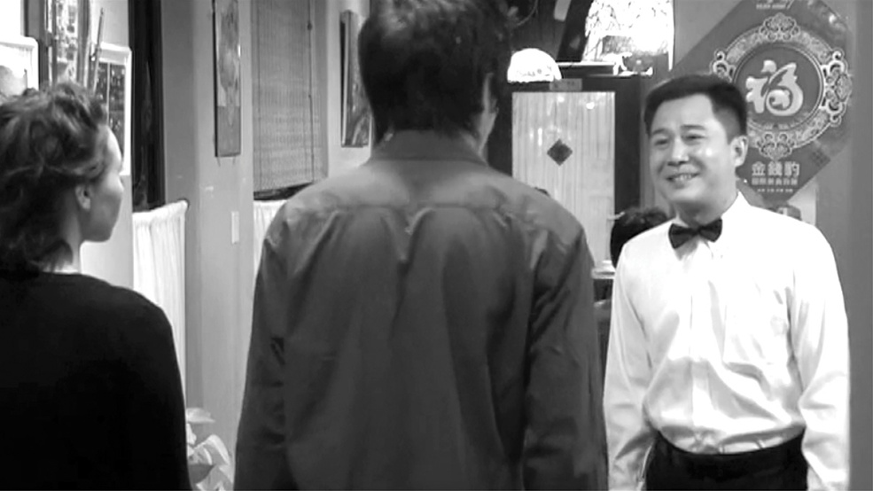
In a one-time situation, the second action takes place as soon as the first is completed.
我们一进饭馆儿，服务员就告诉我们没位子了。
Wǒmen yí jìn fànguǎnr, fúwùyuán jiù gàosù wǒmen méi wèizi le.
As soon as we got into the restaurant, the waiter told us there were no seats available.

Slide 45
这课的语法很容易，我一看就懂。
Zhè kè de yǔfǎ hěn ròngyì, wǒ yí kàn jiù dǒng.
The grammar in this lesson was very easy. I understood it the moment I read it.

Slide 46
谢谢 再见!

