Slide 1
Lesson 2 家庭
© Cheng & Tsui Company, Inc.

Slide 2
Contents
1
Measure words
2
Questions with question words
3
The verb “to have”
4
Use of 的
5
Size of a family
6
Occupation
7
二 and 两
8
Use of 都
9
Tone change for 一
Notes:
Pick a topic you want to practice in class. It will link to a set of PPT for the practice of this topic.

Slide 3
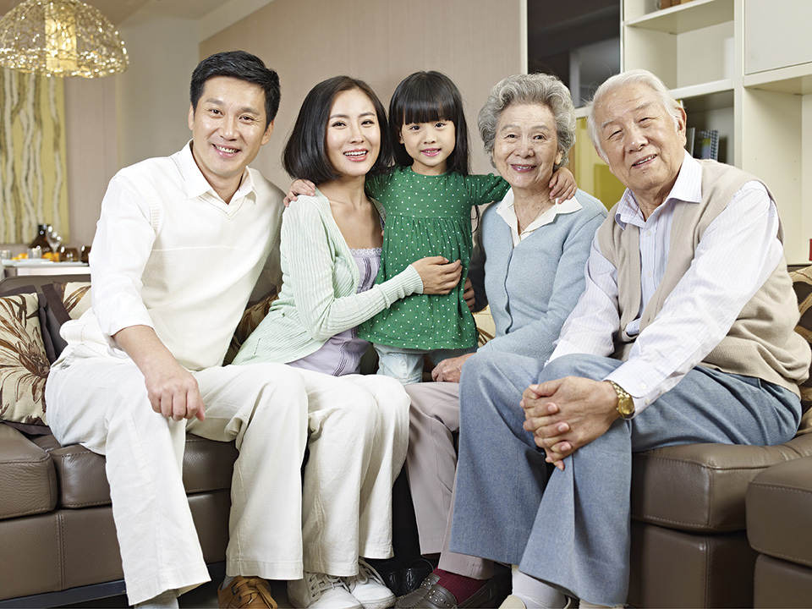
Measure words
Notes:
It is recommended to start this lesson by introducing the photo mentioned in Dialogue 1. This picture corresponds to it. You can click the speaker on the upper-left corner to play the text. At the same time, you can point at the specific person that’s being mentioned. After that, you could ask a series of questions based on the dialogue,
e.g. 这是什么？(point at the whole picture) 这是谁的照片？ 她是谁？他是谁？这个男孩子是我弟弟吗？他是谁？我大哥有女儿吗？etc.

Slide 4
Measure words
一張照片
Notes:
For these four slides, students can read after the teacher, or read on their own. These examples expose them to the general pattern of the two measure words in this lesson, before we summarize the rule.

Slide 5
Measure words
這張照片

Slide 6
Measure words
一個男孩子

Slide 7
Measure words
這個男孩子

Slide 8
Measure words
A Measure Word （M） is needed here:
Number
這
}
M
Noun
那
Notes:
These 3 slides tell students when we use a measure word, and when we use 个 or 张.

Slide 9
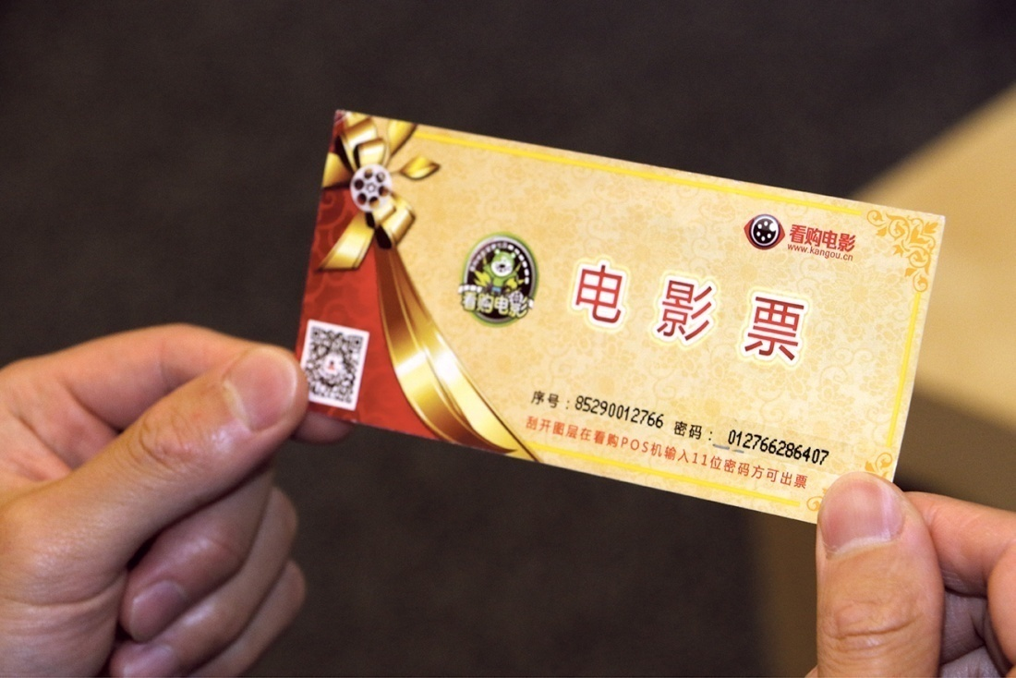
Measure words
張 is for things with a flat surface (照片, paper, table, bed, ...)

Slide 10
Measure words
個 is for people (人，妹妹，老師, ...) and things that don’t have specific measure words (movies, weeks, balls, ...)

Slide 11
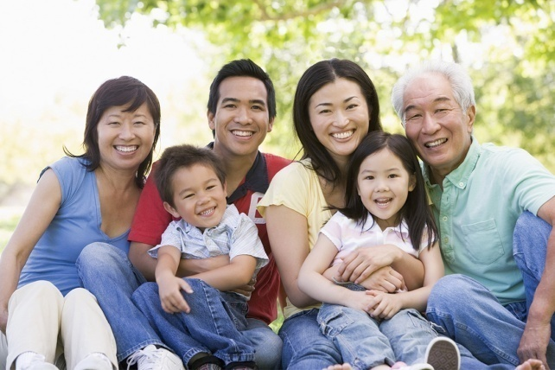
Measure words
(3 photos)
三張照片
Notes:
Now we provide students with some pictures to see if the students could remember to use the Measure Words and to choose the correct Measure Words.
You can wait till after students come up with the phrase, and then show the answer.

Slide 12
Measure words
You try it!
7 students
Notes:
Starting here, there will be no answer. By now students should be able to come up with the correct answer among themselves.

Slide 13
Measure words
You try it!
This teacher

Slide 14
Measure words
You try it!
That boy

Slide 15
Measure words
You try it!
This photo

Slide 16
Questions with question words
In an English “WH” question, where do we place the question word? …
What about in Chinese?
Notes:
In this “Questions with question words” part, you could first ask your students to think (1) where a question word goes in an English WH question (always at the beginning), (2) where it goes in a Chinese WH question. There might be all kinds of answers!

Slide 17
Where is the question word in this sentence?
她是誰？
她是王醫生
Notes:
Then you show them these 3 slides, in which the question word 谁 goes to different places. That really puzzles some students. Let your students try to figure it out, before we give them the rule.

Slide 18
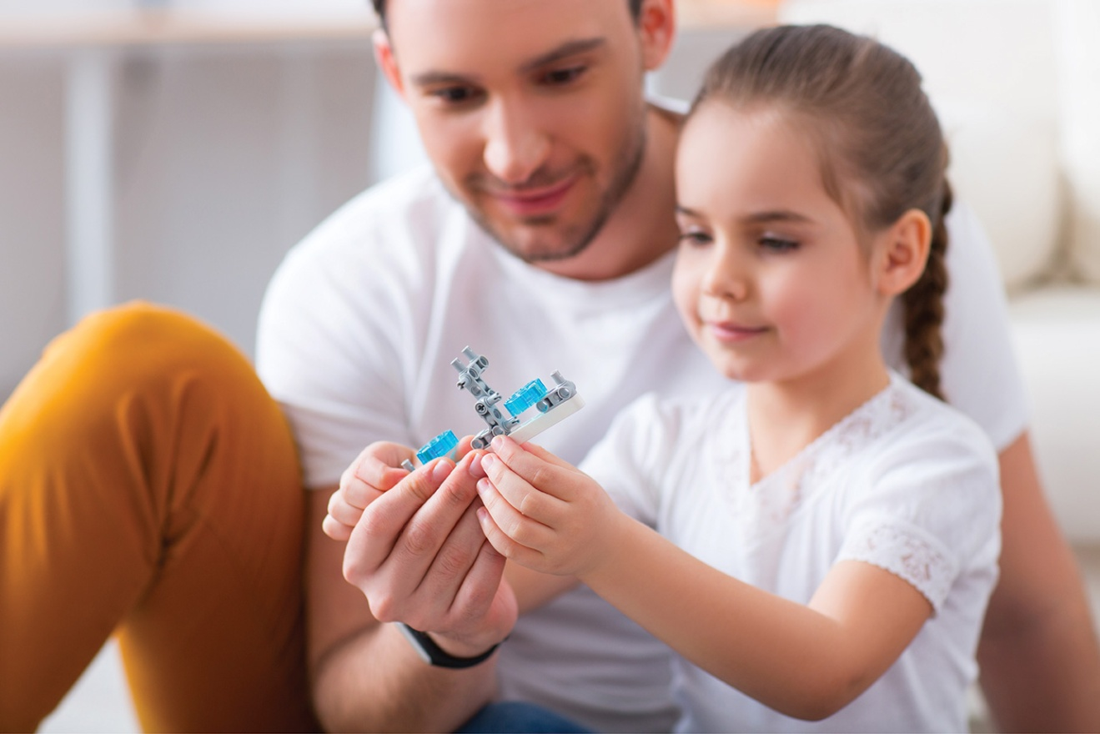
Where is the question word in this sentence?
誰有妹妹？
小李有妹妹。

Slide 19
Where is the question word in this sentence?
這是誰的照片？
這是我的照片。
Notes:
Give students some time to think and discuss…

Slide 20
That’s right…
The question word goes
where the answer would be!

Slide 21
(Pair work)
Can you make a question which will lead to this answer?
這是王朋的老師。
這是誰的老師？
Notes:
Now we provide a couple examples to see if they got it.

Slide 22
(Pair work)
Can you make some questions which will lead to this answer?
她姓李。
誰姓李？ / 她姓什麼？

Slide 23
Negation for the verb “to have”
有 ✓没有
✗不有
Notes:
In this 有/没有part, you could first give oral examples like “我有弟弟，没有姐姐” to remind students that the negation for this verb is not 不but 没, then ask students to carry out a mini-conversation in pairs following the pattern given on the next page.

Slide 24
(Pair work)
－你有... 嗎？
－我没有...。/
我有...，我有Num.個…
Notes:
Give students some time for this conversation. You could choose a few pairs to present in front of the class afterwards.
When you are done, clicking the button will bring you back to the first page – Objectives, where you could choose another topic to practice.

Slide 25
Use of 的
的 = ’s
的 ≠ of (Pay attention to the order)
爸爸的醫生 is “my dad’s doctor”
not “* father of the doctor”
Notes:
A common mistake about 的 is the order. This is a reminder.

Slide 26
Use of 的
你是我的老師
我是...老師的學生
Notes:
Show the students two examples

Slide 27
(Pair work)
Can you complete the sentences?
...是...的姐姐。 / ...是...的弟弟。
弟弟
小文
姐姐
小英
小英是小文的姐姐。/ 小文是小英的弟弟。
Notes:
Then give them 2 slides to practice on their own.

Slide 28
(Pair work)
这是...的...。
媽媽
照片
這是媽媽的照片。
Notes:
After students have completed the sentence and the answer is provided, the button “Click Here” will bring you back to the first page – Objectives, where you could choose another topic to practice.

Slide 29
家
Notes:
Just a fun picture to show that the character 家 is “a little pig under the roof”!

Slide 30
(Pair work)
你家有幾口人？
我家有...口人。
Notes:
You can first introduce your own family by saying 我家有…口人. Then ask a couple of students 你家有几口人? When the students get the pattern, let the students pair up and ask each other this question.
You can also ask a few students to report to class “xxx家有…口人“.

Slide 31
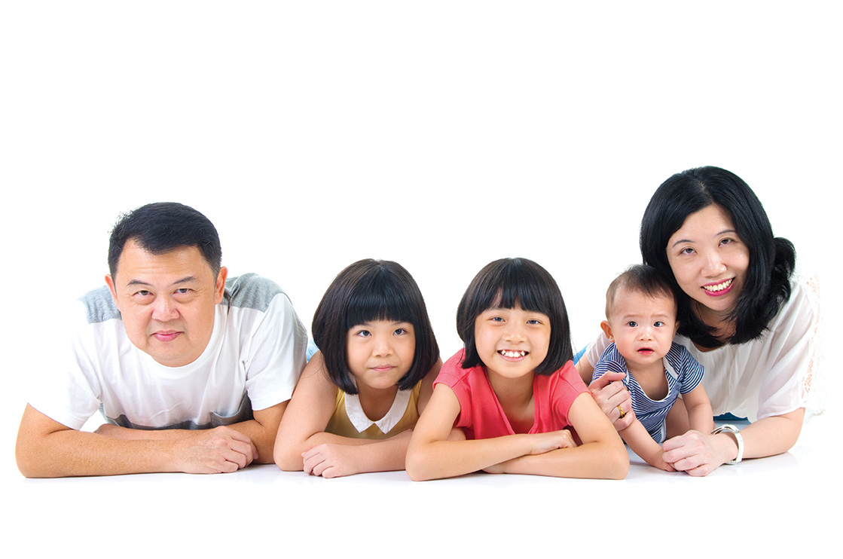
(Pair work)
（你家）有誰？
（我家）有爸爸、媽媽、...、...、和我。
Notes:
Same as the last slide. You can first introduce your own family, then ask a couple students.
After that, pair students up for this mini-conversation.
The button “Click Here” will bring you back to the first page – Objectives, where you could choose another topic to practice.

Slide 32
Occupation
老師
Notes:
The following are four slides for occupations we learned in the text, plus a few extra ones that students might want to know.

Slide 33
Occupation
學生

Slide 34
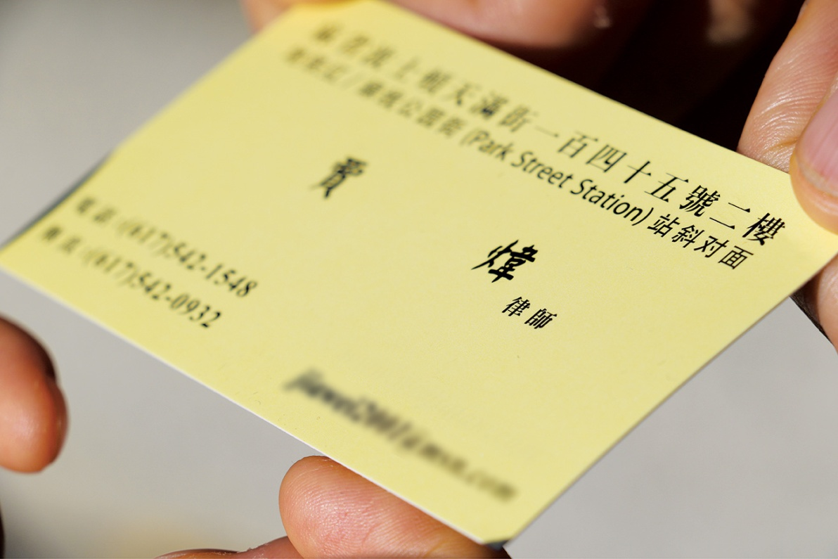
Occupation
律師

Slide 35
Occupation
醫生

Slide 36
Occupation
你爸爸做什麼工作？
我爸爸是老師。

Slide 37
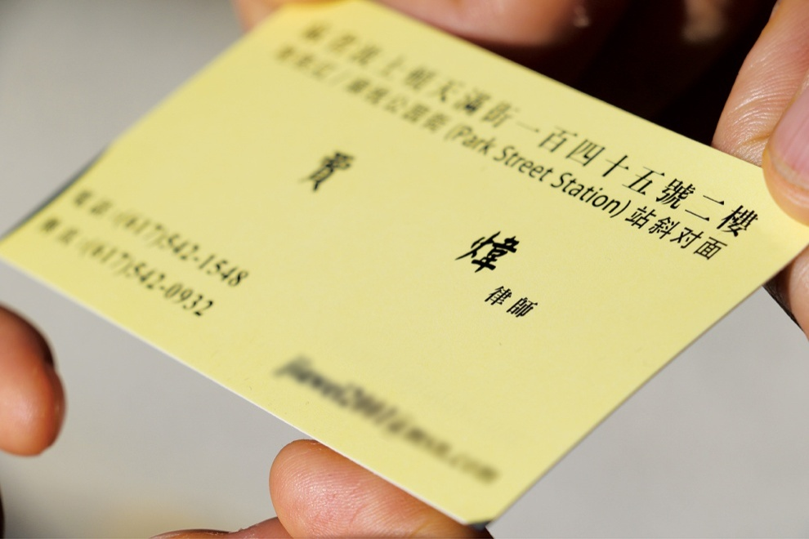
Occupation
你媽媽做什麼工作？
我媽媽是律師。
Notes:
After showing students some of the “occupations,” introduce these two mini-conversations (this slide and the next) on how to ask about occupation.

Slide 38
(Pair work)
...做什麼工作？
...是...。
Notes:
Then it is time for students to ask each other. You should walk around the classroom, making sure students don’t answer with “…做….” Correct them by using “是”
The button “Click Here” will bring you back to the first page – Objectives, where you could choose another topic to practice.

Slide 39
二 and 兩
二：used for counting (1, 2, 3, ...), and in two-digit numbers (12, 22, 25, 72, ...)
兩：used for measuring (two of something) – 兩張照片，兩個學生 (go with a Measure Word)
Notes:
This is an information sheet for students to read.

Slide 40
(Whole class)
Can you count from 1-99?
Notes:
Before practicing, you might want to review the numbers. Try some fun ways (1-20, 40 down to 30, the odd numbers starting 1, the even numbers starting 2, etc.) You could ask the whole class to say them one by one, or together, or ask individual students.

Slide 41
二 and 兩
32
三十二
Notes:
Eight slides of practice starting here

Slide 42
二 and 兩
Two older sisters
兩個姐姐

Slide 43
二 and 兩
Two photos
兩張照片

Slide 44
二 and 兩
24
二十四

Slide 45
二 and 兩
52 students
五十二個學生

Slide 46
二 and 兩
Two lawyers
兩個律師

Slide 47
二 and 兩
2
二

Slide 48
二 and 兩
29 photos
二十九張照片
Notes:
The button “Click Here” will bring you back to the first page – Objectives, where you could choose another topic to practice.

Slide 49
(Pair work) How do you use 都 to summarize?
王朋是學生。李友是學生。高文中也是學生。
王朋、李友、高文中... ...
王朋、李友、高文中都是學生。
Notes:
These five slides practice the use of 都, and the differences between 都不，不都，都没有，不都有.
Students can do this in pairs. Please make sure to give students enough time to discuss, then work it out together in class.

Slide 50
(Pair work)
王朋不是老師。李友不是老師。高文中也不是老師。
王朋、李友、高文中... ...
王朋、李友、高文中都不是老師。

Slide 51
(Pair work)
王朋和高文中是男學生。李友是女學生。
王朋、李友、高文中... ...
王朋、李友、高文中不都是男學生
/不都是女學生。

Slide 52
(Pair work)
王朋没有兒子。李友没有兒子。高文中也没有兒子。
王朋、李友、高文中... ...
王朋、李友、高文中都没有兒子。

Slide 53
(Pair work)
高文中有姐姐。李友也有姐姐。白英愛没有姐姐。
高文中、李友、白英愛... ...
高文中、李友、白英愛不都有姐姐。
Notes:
The button “Click Here” will bring you back to the first page – Objectives, where you could choose another topic to practice.

Slide 54
Tone change for 一 and 不
(一 and 不 follow the same tone change rules.)
tone for 一/不 the tone after it
\ –
\ /
\ √
/ \

Slide 55
Tone change for 不
bu tīng
bù tīng
bu lái
bù lái
bu mǎi
bù mǎi
bu shì
bú shì

Slide 56
Tone change for 一
yi zhāng
yì zhāng
yi nián
yì nián
yi běn
yì běn
yi gè
yí gè

Slide 57
再見!
Zài jiàn!

