Slide 1
Lesson 3 時間
© Cheng & Tsui Company, Inc.

Slide 2
Contents
1
Dates
2
Birthday and age
3
Hours and Minutes
4
Order of Time Words
5
Pivotal sentence
6
Ask for opinion (怎么样？)
7
Alternative question (...还是...?)
8
Affirmative-Negative question
9
New Radicals in this lesson
Notes:
Clink on the topic of your choice, which will lead to a set of slides for the practice of that topic.

Slide 3
How to NAME the dates?
Year
去年 今年 明年
qùnián jīnnián míngnián
(last year) (this year) (next year)

Slide 4
How to NAME the dates?
Day
昨天 今天 明天
zuótiān jīntiān míngtiān
(yesterday) (today) (tomorrow)

Slide 5
How to NAME the dates?
month
上個月 這個月 下個月
shàngge yuè zhège yuè xiàge yuè
(last month) (this month) (next month)

Slide 6
How to NAME the dates?
week
上個星期 這個星期 下個星期
shàngge xīngqī zhège xīngqī xiàge xīngqī
(last week) (this week) (next week)

Slide 7
How to NAME the dates?
The 12 months: ~月
一月, 二月，三月，四月，
五月，六月，七月，八月，
九月，十月，十一月，十二月

Slide 8
How to NAME the dates?
Day of the month： ～號 (hào)
一號，二號，三號，四號，...
三十號，三十一號
*日(rì) – written 二〇二二年十月三十一日

Slide 9
How to NAME the dates?
Day of the week: 星期～ (xīngqī)
The seven days of the week:
星期一，星期二，星期三，
星期四，星期五，星期六，
星期天/星期日(xīngqītiān/ xīngqīrì)

Slide 10
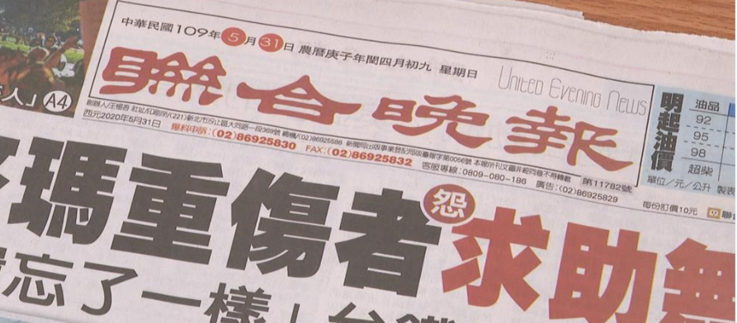
Can you find the date on this Daily Newspaper?

Slide 12
How to NAME the dates?
Which...?
哪 (nǎ): which 年?
/ 二 O 一 幾年？
Which year?
Which month?
幾月?
Which day of the month?
幾號?
Which day of the week?
星期幾?

Slide 13
How to ASK about year, month, day
Year:
－今年（去年、明年）是哪年（or 二O 一幾年）？
－今年是二O ... ...年。
－我的生日是二O ... ...年。
Notes:
You can ask students to answer based on the real situation.

Slide 14
How to ASK about year, month, day
這是哪年？
Year:
1776
一七七六年
Notes:
By issuing the Declaration of Independence, adopted by the Continental Congress on July 4, 1776, the 13 American colonies severed their political connections to Great Britain.

Slide 15
How to ASK about year, month, day
Year:
這是哪年？
1885
一八八五年
Notes:
The Tacoma Method. Chinese expulsion occurred on Nov. 3 in Tacoma where the city’s leaders forcefully expelled its Chinese residence and burned their houses and settlement.

Slide 16
How to ASK about year, month, day
這是哪年？
Year:
1949
一九四九年
Notes:
The Communists gained control of mainland China and established the People's Republic of China in 1949, forcing the leadership of the Republic of China to retreat to the island of Taiwan.

Slide 17
How to ASK about year, month, day
這是哪年？
Year:
1997
一九九七年
Notes:
Sovereignty of Hong Kong was transferred from the United Kingdom to the People's Republic of China at midnight on 1 July 1997. This event ended 156 years of British rule in the former colony.

Slide 18
How to ASK about year, month, day
這是哪年？
Year:
2000
二OOO年

Slide 19
How to ASK about year, month, day
這是哪年？
Year:
2005
二OO五年

Slide 20
How to ASK about year, month, day
Month:
－这個月（or 上個月、下個月）是幾月？
－这個月是...月。
Notes:
You can ask students to answer based on the real situation.

Slide 21
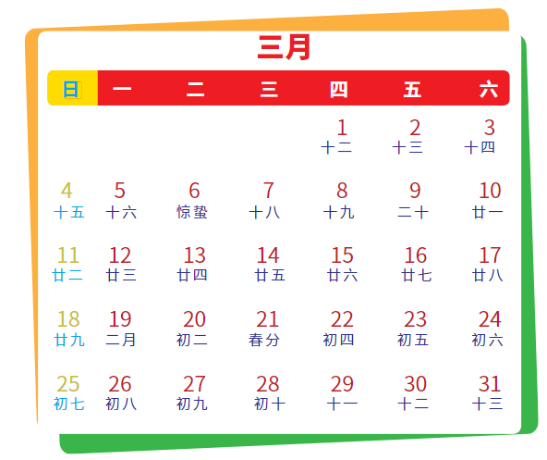
How to ASK about year, month, day
Month:
這個月是幾月？
這個月是三月。
Notes:
These seven slides are for students to practice. You can show the answer after students respond.

Slide 22
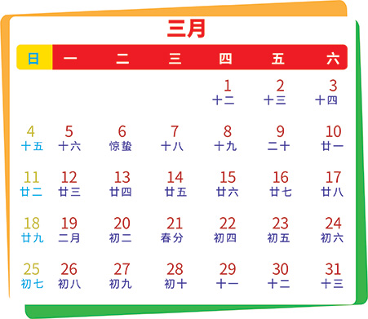
How to ASK about year, month, day
Month:
December
這個月是幾月？
這個月是十二月。

Slide 23
How to ASK about year, month, day
Month:
February
這個月是幾月？
這個月是二月。

Slide 24
How to ASK about year, month, day
Month:
April
這個月是幾月？
這個月是四月。

Slide 25
How to ASK about year, month, day
Month:
July
這個月是幾月？
這個月是七月。

Slide 26
How to ASK about year, month, day
Month:
November
這個月是幾月？
這個月是十一月。

Slide 27
How to ASK about year, month, day
Month:
March
這個月是幾月？
這個月是三月。

Slide 28
How to ASK about year, month, day
Day of the month:
－今天（or 昨天、明天）是幾號？
－今天是......號。
Notes:
You can ask students to answer based on the real situation.

Slide 29
How to ASK about year, month, day
Day of the week:
－今天（or 昨天、明天）是星期幾？
－今天是星期 ... 。
Notes:
You can ask students to answer based on the real situation.

Slide 30
How to ASK about year, month, day
Day of the week:
今天是星期幾？
Thursday
今天是星期四。
Notes:
These five slides are for students to practice.

Slide 31
How to ASK about year, month, day
Day of the week:
今天是星期幾？
Wednesday
今天是星期三。

Slide 32
How to ASK about year, month, day
Day of the week:
今天是星期幾？
Monday
今天是星期一。

Slide 33
How to ASK about year, month, day
Day of the week:
今天是星期幾？
Friday
今天是星期五。

Slide 34
How to ASK about year, month, day
Day of the week:
今天是星期幾？
Sunday
今天是星期日/星期天。

Slide 35
(Pair work)
August
－...月...號是星期幾？
－...月...號是星期... 。
Notes:
This is for students to interact with each other. Ask students to work in pairs.

Slide 36
How to COUNT the dates (how many years, months, ...)
幾年？ 多少年？
幾個月？ 多少個月？
幾天？ 多少天？
幾個星期？多少個星期？
*多少(duōshǎo) can be used for counting any numbers
几 is used for counting numbers under 10
Did you notice that 年 and 天 don’t use a measure word?

Slide 37
How to COUNT the dates (how many years, months, ...)
一年有多少個月？
一年有十二個月。

Slide 38
How to COUNT the dates (how many years, months, ...)
一個月有多少天？
一個月有三十天 or 三十一天。
二月有二十八天 or 二十九天。

Slide 39
How to COUNT the dates (how many years, months, ...)
一個星期有幾天？
一個星期有七天。

Slide 40
How to COUNT the dates (how many years, months, ...)
一年有多少個星期？
一年有五十二個星期。
Notes:
Do not click the button until the answer is displayed.
Clicking the button will lead back to the first page (Objectives) where you can choose another topic.

Slide 41
(Pair work) Birthday
－你的生日是幾月幾号？
－我的生日是...月...号。
Notes:
Let the students ask each other, then report to the class.

Slide 42
(Pair work） Age
Note: a. No 是 is used for age expressions;
b. Do not use 几岁 unless the person is under 10 years old.
Notes:
Let the students ask each other, then report to class.
After the practice, clicking the button will lead back to the first page (Objectives) where you can choose another topic.

Slide 43
Hours and Minutes

Slide 44
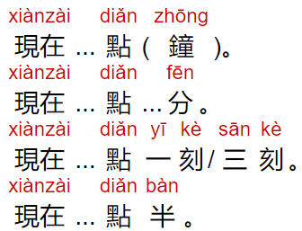
Hours and Minutes

Slide 45
Hours and Minutes

Slide 46
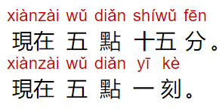
Hours and Minutes
Notes:
These seven slides are for students to practice.

Slide 47
Hours and Minutes

Slide 48
Hours and Minutes

Slide 49
Hours and Minutes

Slide 50
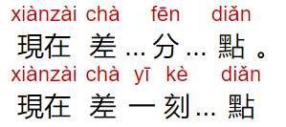
Hours and Minutes
差 (chà): to be short of

Slide 51
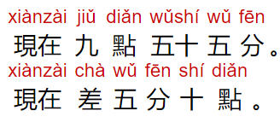
Hours and Minutes

Slide 52
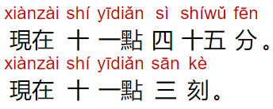
Hours and Minutes
Notes:
Let the students ask each other, then report to class.
Clicking the button will lead back to the first page (Objectives) where you can choose another topic.

Slide 53
Order of Time Words
Order: From bigger unit to smaller unit
Notes:
Ask students to compare the orders of Time Words in US and China. (Also, what about in England?)

Slide 54
AM & PM

Slide 55
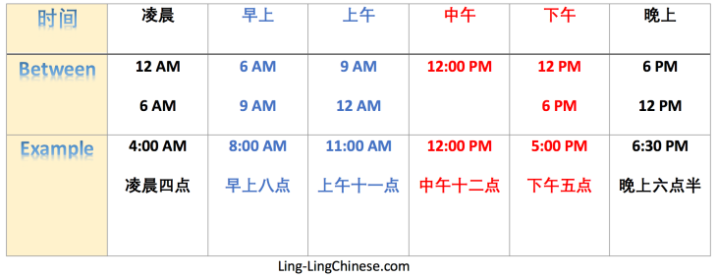

Slide 56
Order of Time Words
May 25, 2003
Can you say these in the right order?
May 15, 2022
二O二二年五月十五號
Notes:
These four slides are for students to practice.

Slide 57
Order of Time Words
May 25, 2003
Can you say these in the right order?
July 4, 1776
一九九六年七月四號

Slide 58
Order of Time Words
May 25, 2003
Can you say these in the right order?
Oct. 10, 1949
一九四九年十月十號

Slide 59
Order of Time Words
May 25, 2003
Can you say these in the right order?
6:30 pm.
晚上六點半
Notes:
Wait till after the answer is displayed, click the button. It leads back to the first page where you can pick another topic.

Slide 60
New Radicals
日：明，昨，晚，星
言(讠)：誰，請，謝，認識
食(饣)：飯，餓
金(钅)：鐘
Notes:
You can spend some time to explain the meaning of each radical.
Clicking the button will lead back to the first page (Objectives) where you can choose another topic.

Slide 61
Pivotal sentence
Sub. V. Obj.
我 請 你
Sub. V. Obj.
你 吃 飯
Sub. V. pivot V. Obj.
我 請 你 吃 飯
Notes:
Lead students’ attention to the “Pivot” point.

Slide 62
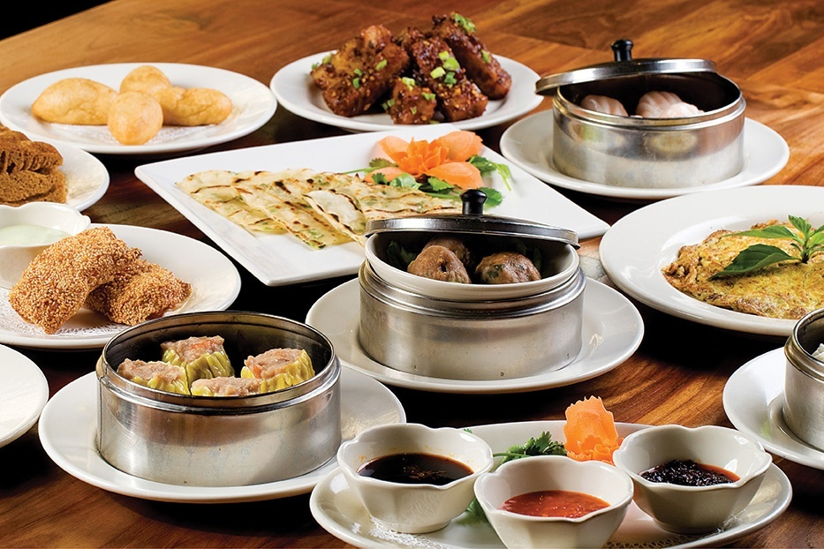
Pivotal sentence
王朋請李友吃中國飯。

Slide 63
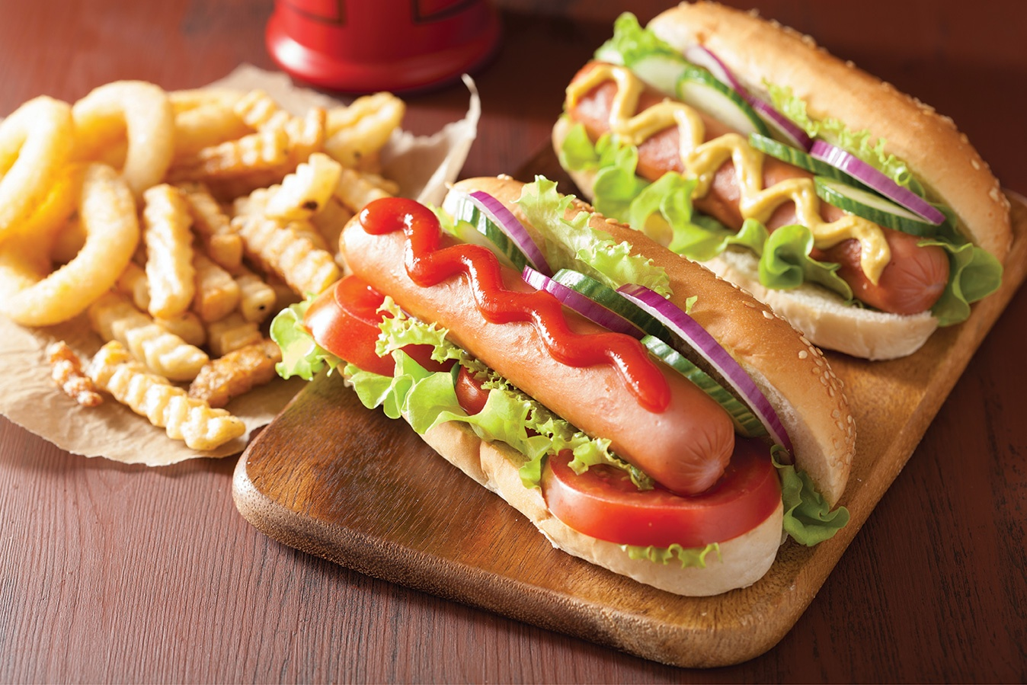
Pivotal sentence
李友請王朋吃美國飯。

Slide 64
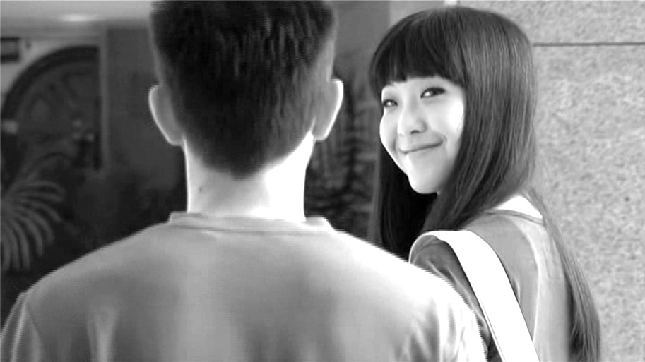
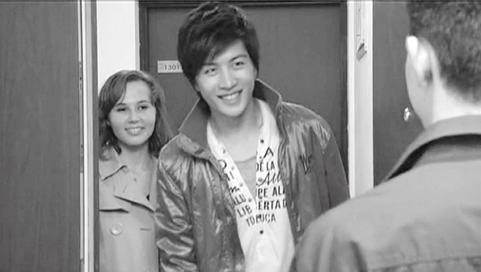
(Pair work)
你請誰吃飯？
我請…吃飯。
Notes:
You can ask a couple students, and also could let students ask each other.
Clicking the button will lead back to the first page (Objectives) where you can choose another topic.

Slide 65
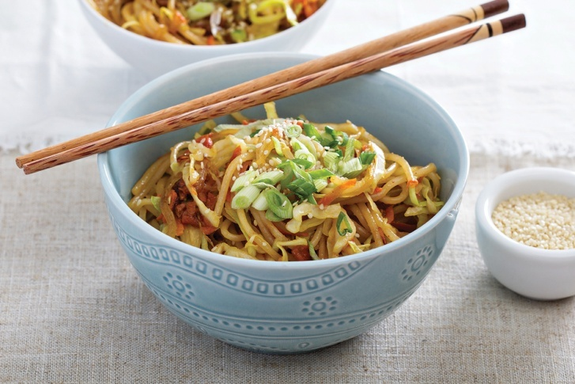
Ask for opinion
How about if...
you treat me to dinner?
你請我吃飯，怎麼樣？
Notes:
These five examples can show students the pattern. You can ask students to summarize how to use 怎么样 (after a statement, or right after a noun phrase).

Slide 66
Ask for opinion
How about...
we eat at 7:00?
我們七點吃飯，怎麼樣？

Slide 67
Ask for opinion
How about if ...
we eat Mexican food?
我们吃墨西哥菜，怎麼樣？

Slide 68
Ask for opinion
How about...
8:00?
八點怎麼樣？

Slide 69
Ask for opinion
How about…tomorrow night?
明天晚上怎麽樣？

Slide 70
Ask for opinion
What do you think of this university?
這個大學怎麼樣？
Notes:
After students answer this question, point out that the answers to 怎么样 are always Adjectives.
Clicking the button will lead back to the first page (Objectives) where you can choose another topic.

Slide 71
Alternative question
...還是...?
Make an alternative question for each of the following

Slide 72
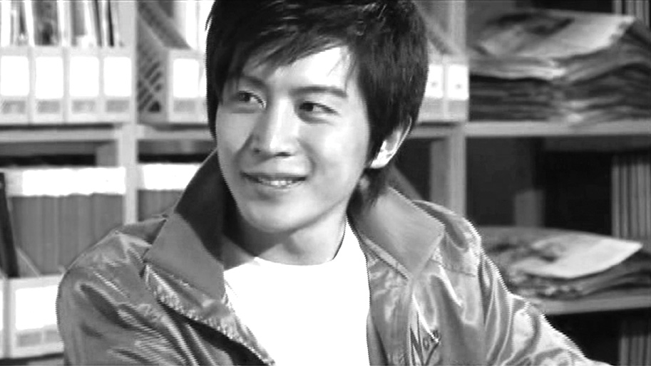
Alternative question
中國人
美國人?
他是中國人還是美國人？

Slide 73
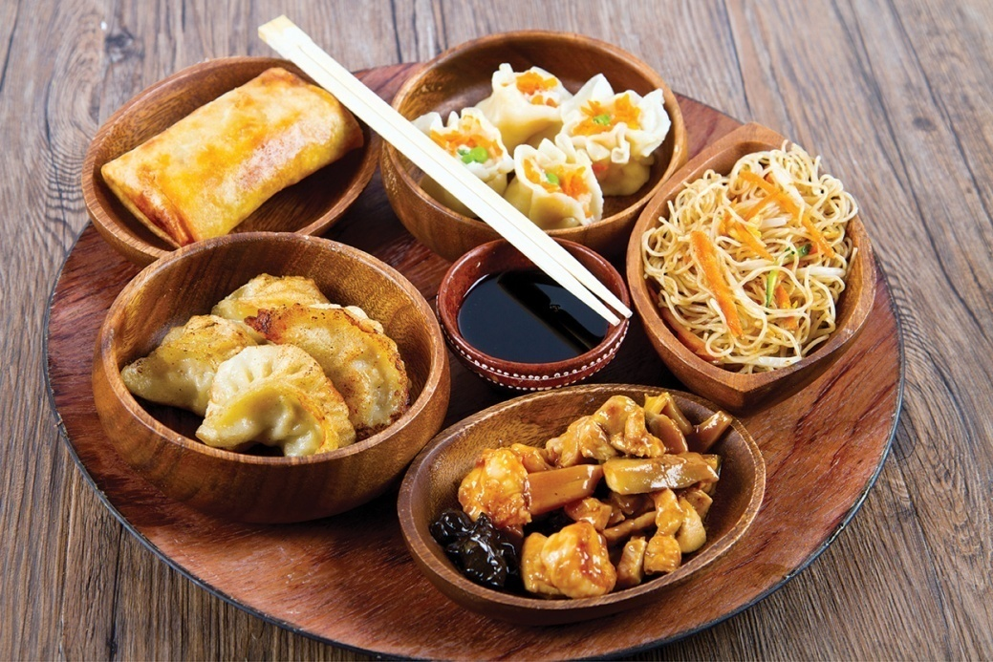
Alternative question
你喜歡吃什麼？
中國飯
美國飯
你喜歡吃中國飯還是美國飯？

Slide 74
Alternative question
李先生做什麼工作？
老師
醫生
李先生是老師還是醫生？

Slide 75
Alternative question
我們幾點吃飯？
六點
七點
我們六點(吃飯)還是七點吃飯？

Slide 76
Alternative question
April
星期四
今天
星期五
今天是星期四還是星期五？

Slide 77
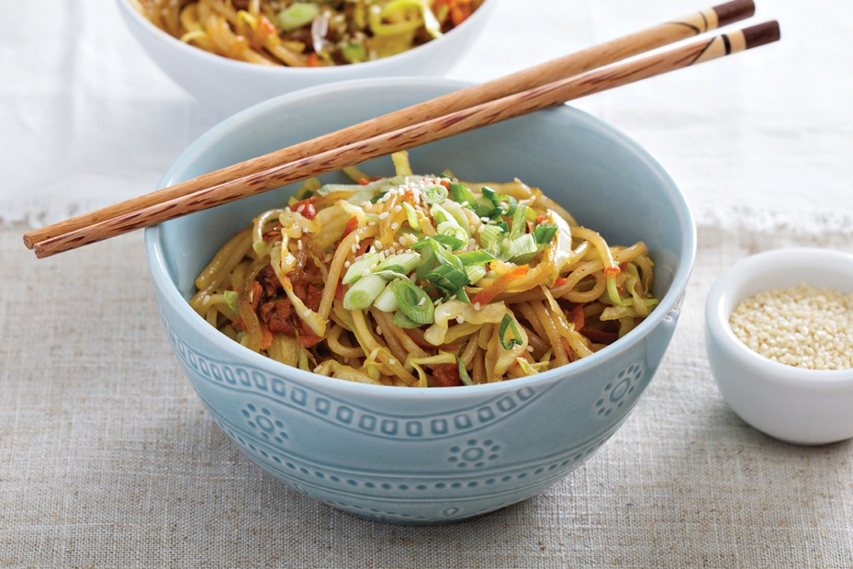
Alternative question
你請我吃飯
我請你吃飯
你請我吃飯還是我請你吃飯？
Notes:
Clicking the button will lead back to the first page (Objectives) where you can choose another topic.

Slide 78
Affirmative-Negative question
S V O 嗎？
S V + neg. V O?

Slide 79
Affirmative-Negative question
是
是不是？
吃
吃不吃？
請
請不請？
Notes:
First show some example

Slide 80
Affirmative-Negative question
You try it!
認識
認識不認識？
喜歡
喜歡不喜歡？
有
有没有？
Notes:
Then let students try to change the form

Slide 81
Affirmative-Negative question
Adjectives:
好
好不好？
忙
忙不忙？
高
高不高？

Slide 82
Affirmative-Negative question
你是學生嗎？
你是不是學生？
Notes:
Try 4 sentences

Slide 83
Affirmative-Negative question
你認識王律師嗎？
你認識不認識王律師？

Slide 84
Affirmative-Negative question
你喜歡吃中國飯嗎？
你喜歡不喜歡吃中國飯？

Slide 85
Affirmative-Negative question
你有她的照片嗎？
你有没有她的照片？
Notes:
Clicking the button will lead back to the first page (Objectives) where you can choose another topic.

Slide 86
(Pair work) Conversation
- (Invitation to dinner), how about it?
- Why?
- Because ... ...
- Great! Thanks. What time?
- ___.
- But I’m busy at ___.
- How about ___?
- Good. See you at ___!
Notes:
You could ask the students carry out this short conversation at the end, to review the new expressions.

Slide 87
再見!
Zài jiàn!

