Slide 1
Looking for the Mechanism of Anisotropic Surface Self-diffusion on Ice Crystals Using Molecular Dynamics
Amrei Oswald*¹, Natalie Bowens¹, Ivan Gladich², Steven Neshyba¹, and Martina Roeselova²
¹University of Puget Sound, Tacoma, WA
²Institute of Organic Chemistry and Biochemistry, Prague, Czech Republic.
*aoswald@pugetsound.edu

Slide 2
Cirrus clouds are important for climate because of their light-scattering properties.
Stephens, G.L.; Tsay, S.; Stackhouse, P.W.; Flatau, P.J. Journal of Atmospheric Science, 1990, 47, 1742-1753

Slide 3
Cirrus clouds are comprised of faceted ice crystals.
Z
X
The structure of these crystals impacts the way they scatter light.
Yang, P.; Liou, K.N. Contr. Atmos. Phys. 1998, 71, 223-248.

Slide 4
It is believed that the shape and texture of cirrus ice crystals depends on surface diffusivity.
ε₁
ε₂
Exposed ice facets develop a quasi-liquid layer (QLL)
Hobbs, P.V.; Scott, W.D. Journal of Geophysical Research, 1965, 70, 5025-5034

Slide 5
Molecular dynamics indicates that surface diffusivity is anisotropic
Ivan Gladich, William Pfalzgraff, Ondřej Maršálek, Pavel Jungwirth, Martina Roeselová, and Steven Neshyba, "Arrhenius analysis of anisotropic surface diffusion on the prismatic facet of ice", Physical Chemistry Chemical Physics, 13, 19960-9 (2011).

Slide 6
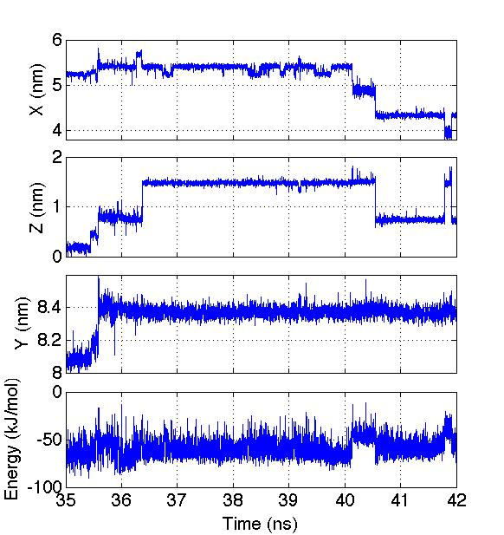
Bolton-Pettersson mechanism
Molecules move from ε₂ to ε₁ where they diffuse
Diffusion occurs through the breaking and reforming of single hydrogen bonds
ε₁
ε₂
Bolton, K.; Petterson, J.B.C. J. Phys. Chem. 2000, 104, 1590-1595

Slide 7
Our approach: To take a closer look at these sudden jumps to see if we can identify what is causing anisotropy.
Z 5.4 nm
Y 5 nm
X 3.7 nm

Slide 8
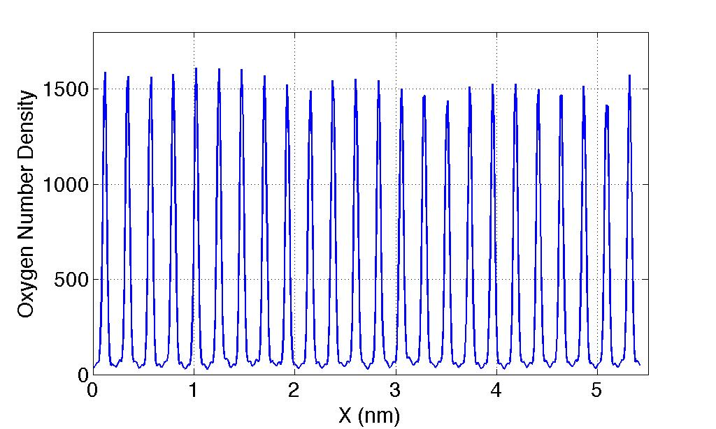
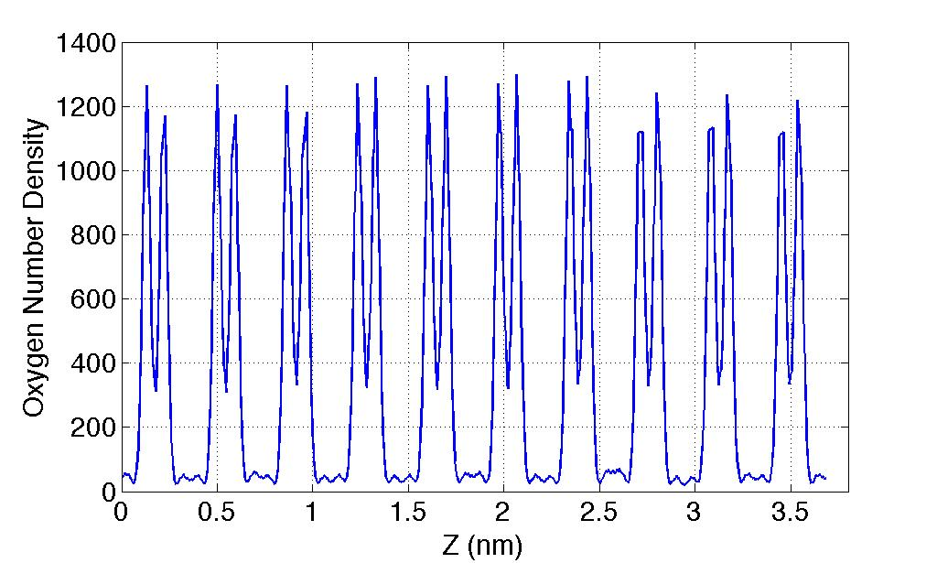
Molecules in ε₁ have 1.5 fewer hydrogen bonds on average
Structural differences create different potential energy barriers for the molecule to overcome

Slide 9
Hypotheses
Bolton-Pettersson Mechanism
Predicts most diffusion will occur in ε₁
My hypothesis
Predicts most anisotropy will occur in ε₂

Slide 10
Results

Slide 11
Results

Slide 12
ε₁
ε₂

Slide 13
Summary
Diffusion events occur through the breaking and forming of single hydrogen bonds
Anisotropy is restricted to the ε₁ layer
Next steps:
Euler angle analysis to see if molecules are restricted to certain orientations
Look at which Hydrogen bonds are breaking

Slide 14
Acknowlegments
Steven Neshyba
Natalie Bowens
Penny Rowe
Martina Roeselova
Ivan Gladich
University of Puget Sound Enrichment Committee
MJ Murdock Charitable Trust

Slide 15
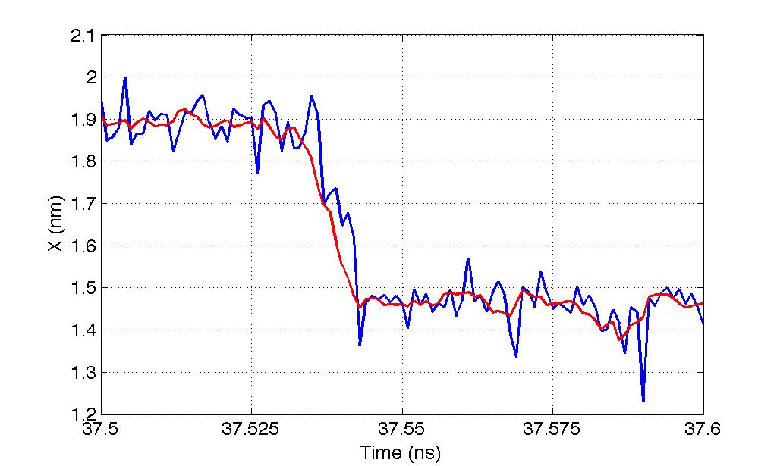
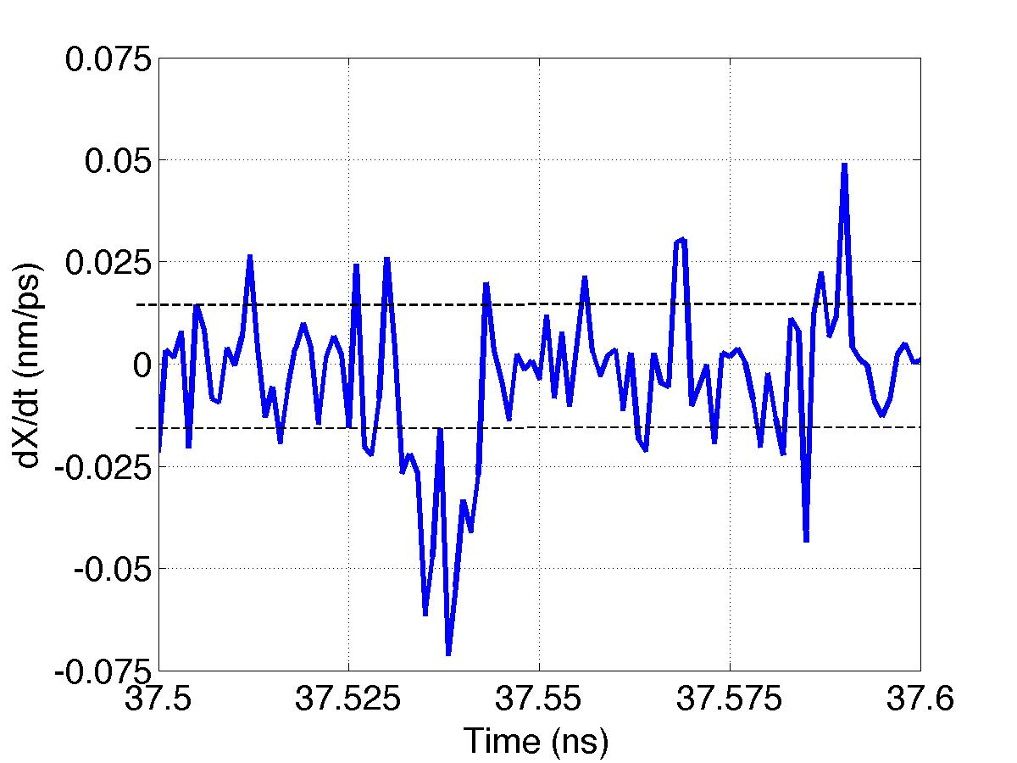

Slide 16
Ivan Gladich, William Pfalzgraff, Ondřej Maršálek, Pavel Jungwirth, Martina Roeselová, and Steven Neshyba, "Arrhenius analysis of anisotropic surface diffusion on the prismatic facet of ice", Physical Chemistry Chemical Physics, 13, 19960-9 (2011).

Slide 17
Ivan Gladich, William Pfalzgraff, Ondřej Maršálek, Pavel Jungwirth, Martina Roeselová, and Steven Neshyba, "Arrhenius analysis of anisotropic surface diffusion on the prismatic facet of ice", Physical Chemistry Chemical Physics, 13, 19960-9 (2011).

Slide 18
Ivan Gladich, William Pfalzgraff, Ondřej Maršálek, Pavel Jungwirth, Martina Roeselová, and Steven Neshyba, "Arrhenius analysis of anisotropic surface diffusion on the prismatic facet of ice", Physical Chemistry Chemical Physics, 13, 19960-9 (2011).

