Slide 1
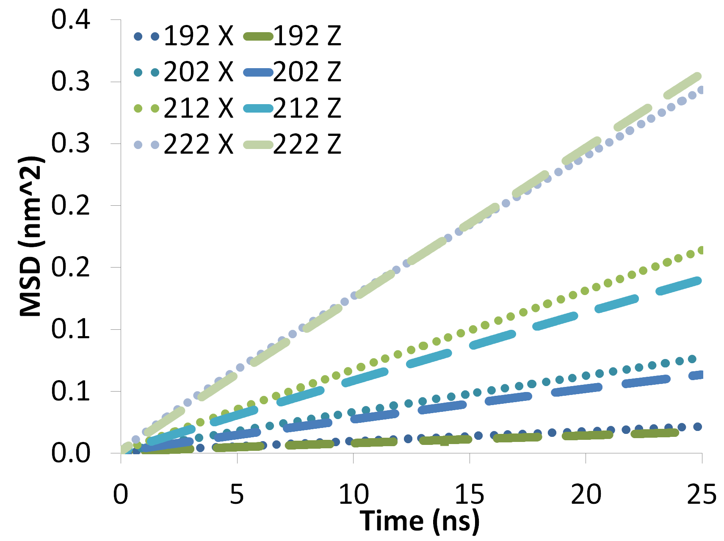
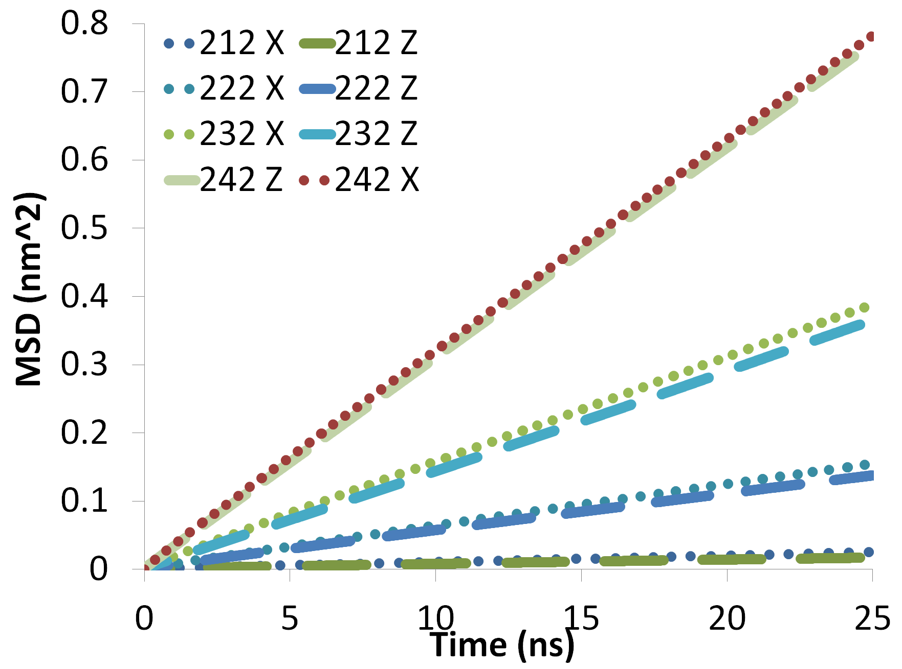
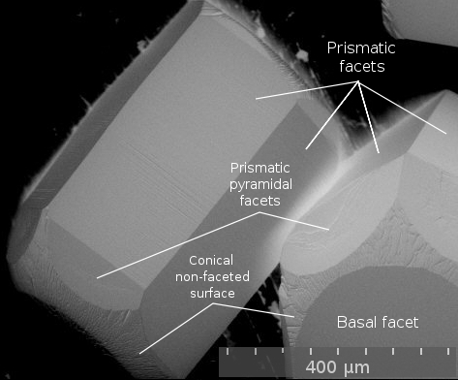
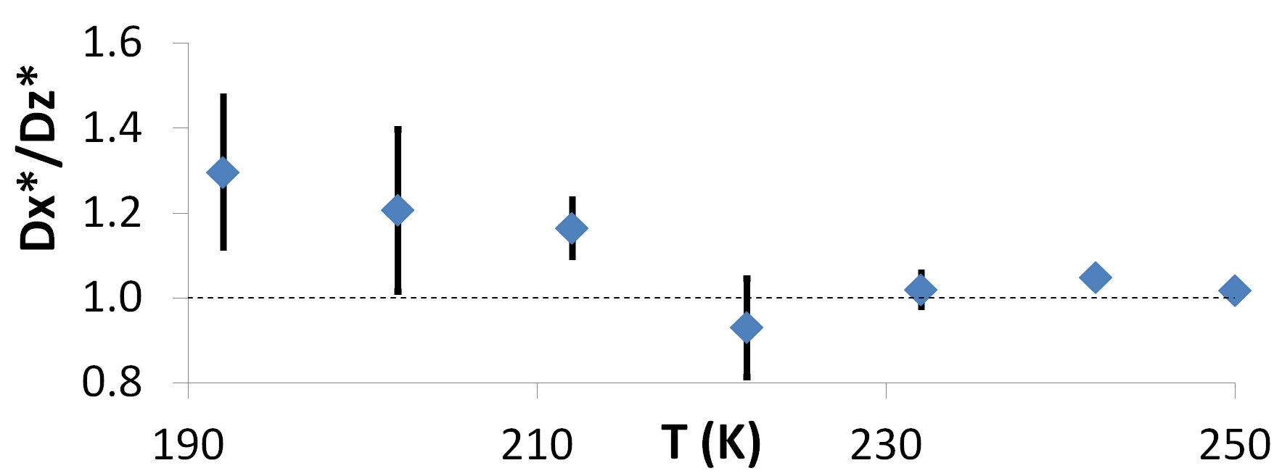
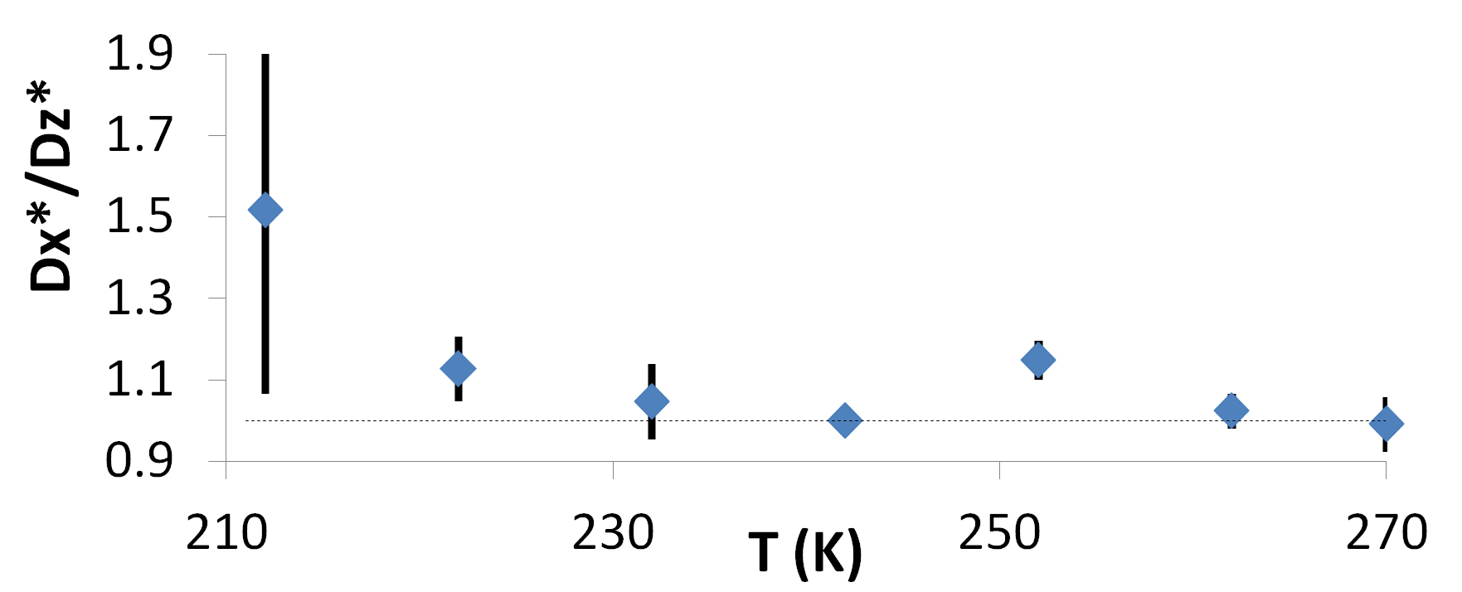
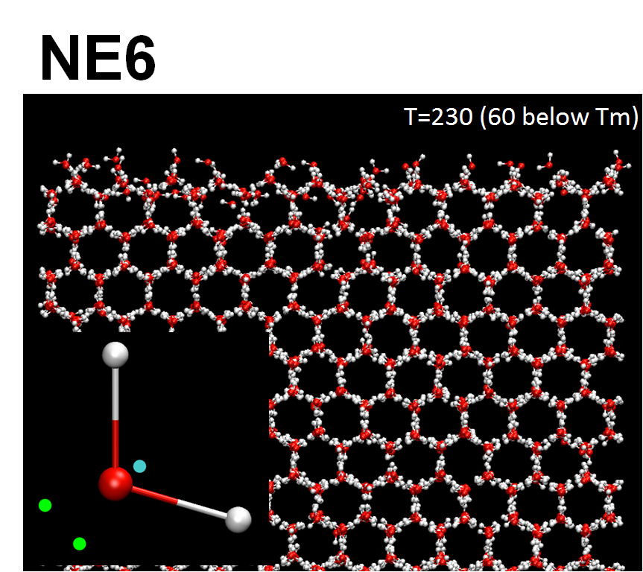
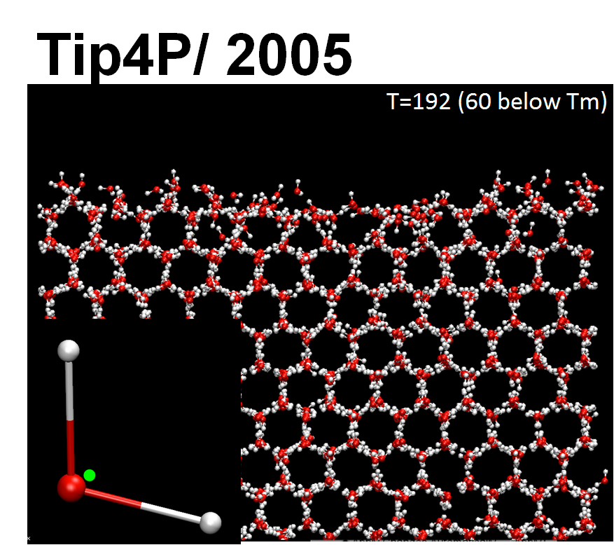
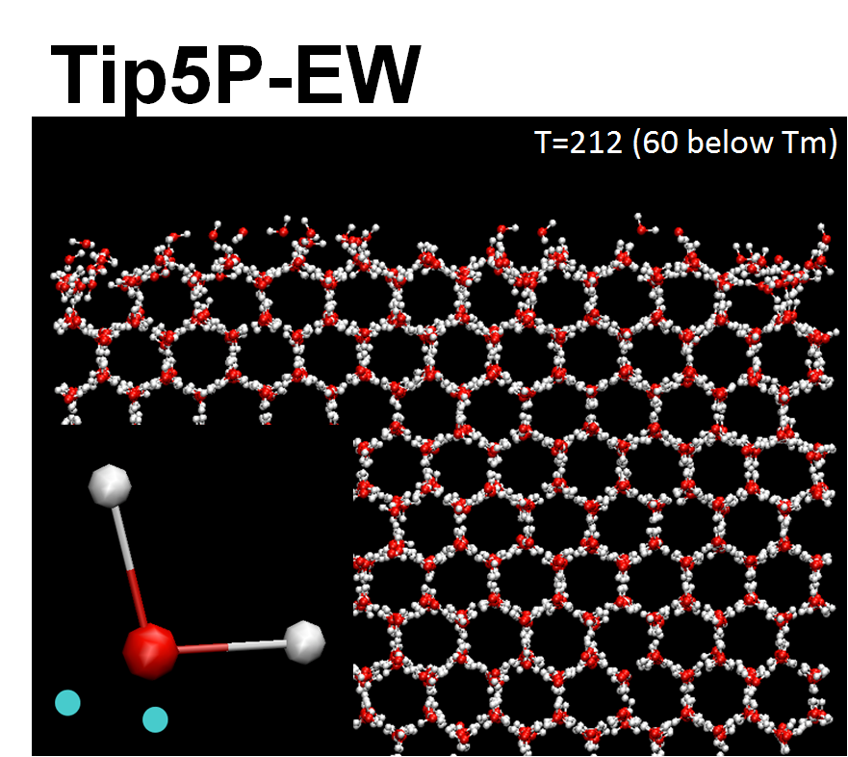
Anisotropic Diffusivity of the Prismatic surface of ice is model Independent
Natalie Bowens¹, Ivan Gladich², Amrei Oswald¹, Steven Neshyba¹, and Martina Roeselova²
¹University of Puget Sound, Tacoma, WA
²Institute of Organic Chemistry and Biochemistry, Prague, Czech Republic.
1. Introduction
4. Temperature Dependent Results
Cirrus clouds are important modulators of earth's climate by reflecting and absorbing solar radiation7. These radiative properties are strongly influenced by surface self-diffusion of adsorbed water molecules taking place at the ice-air interface7. A direct effect is the influence of surface self-diffusion on surface roughness, which normally leads to increased cloud reflectivity. An indirect effect is the influence of surface diffusion on the evolution of ice crystal shape itself, which can lead to either increased or decreased cloud reflectivity, depending on the shape3.
 | Tip4P/ 2005 | Tip5P-EW
A.
B.
In simulations reported by Gladich et al., the surface diffusion of ice was found to be anisotropic (prefer a direction) at low temperatures and isotropic at high temperatures (Fig 1)3. However, the model used by Gladich et al., NE6, is only one of several alternative representations of water in molecular dynamics (MD)2,4. Given the role of surface diffusion in influencing ice crystal shape, roughness, and ultimately the reflectivity of cirrus clouds7, it is important to investigate whether this effect is a true property of ice, or an artifact of NE6.
Figure 1. Prismatic facet of a hexagonal ice crystal1
Z
X
C.
D.
2. Alternative Models of Ice
A
Model specs2,4…
Melting Temperature=289K
Tetrahedral, 6 sites(2 H, 1 O, 2 Lone pairs , 1 dummy charge)
3 Lennard-Jones (LJ) sites (O, 2H)
Stable in ice phase
B
Figure 3. A, B) One-dimensional in-plane mean square displacement of water oxygen atoms as a function of time for selected simulation temperatures for the specific model (Tip4P/2005 or Tip5P-EW) at low temperatures (-60, -50, -40, -30 below model melting temperature). C, D) Diffusion anisotropy coefficient (D*x/D*z) as a function of temperature for Tip4P2005 (in C) and Tip5-EW (in D). Note: diffusion in x direction is faster than z at low temperature and is roughly isotropic for high temperatures. Also, that this change in diffusivity occurs between -30 and -40 of Tm for Tip4P2005, and between -40 and -30 of Tm for Tip5P.
A
Model specs2,6…
Melting Temperature=252K
Planar, 3 sites (2 H, 1 O, 1 dummy charge)
1 LJ site (O)
Reliable phase diagram (tuned to experimental)
5. Arrhenius Analysis
B
Figure 4 shows the Arrhenius plot for both the Tip4P/2005 and the Tip5PEW with the log(D*) plotted with respect to inverse temperature. The solid trend-line is for the Tip5 data excluding the last point and the dashed is for Tip4.
The Ea is associated with the slope of figure 4A. So, the instantaneous derivative of the poly fit graph multiplied by R was used to calculate Ea for each temperature, shown in Figure 4B.
Tip4’s average Ea over the temperature interval of192 to 250K is about 21 KJ/mole and Tip5’s is 29KJ/mole over the interval of 212 to 270K. This is roughly the Ea of one H-bond.
Also, Figure 4B seems to indicate that the Ea increases as temperature increases.
A
A
Model specs2,5…
Melting Temperature=272K
Tetrahedral, 5 sites(2 H, 1 O, 2 Lone pairs)
1 LJ site (O)
Tm closest to experimental & good diffusivity
B
B
Figure 2. A)Cross-sectional view of specified model’s simulated prismatic surface . B)Representation of a water molecule for specified model.
Note: Considering the differences between how water molecules are represented in each model, if anisotropy was true of all than it can be concluded that it is a generic feature of ice (not an artifact of the NE6 model).
Figure 4: A
3. Computational Detail
6. Conclusions
Slabs of ice (2880 molecules) for each model were constructed and annealed to seven temperatures at intervals between -60 °C and -2°C. With the trajectories created after annealing, the tetrahedral order (q) of each Oxygen was calculated using Eq 1.
(1)
Isotropic diffusivity is apparent at high temperatures
Anisotropic diffusivity occurs a low temperatures
Change in diffusivity happens at roughly the same relative super-cooling degree. ( roughly -40C under Tm)
Through the Arrhenius analysis, found that the Ea is roughly the energy of 1 hydrogen bond for both Tip4 and Tip5
Then the q* for each model was calculated through bulk liquid and ice analysis, through the eq 2.
(2)
This q* is used to distinguish liquid-like molecules to get in order calculate, Q, the fraction of the slab that is liquid-like. The GROMACS utility g_msd was used to obtain the MSD plot mean squared displacement, MSD(t) in the in-plane directions using a single temperature trajectory. The utility created multiple MSD(t) functions from each specific trajectory, which differ only in starting time (advanced in intervals of 20 ps). The result is shown in Fig 3(A and B). By combining Eq 3 and Eq 4 the diffusivities, D*, in the in-plane directions were calculated and compared using the ratio of D*x/D*z, shown in Fig 3(C and D).
(3), (4)
5. References
[1] W. C. Pfalzgraff, R. M. Hulscher, and S. P. Neshyba, “Scanning electron microscopy and molecular dynamics of surfaces of growing and ablating hexagonal ice crystals,” Atmos. Chem. Phys, vol. 10, pp. 2927–2935, 2010.
[2] I. Gladich and M. Roeselová, “Comparison of selected polarizable and nonpolarizable water models in molecular dynamics simulations of ice I(h),” Phys Chem Chem Phys, vol. 14, no. 32, pp. 11371–11385, Aug. 2012.
[3] I. Gladich, W. Pfalzgraff, O. Maršálek, P. Jungwirth, M. Roeselová, and S. Neshyba, “Arrhenius analysis of anisotropic surface self-diffusion on the prismatic facet of ice,” Phys. Chem. Chem. Phys., vol. 13, no. 44, pp. 19960–19969, 2011.
[4] H. Nada and J. P. J. M. van der Eerden, “An intermolecular potential model for the simulation of ice and water near the melting point: A six-site model of H[sub 2]O,” The Journal of Chemical Physics, vol. 118, no. 16, p. 7401, 2003.
[5] S. W. Rick, “A reoptimization of the five-site water potential (TIP5P) for use with Ewald sums,” The Journal of Chemical Physics, vol. 120, no. 13, p. 6085, 2004.
[6] J. L. F. Abascal and C. Vega, “A general purpose model for the condensed phases of water: TIP4P/2005,” The Journal of Chemical Physics, vol. 123, no. 23, p. 234505, 2005.
[7] G. L. Stephens, S.-C. Tsay, P. W. Stackhouse, and P. J. Flatau, “The Relevance of the Microphysical and Radiative Properties of Cirrus Clouds to Climate and Climatic Feedback,” Journal of the Atmospheric Sciences, vol. 47, no. 14, pp. 1742–1754, Jul. 1990.
An Arrhenius analysis was carried out to investigate the mechanism of diffusion through the activation energy, Ea 2,3.
Gladich et al
Stephens et al. (cloud climate)
Pfalse(graph of SEM)
Nada(NE6)
Abascal &Vega (tip4)
Rick (Tip5)

