Slide 1

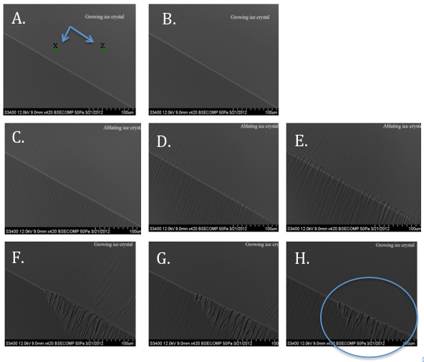
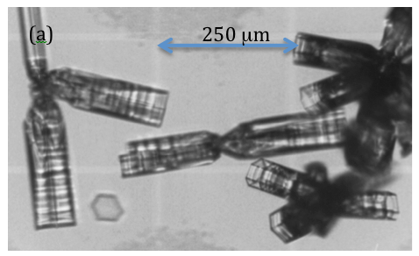
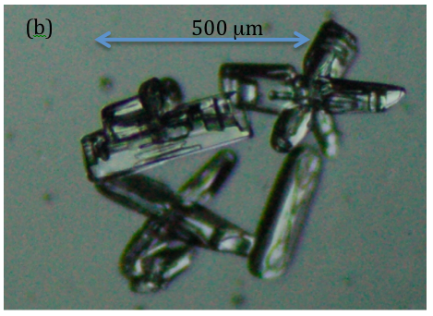
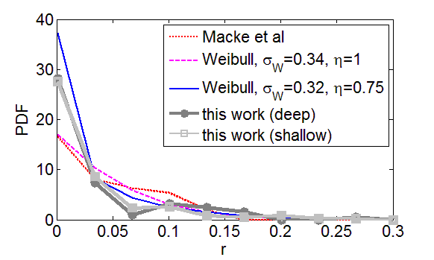
Quantitative characterization of rough prismatic facets of ice by scanning electron microscopy
Steven Neshyba^{1*}, Mitch Benning¹, Becca Lowen¹, Penny Rowe², Martina Roeselova³, and Ivan Gladich³
¹Univ. of Puget Sound, Tacoma, WA, USA; ²Univ. of Idaho, Moscow, ID, USA; ³Inst. of Organic Chemistry and Biochemistry, Prague, CR
Introduction
It is widely recognized that ice crystal habit and size are important determiners of the radiative properties of atmospheric ice crystals¹⁻². However, the effect of mesoscopic roughness of atmospheric ice is only beginning to be understood. For example, whereas surface height variations typically used in cloud remote sensing applications are azimuthally isotropic in the facet plane³⁻⁴, this property has not been established by observation. Accurate representation of surface height is required to reproduce light scattering due to clouds, including halo effects.
3. Inferring surface height functions and roughness metrics from VPSEM
VPSEM images of deep-roughened prismatic facets resulting from ablation (σ<0) conditions
VPSEM image of shallow-roughened prismatic facets resulting from near-equilibrium (σ≈0) conditions
Atmospheric ice at ground level showing facet-specific, azimuthally anisotropic mesoscopic roughness⁵. (a) A bullet cluster of tapered hexagonal ice prisms photographed on 21 July 1992 at South Pole Station. (b) Aggregate and bullet clusters photographed on 25 February 2011 at Summit, Greenland.
Surface height function for deep roughening.
Surface height function for shallow roughening.
Available observations from the laboratory and field suggest that roughening is facet-specific, with some facets exhibiting distinct azimuthal anisotropy; moreover, the roughness responds differently to near-equilibrium (with supersaturation σ≈0) vs ablation (σ<0) conditions⁵⁻⁷. Recently, we have explored the use of variable pressure scanning electron microscopy (VPSEM) of substrate-grown hexagonal ice prisms to document these dependencies. Advantages of VPSEM include high resolution and the ability to finely tune vapor pressure and temperature within the SEM chamber, capabilities that permit examination of ice crystal response to multiple growth and ablation cycles. This poster addresses quantitative characterization of the morphology of mesoscopic roughness using VPSEM. This description centers on a surface-normal roughness parameter,
  r=1-cosϕ
where cosφ is the projection of the VPSEM view vector onto the surface normal. We explore two roughness regimes: shallow roughening that results from exposing ice to near-equilibrium conditions, and deep roughening that results from exposing ice to ablation conditions.
Roughness metric <r>= 0.05.
Roughness metric <r>= 0.04.
The mean roughness metric, <r>, plotted as a function of
left: the characteristic angle, δ_{c}, of a surface whose height varies sinusoidally;
middle: the maximum tilt angle, t_{M}=θ_{max}/90°, of the uniform, random-tilt surface height distribution of Macke et al¹; and
right: the scale and shape parameters, σ_{W} and η_{W}, of the skewed, random-tilt surface height distribution of Weibull^{3,4}.
Weibull and Macke distribution functions with mean roughness parameters equivalent to deep roughening; also shown are observed distribution functions for shallow and deep roughening.
Summary of metrics for deep and shallow roughening cases. Metrics for deep and shallow roughening differ primarily in the characteristic spatial wavelength, λ, and depth, σ_{y}.
4. Conclusions
Despite significantly different depths and spatial wavelengths, the deep and shallow roughening cases documented here have remarkably similar mean roughness (<r>=0.04-0.05), probability distributions, and sinusoid-equivalent characteristic angles (22°-25°).
The distribution of roughness suggests overall Weibull shape parameters that compare favorably with observations of natural ice crystals at South Pole, including significant skew (η_{W}<1)⁴. This degree of roughening can be expected to cause a 6-7% reduction in the shortwave asymmetry parameter of hexagonal columns, and a 20% increase in the shortwave reflectivity of cirrus clouds of typical thickness.
In contrast to predictions based on Weibull and other random-tilt representations of surface roughness, the strikingly anisotropic roughening documented here would likely retain shortwave halos.
5. Future work
It is not understood why prismatic surfaces exhibit the strongly anisotropic, annular roughening pattern seen here, in contrast to roughening on basal and pyramidal facets. Exploratory theoretical work, using a Burton-Cabrera-Frank formalism for the quasi-liquid layer, is under way.
2. Experiment
Micrographs were taken using a Hitachi S-3400N variable pressure scanning electron microscope (VPSEM) equipped with a backscattered electron detector, accelerating voltage of 12 kV and a probe current of 90, in which a rough-cut copper specimen stub was mounted on an examination stage atop a Deben Ultra-Cool stage MK3 version Peltier cooling element. An aluminum reservoir containing 4mL of de-ionized ice initially at -15°C was placed in the VPSEM chamber, and the chamber was closed and pumped down to a nominal operating pressure of 50 Pa. Upon reaching that pressure, the Peltier cooling system was set to -45°C, and monitored for ice growth.
6. References
Macke et al (1996), J. Atmos. Sci. 53, 2813–2825.
Yang and Liou (1998), Beitrage zur Physik, 71, 223–248.
Yang et al (1998), Geos. Rem. Sens., 46, 1940–1947.
Shcherbakov et al (2006), J. Atmos. Sci. , 63, 1513–1525.
Walden, personal communication.
Pfalzgraff et al (2010), Atmos. Chem. Phys, 10, 2927–2935.
Walden et al (2003), J. Appl. Met., 42, 1391–1405 .

