Slide 1
243nd ACS National Meeting
Division of Geochemistry
San Diego, CA, USA, 25-29 March 2012
Arrhenius Analysis of Anisotropic Surface Self-Diffusion on the Prismatic Facet of Ice.
Institute of Organic Chemistry and Biochemistry,
Academy of Science of Czech Republic.
University of Puget Sound,
WA, USA.
Ivan Gladich, William Pfalzgraff, Ondrej Marsalek, Pavel Jungwirth,
Martina Roeselova, Steven Neshyba

Slide 2
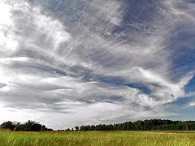
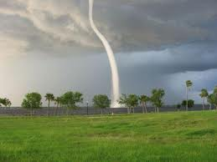
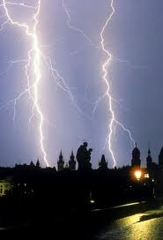
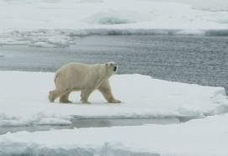
INTRODUCTION
Why ice? Because air-ice surface is a relevant atmospheric interface….
Notes:
Due to…
Parallel displaced…

Slide 3
INTRODUCTION
Light-scattering properties of cirrus clouds influence the Earth’s radiative bugdet.
The optical properties of cirrus clouds are related to the surface mesoscopic (micrometer-scale) structure of the ice crystals that comprise those clouds.
The ice-crystal surface morphology is not static with time: an ice crystal can grow, and eventually fall and ablate in underlying warm air.
Notes:
Cirrus clouds can cover a large portion of the Earth atmosphere.
They live above 5000m and they are formed of ice crystals.

Slide 4
INTRODUCTION
Scanning Electron Microscopy (SEM) on ice crystals show:
Growing and ablating of ice crystals appears to occur in a distinctively facet-specific way.
2) Prismatic facets exhibit anisotropy growing and ablating by trans-prismatic strands[1].
Growing
Ablation
[1] Pfalzgraff W. C. et al., Atmos. Chem. Phys., 10, 2927-2935, (2010).
Notes:
Variable Pressure Scanning Electron Microscope (VP-SEM) works at ~100 Pa << normal atmospheric condition in cirrus clouds(~200 hPa) <<atm pressure at the ground (1000 hPa)=> the implication on real clouds must be carefully evaluated.
-45 C taken every 30 s in the growing process.
30 s interval also for the ablation process.
The scal of the pictures ~ 50 micro-meter.

Slide 5
INTRODUCTION
The presence of trans-prismatic strands affects the optical properties of ice crystals.
Theoretical/computational works provide insights into trans-prismatic strands formation.
1) Surface diffusivity is a key factor that governs ice crystal surface morphology[1].
2) Surface diffusivity on primary prismatic ice facet is anisotropic[2].
[1] Bales G. S. et al., Phys. Rev. Lett., (1990).
[2] Pfalzgraff W. C. et al., J. Phys. Chem. A, (2011).
Notes:
Basal Plane = 0001
Primary prismatic = 10-10
Secondary prismatic = 11-20
Bales=>empirical model to investigate sformation of step of crystal growth.Since the dimension, the model is empirical.

Slide 6
INTRODUCTION
However…
1) More systematic analysis of water diffusivity on ice surface.
2)Temperature effects? At temperature closer to the melting one, a quasi liquid layer (QLL) would be expected to mask the underlying crystal structure => still anisotropic diffusivity?
3) Molecular picture of water diffusivity on ice surface.
Using molecular dynamics (MD) we want to investigate:
1) How does prismatic surface diffusion anisotropy evolve with temperature?
2) How does the molecular mechanism of diffusion change with temperature? In the context of Arrhenius analysis, which is the activation energy barrier for the in-plane diffusion on the primary prismatic facet?
Using molecular dynamics (MD) we want to investigate:
1) At temperature closer to melting one, a quasi liquid layer (QLL) would be expected to hide the underlying crystal structure; how does prismatic surface diffusion anisotropy evolve with temperature?
2) In the context of Arrhenius analysis, which is the activation energy barrier for the in-plane diffusion on the primary prismatic facet?
Using molecular dynamics (MD) we want to investigate:
1) At temperature closer to melting one, a quasi liquid layer (QLL) would be expected to hide the underlying crystal structure; how does prismatic surface diffusion anisotropy evolve with temperature?
2) In the context of Arrhenius analysis, which is the activation energy barrier for the in-plane diffusion on the primary prismatic facet?
Using molecular dynamics (MD) we want to investigate:
1) At temperature closer to melting one, a quasi liquid layer (QLL) would be expected to hide the underlying crystal structure; how does prismatic surface diffusion anisotropy evolve with temperature?
2) In the context of Arrhenius analysis, which is the activation energy barrier for the in-plane diffusion on the primary prismatic facet?
Notes:
Cirrus clouds can cover a large portion of the Earth atmosphere.

Slide 7
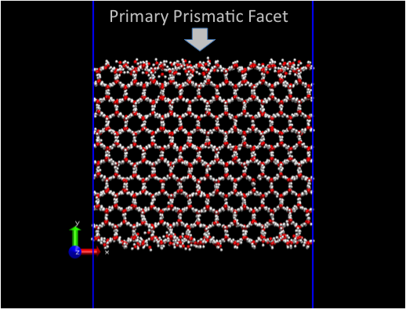
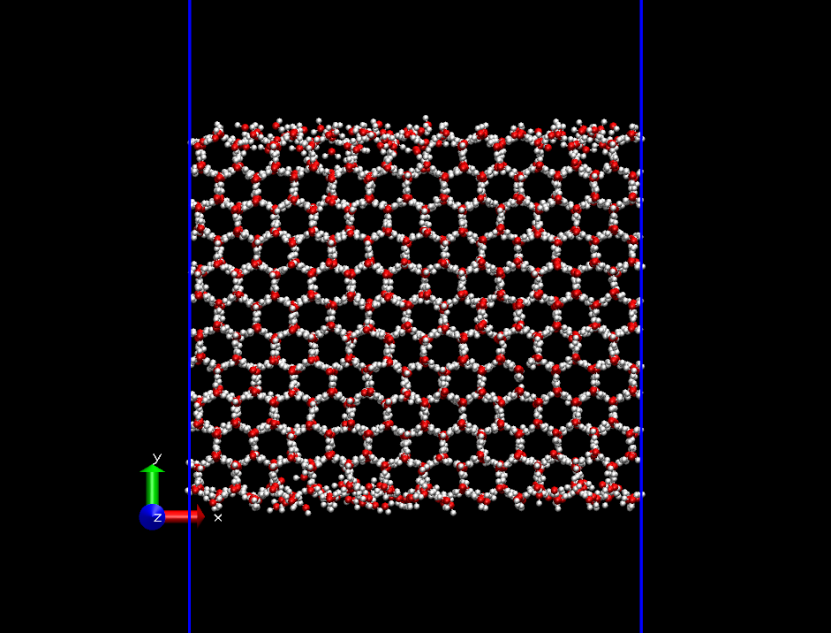
METHODOLOGY
MD simulations performed using the six site (NE6) water model (Tm=289K).
Ice crystal of 2880 water molecules (5.4nm X 4.7 nm X 3.7 nm in x, y, z directions).
12 bi-layers perpendicular to the primary prismatic facet.
The initial ice crystals were annealed from 0K to the desire temperature (230, 240, 250, 260, 270, 287 K) in 1.5 ns using zero-pressure barostate.
Two primary prismatic facet/vacuum interfaces were created enlarging the y-dimension of the box to 12 nm.
Production run of 100 ns, constant volume simulation (NVT) with dt=2 fs. First 4 ns of each trajectory were excluded to allow formation of ice-QLL.
Notes:
We want to achive that using…
Roughly speaking, we would like to put our PAH on the top of ice surface…
We are working at lower temperature => we need an appropriate force-field (i,.e set of parameters)
it is important to reproduce the correct solvent-solute ….
There is a double aspect to take on mind…

Slide 8
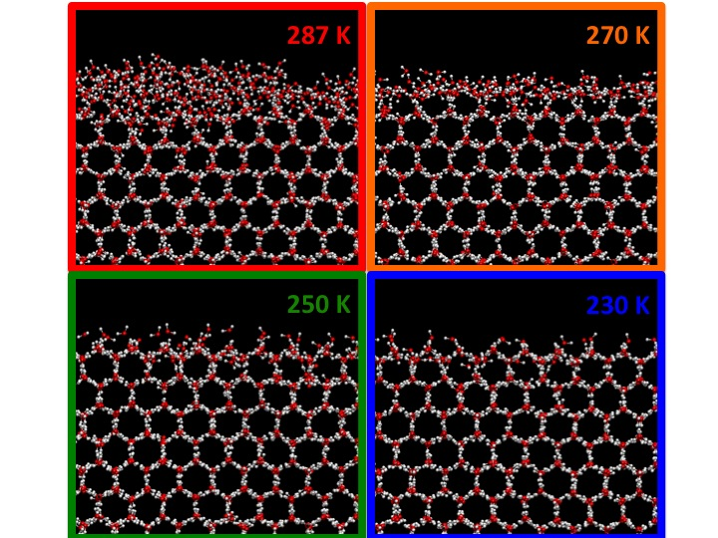
RESULTS
At the vacuum/ice interface, a liquid like layer (called QLL) is present on the top of the ice crystal.
The thickness of the QLL
increases with the temperature.
For each water molecule we have to define an order parameter to determine if it belongs to the liquid or solid phase
We use a four nearest-neighbour oxygen parameter.
Notes:
In order to study the water surface diffusivity, we have to determine what belongs to the liquid phase (=> mobile) and what belong to solid phase (immobile)

Slide 9
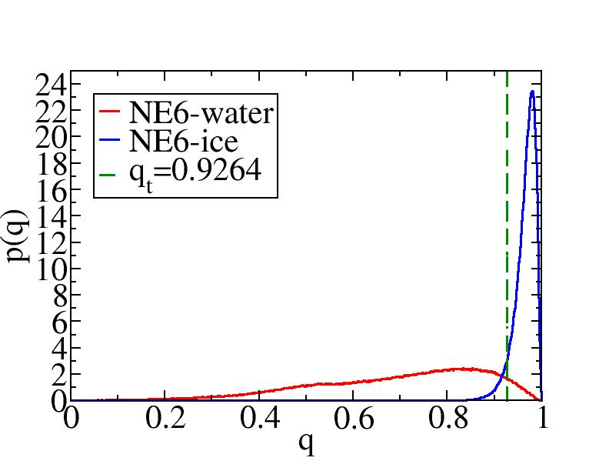
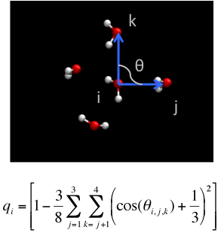
RESULTS
q_{t}
Using the probability densities for bulk ice and bulk liquid water we can define q_{t} such that:
q>q_{t} => Ice like water molecule;
q<q_{t} => Liquid like water molecule.
[1]Errigton J. R. and Debenedetti P. G., Nature, 409, 318-312 (2001).
Notes:
qt such that the probability of incorrectly assign a liquid-like molecule as ice-like=probability of assign an ice-like molecule to liquid like.
Definition of Conde and Vega J.Chem. Phys. 2008.
Definition of Errington J. R. and Debenedetti P. G., Nature, 2001
This order parameters takes one for tethraedral arrangment; smaller than one in bulk water

Slide 10
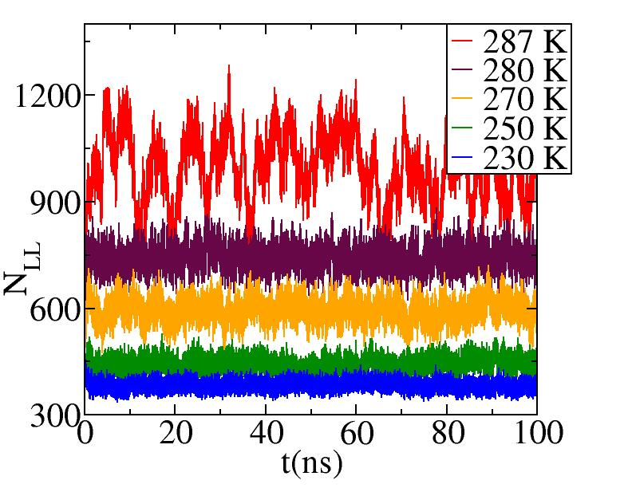
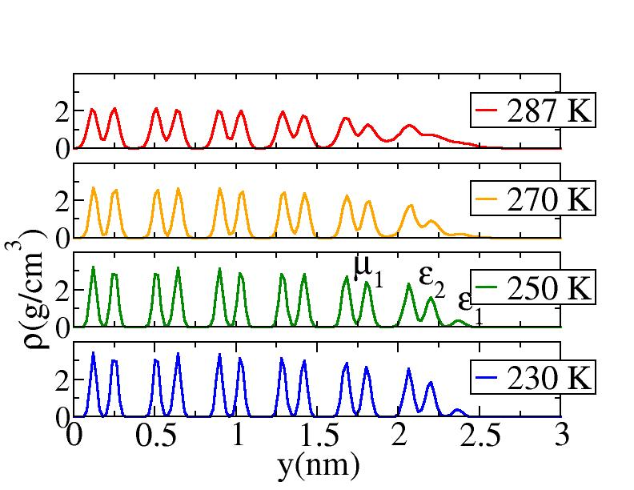
RESULTS
With increasing temperature, water molecules from the inner bi-layers start to contribute to the formation of the ice-QLL.
Upon increasing the temperature, more interfacial water molecules become mobile and contribute to the diffusion in the QLL.

Slide 11
RESULTS
Diffusivity calculated from the slope of the one-dimensional mean square displacement as a function of time.
Sublimating water molecules (N_{EV}) were excluded from the calculation of MSD.
The immobile water molecules in the ice crystal do not contribute to the diffusion coefficient: we scaled the diffusivity by the effective number of mobile water molecules
Notes:
Review definition…

Slide 12
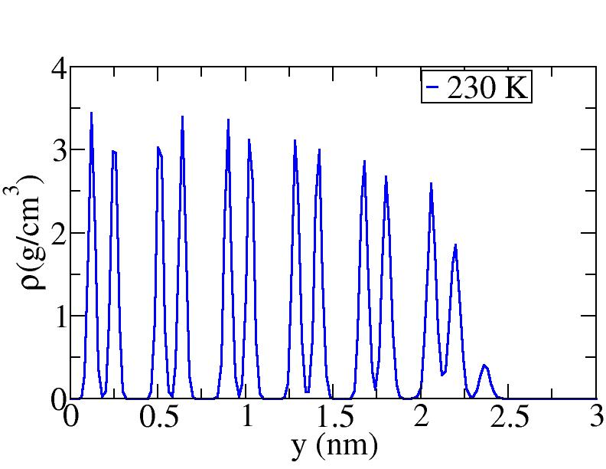
230 K
RESULTS
ε₁
y(nm)
ε₂
μ₁
Trajectory of one particular water molecule at 230 K in x, y, z directions.
Lateral diffusion in x-z plane associated with vertical y-transition from ε₂ to ε₁ (and vice versa) sub-layers.
Surface water molecules move on an underlying crystal structure.
x(nm)
ε₂
z(nm)
ε₁
t(ns)

Slide 13
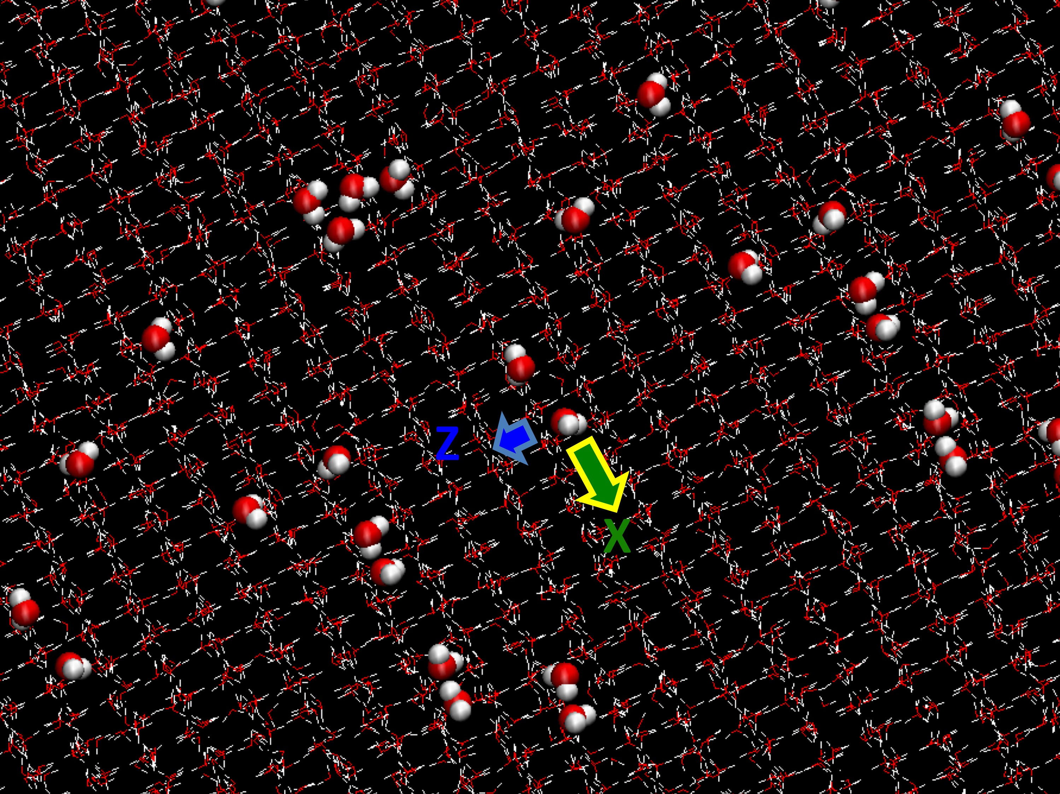
230 K
RESULTS
ε₁
y(nm)
ε₂
μ₁
x(nm)
z(nm)
t(ns)

Slide 14
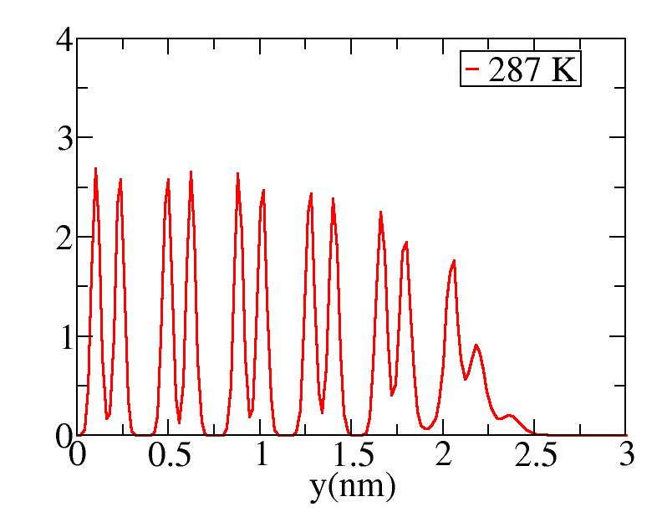
287 K
RESULTS
ε₁
y(nm)
ε₂
μ₁
Trajectory of one particular water molecule at 287 K in x, y, z directions: ε₂ and ε₁ are merged in one layer. Molecules from μ₁ also contribute to the in-plane diffusion.
Surface water molecules move on a thick ice-QLL.
μ₁
ε₂
ε₁

Slide 15
287 K
RESULTS
ε₁
y(nm)
ε₂
μ₁
x(nm)
z(nm)
t(ns)

Slide 16
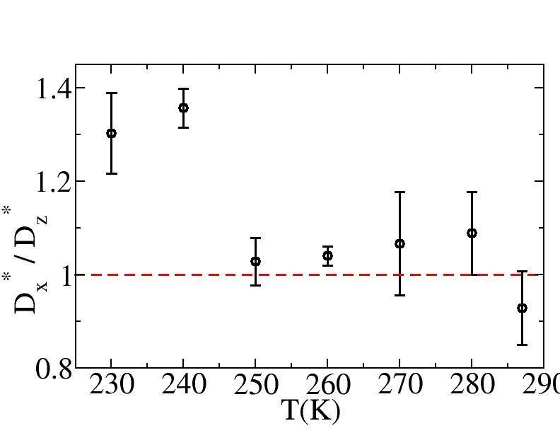
RESULTS
At lower temperature, horizontal diffusivity is associated with vertical exchange of molecules between ε₁ and ε₂ bi-layers. This contribution is generally different in the x or z directions because water molecules move on the underling primary prismatic crystalline structure (facet-proximate mechanism)
Anisotropy of diffusivity (D*x/D*z≠1).
At higher temperature the outer part of the QLL is farther from the underlying crystalline structure (facet-distant mechanism) => quasi 3-D diffusion, isotropic diffusivity (Dx* /D*z ~1).

Slide 17
RESULTS
The bulk liquid water diffusivity in supercooled regime has a negative slope of the Arrhenius plot suggesting an activation energy that decreases with the temperature.
The water diffusivity in the QLL agrees with available experimental data within the quoted precision.
Positive curvature of the Arrhenius plot of surface diffusivity on ice suggests an activation energy that increases with the temperature.
[1] Nasello et al., Scr. Mater, 2007, 56, 1071-1073. (Ice Surface-Experimental)
[2] Carignano et al., Mol. Phys., 2005, 103, 2957-2967. (Bulk Water-Computational)
[2] Price et al., J. Phys. Chem. A, 1999, 103, 448-450. (Bulk Water-Experimental)
Notes:
The Arrhenius plot display the ln of D vs. the 1/T gives you the RATE CONSTANT

Slide 18
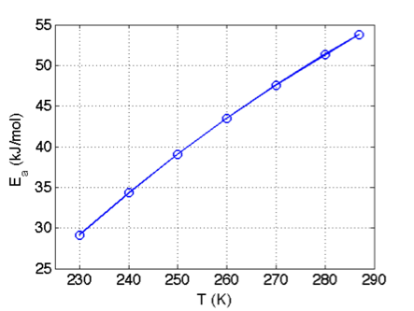
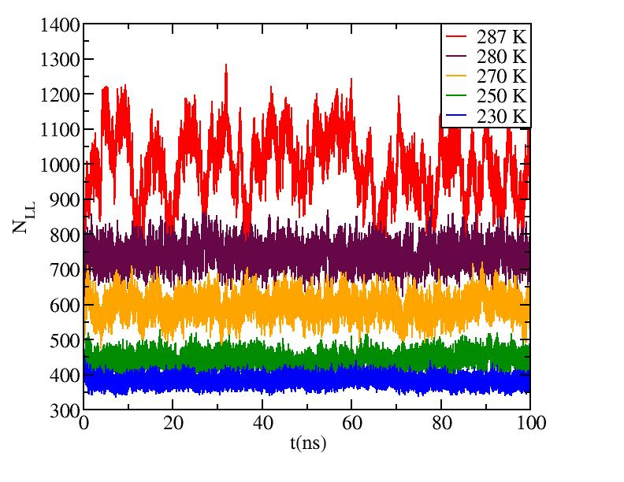
RESULTS
ε₂
μ₁
ε₂
ε₁
ε₁
Low T => smaller activation energy
High T (closer to melting)=> vertical motion takes a molecule from a more hydrated environment (μ₁) closer to the surface where fewer hydrogen bonding partners are available=> higher activation energy.
Using the probability densities for bulk ice and bulk liquid water we can define q_{t} such that:
q>q_{t} => Ice like water molecule;
q<q_{t} => Liquid like water molecule.
Notes:
In the QLL, the facet-proximate diffusion (low T) may be expected to have an smaller activation energy than the facet-distant diffusion (high T) because the vertical motion takes a molecule from a more hydrated environment closer to the surface where fewer hydrogen bonding partners are available.

Slide 19
CONCLUSIONS
Conclusions:
The self-diffusion on ice surface occurs by significantly different mechanism compared to bulk self-diffusion in supercooled water.
At low temperature, the water molecules are exposed to the anisotropic underlying crystalline terrain leading to anisotropic in-plane diffusion.
At temperatures close to the melting, thick QLL leads to quasi 3-D liquid-like diffusivity.
The Arrhenius analysis shows an activation energy for in-plane diffusion in the QLL increasing with the temperature as a result of a thicker QLL where molecules move vertical from more to less hydrogen bonding environment.
Notes:
A covalent bond is a form of chemical bonding that is characterized by the sharing of pairs electrons between atoms. The stable balance of attractive and repulsive forces between atoms when they share electrons is known as covalent bond.
A noncovalent bond is a type of that does not involve the sharing of pair electron but rather involves more dispersed variotions of elctromagnetic interactions

Slide 20
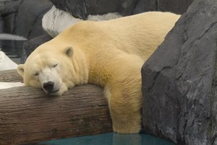
ACKNOWLEDGEMENTS
Acknowledgements:
Czech Science Foundation (P208/10/1724)
The Czech Ministry of Education, Youth and Sport (LC512, and ME09064)
NSF(CHEM-0909227)
Thank you
for you attention.

