Slide 1
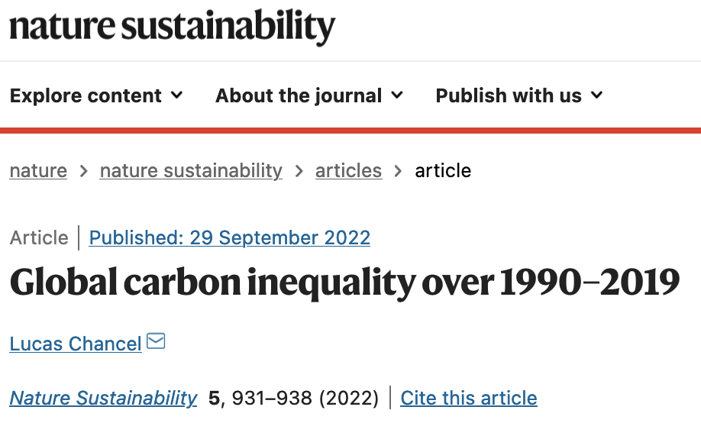
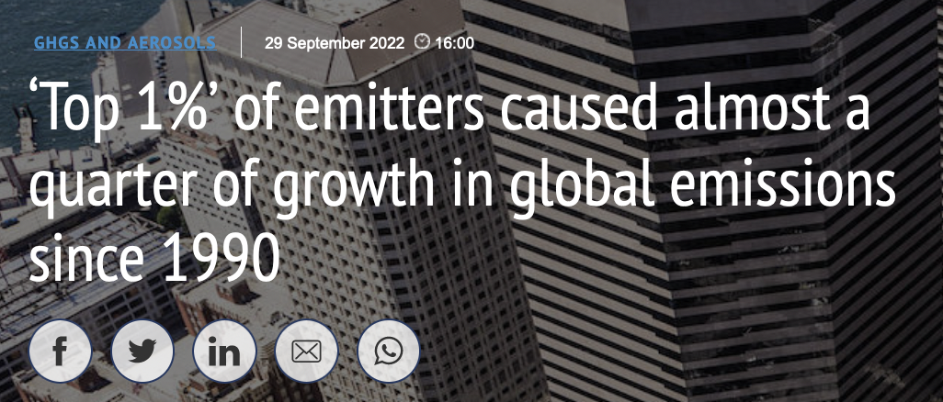
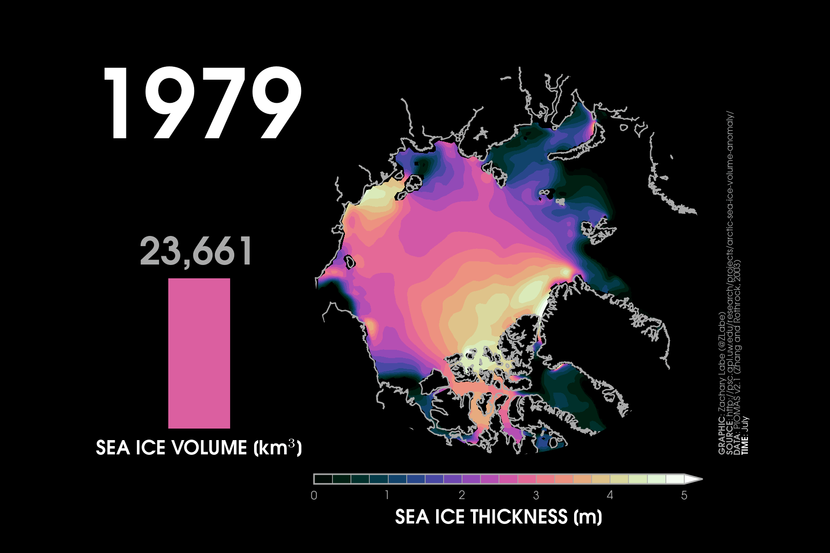
https://www.nature.com/articles/s41893-022-00955-z
https://www.carbonbrief.org/top-1-of-emitters-caused-almost-a-quarter-of-global-emissions-since-1990/
https://flightfree.org/flight-emissions-calculator
https://www.carbon.place/
Carbon Acknowledgement (drafted w/Climate Alliance of the South Sound)
“We deeply regret the extreme hardships that coming generations of people and non-humans will endure as a result of the present-day damage being inflicted on the global climate system. We recognize that this damage is a known consequence of the pervasive exercise of wealth-enabled carbon privilege. We also commit to exercising our individual agency and our collective power now, to build the best possible future and avert the worst consequences of climate damage.”
https://zacklabe.files.wordpress.com/2023/08/sit_piomas_jul23.gif
https://www.nature.com/articles/s41467-023-38511-8
http://www.climatecodered.org/2023/06/dramatic-arctic-sea-ice-news-should-not.html
https://www.facebook.com/profile.php?id=100094500456474
https://heated.world/p/what-you-wont-hear-at-indias-g20?utm_source=post-email-title&publication_id=2473&post_id=136796445&isFreemail=true&r=4hszr&utm_medium=email

